Slide 1
Year 6 Curriculum Afternoon
“Live, Love and Learn like Jesus”

Slide 2
Welcome back
The children have settled brilliantly and are enjoying the new challenges in year 6.
Mrs Wood and Mrs Minty

Slide 3
Our Teaching Philosophy
Making mistakes is essential!
All can achieve
“We like a challenge!”

Slide 4
What to expect in Year 6?
Further develop independence, organisation and personal responsibility
Growing as learners
Rights and responsibilities – Prefects and house captains
PGL – Meeting for parents and children on Tuesday 3rd October at 3:30pm
The structure of our year.

Slide 5
Healthy and Happy Children
Learning partners
Lollipop sticks
I can’t do it…yet
Engage, explore, challenge
Agree, build, challenge

Slide 6
Home Learning
There will be learning challenges set each week which will change as the terms go on.
The aim is for Home Learning to be purposeful, manageable and interesting!
Spelling tests will be sent home, so that you can see how your child is getting on each week.

Slide 7
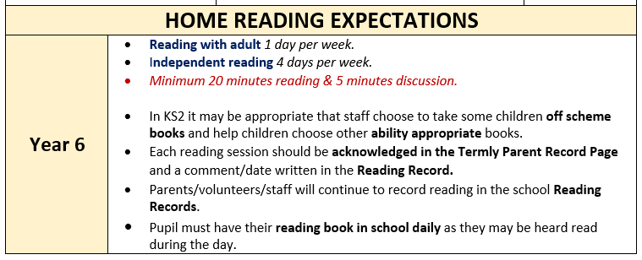
Reading

Slide 8
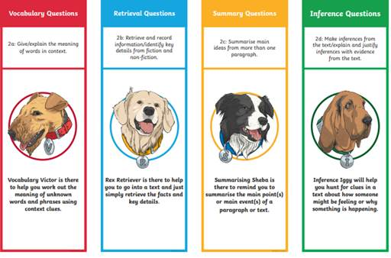

Slide 9
How can you help with Home Learning?
Encourage independence; set timers for independent work
No more than 20-30 minutes. If your child is struggling, write a short note
Reading widely; discussion about texts; expressing opinions; give reasons; monitoring of content
Active learning of spellings
Active learning of times tables – Professor Assessor

Slide 10
WRITING
“Read as a writer and write as a reader”
Regular extended writing opportunities across a range of subjects
Grammar, Punctuation and Spelling (SPaG)
Learning ladders
Aiming towards ‘Working at the Expected Standard of KS2’ means regularly showing a wide range of writing skills

Slide 11
MATHS
Mastering written methods of calculation
Instant recall of times tables facts – this is crucial to enable accessing of Y6 curriculum
Focus on ‘Mastery’ of skills – depth of understanding through:
Fluency – accuracy, speed, efficiency of methods
Reasoning – talking about concept, recognising misconceptions, true/false
Solving - solving word problems, open ended investigations

Slide 12
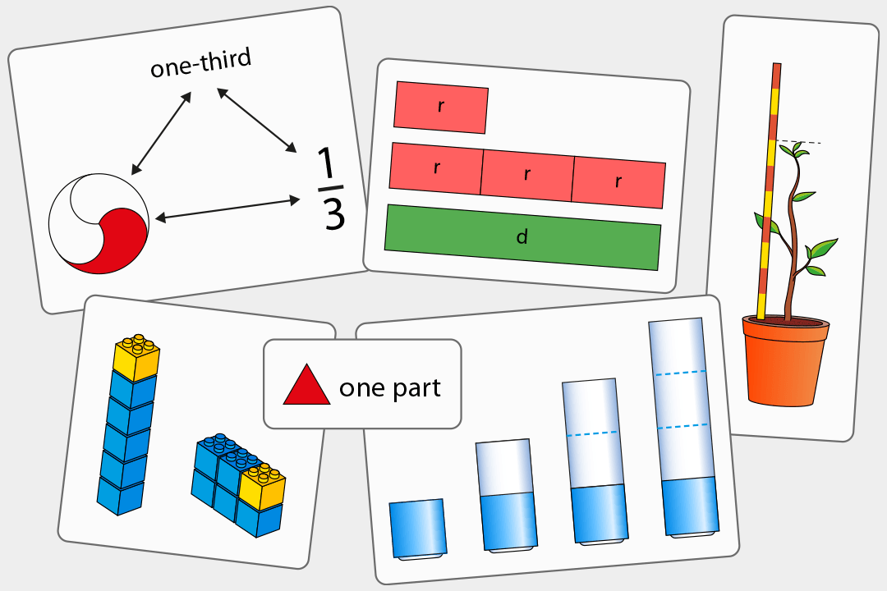
Saint Patrick’s School are in the fourth year of a ‘Teaching for Mastery’ Programme.
This is a 4 year programme developed by NCETM specialists and is guided by the following principles:
Coherence
Lessons are broken down into small connected steps that gradually unfold the concept, providing access for all children and leading to a generalisation of the concept and the ability to apply the concept to a range of contexts.
Representation and Structure
Representations used in lessons expose the mathematical structure being taught.

Slide 13
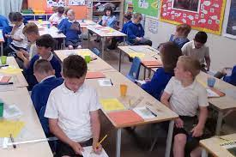
Mathematical Thinking
If taught ideas are to be understood deeply, they must not merely be passively received but must be worked on by the student: thought about, reasoned with and discussed with others.
Fluency
This is where you can help! Make sure your children are fluent with their number bonds and times tables. Children will be taught key facts in daily sessions which are in addition to the maths lessons.
Variation
Variation is twofold. It is firstly about how the teacher represents the concept being taught, often in more than one way, to draw attention to critical aspects, and to develop deep and holistic understanding. It is also about the sequencing of the episodes, activities and exercises used within a lesson and follow up practice, paying attention to what is kept the same and what changes, to connect the mathematics and draw attention to mathematical relationships and structure.

Slide 14
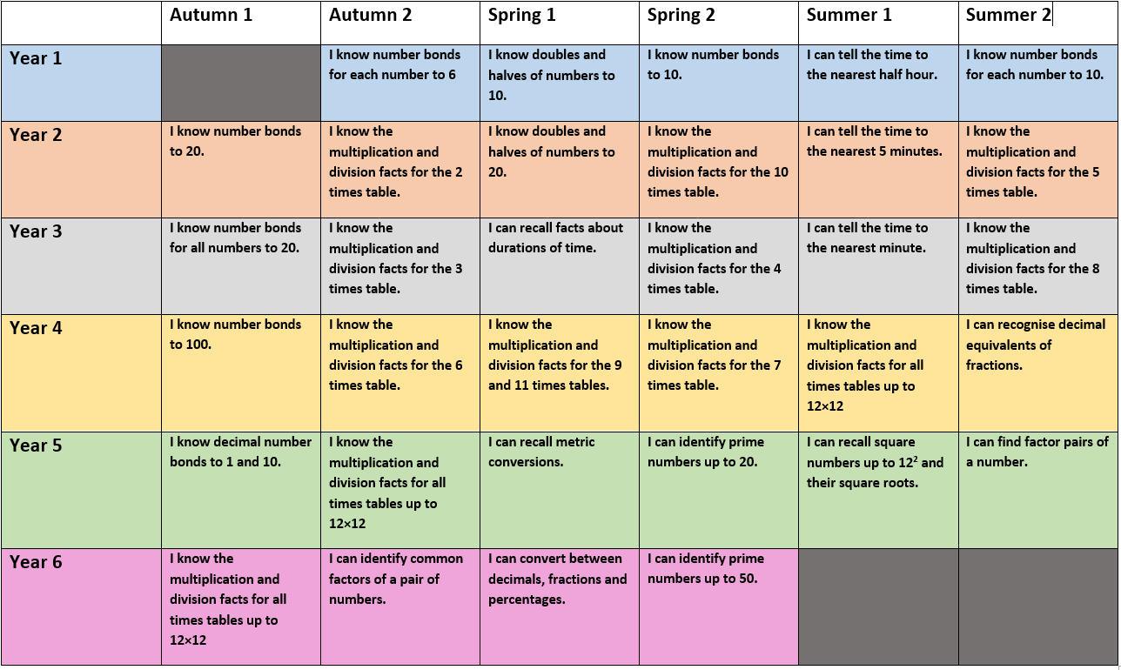

Slide 15
The ‘S’ word & Assessment
The SATs week is the week commencing Monday 13th May 2024.
Preparation began in Year 5 and will continue throughout Year 6!
The school will provide children with revision books later in the year
Boosting opportunities

Slide 16
Assessment and Recording
We use a variety of summative and formative assessments to ensure every
child makes progress along their personal learning journey.
Within the Stage that the pupils are working on we assess whether pupils are
Working Below Expectations, Working towards expectations, Meeting Expectations,
Exceeding Expectations
ATTAINMENT – It is not expected that pupils will be Meeting Expectations until summer term,
however, we will be able to report to you during the year whether or not your child is on track
To meet expectations.
PROGRESS – This looks at each individual’s starting points.

Slide 17
Secondary Schools
Which Secondary School? If you would like to find out what your local Secondary Schools are like, please contact them to see if it is possible to visit.
PLEASE DO NOT FORGET to apply to the Secondary school that you would like your child to attend!
Transition – I will be contacted by all of the Secondary Schools regarding transition details. Every effort is made to make sure that your child has a smooth transition into their chosen Secondary School.

Slide 18
Other information
Mobile Phones: If your child is walking home on their own and you wish for them to have a mobile phone, please fill in the mobile phone permission slip and return to the school office. Phones will be stored safely in the classroom at the start of each day and collected at the end of each day.
Communication: Please do not hesitate to contact Mrs Wood or Mrs Minty if you have any questions or concerns.

