Slide 1
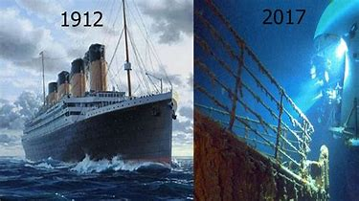
Titanic and how it sank
By Henry

Slide 2
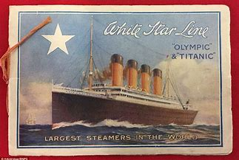
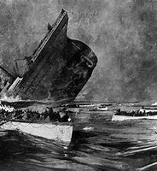
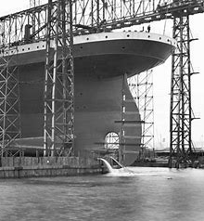
Titanic production started in 1909 and finished in 1912 three long years of hard work !!!
Wow I think that’s totally amazing!
Titanic was made of steel plate metal because it was light and super strong at the time.
The titanic was built to be the fastest cruise liner.
Titanic was built in Belfast in Northern island by manufacturer Harland and Wolff. The owners were the White Star Line Company.

Slide 3
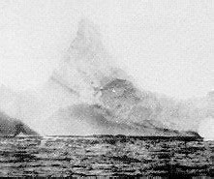
The Titanic hit an iceberg on the 15th of April 1912 on her maiden voyage. So much for the unsinkable!
It damaged the hull so the titanic took the plunge of doom.

Slide 4
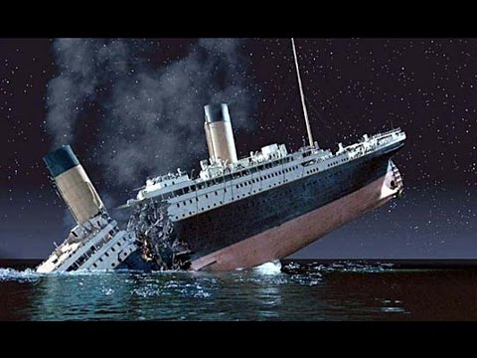
For a 1st class ticket on titanic at the time it cost around £30 which would be equivalent to £2,500 at todays money. That was tons and tons of money in those days. Well if I knew what was going to happen I would not pay half the money to ride !!!
Hey not cool
☹

Slide 5
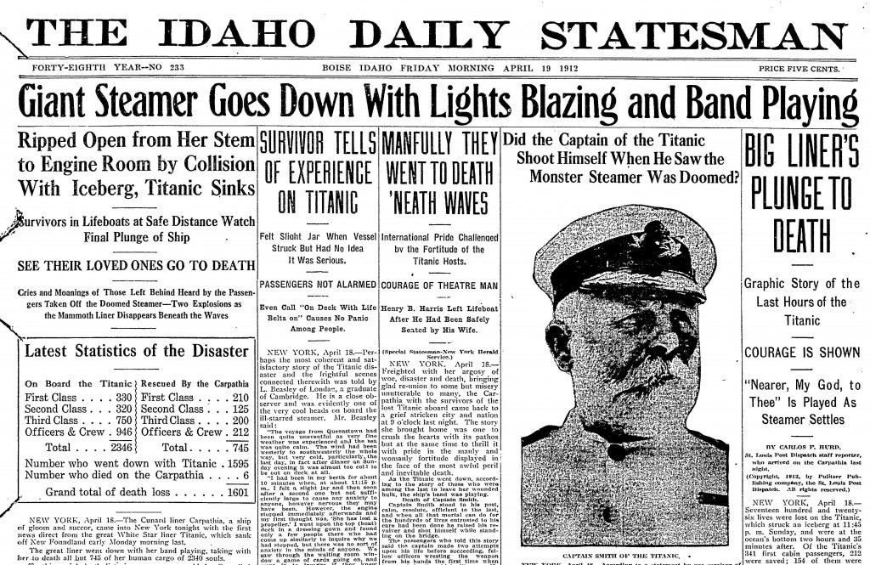
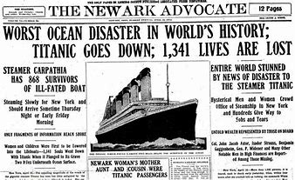
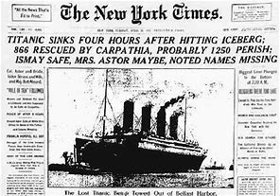
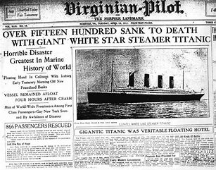
All the news at the time said;
Titanic tragedy kills thousands
- Titanic sinks into the deep
Titanic takes a dunk to the depths !!

Slide 6
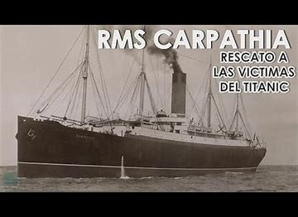
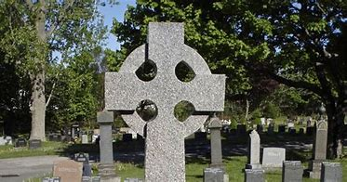
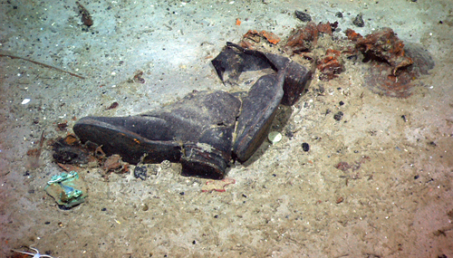
We will miss all people who died on the Titanic and thanks to the crew of the rescue ship Carpathia who were heroes.
A gory reminder of the death and destruction of the titanic tragedy.
1,500 people died on that fateful night.

Slide 7
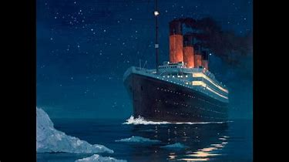
The end
Thank you for watching my Titanic PowerPoint
By the epic author Henry Samways.

