Slide 1
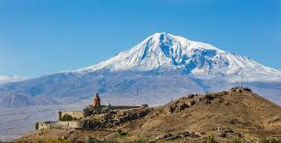
We three kings of orient are Bearing gifts we traverse afar Field and fountain Moor and mountain Following yonder star

Slide 2
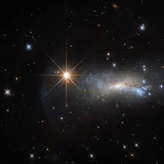
O star of wonder, star of night Star with royal beauty bright Westward leading, still proceeding Guide us to thy perfect light

Slide 3
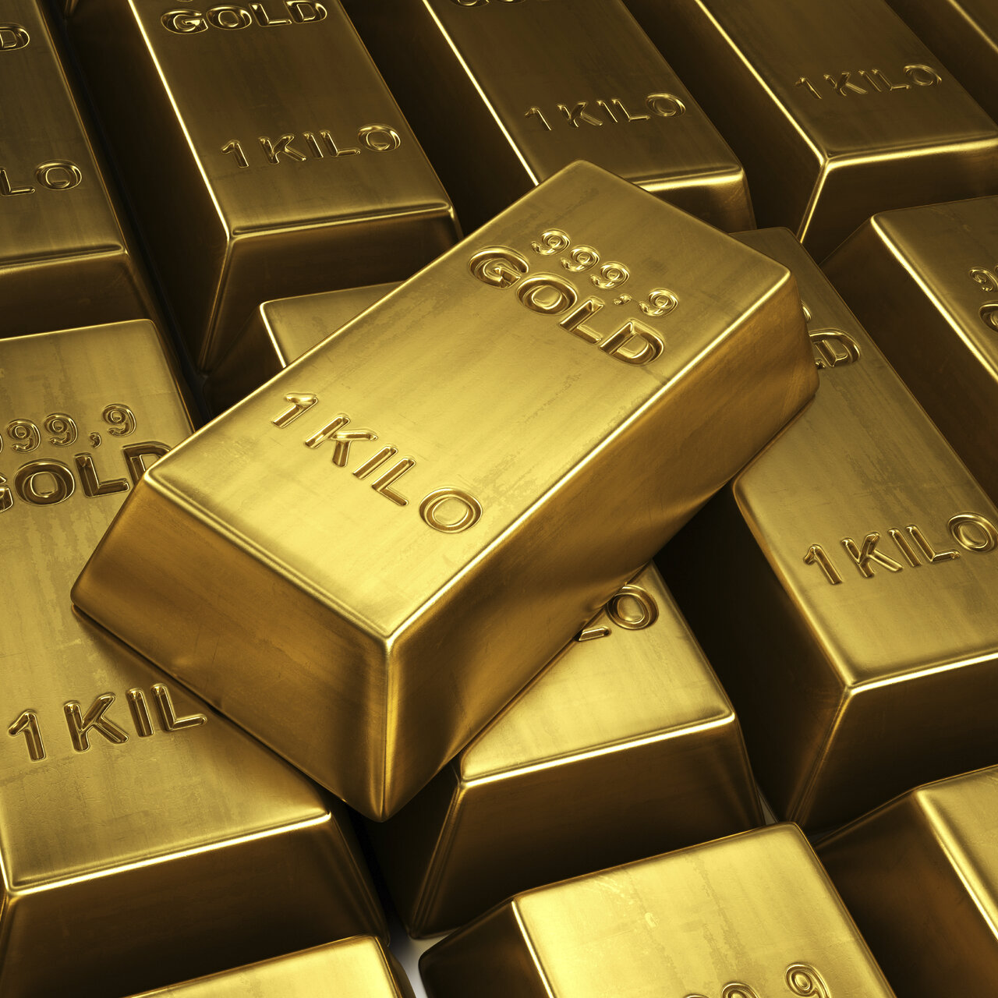
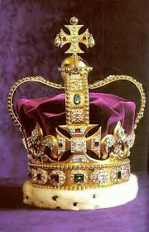
Born a King on Bethlehem's plain Gold I bring to crown Him again King for ever, ceasing never Over us all to reign

Slide 4
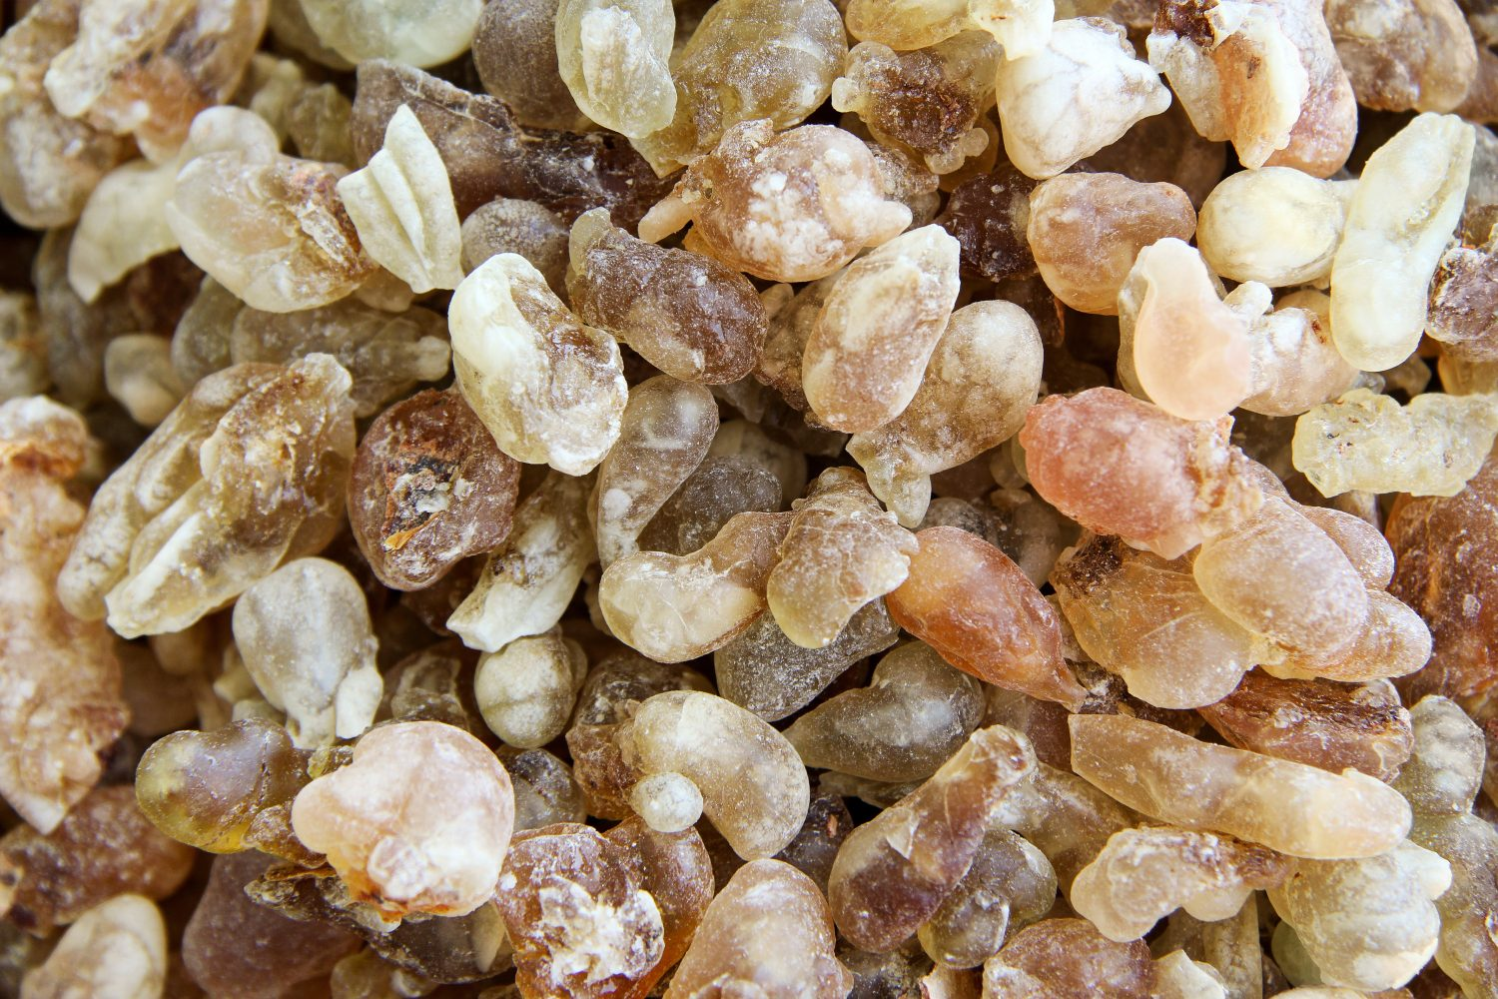
Frankincense to offer have I Incense owns a Deity nigh Prayer and praising All men raising Worship Him, God most high

Slide 5
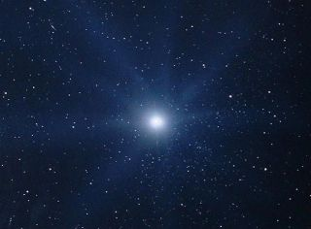
O star of wonder, star of night Star with royal beauty bright Westward leading, still proceeding Guide us to thy perfect light

Slide 6
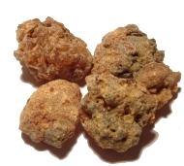
Myrrh is mine; its bitter perfume Breathes a life of gathering gloom Sorrowing, sighing, Bleeding, dying, Sealed in the stone-cold tomb.

Slide 7
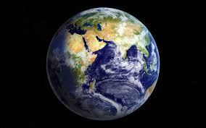
Glorious now behold Him arise, King, and God, and Sacrifice; Heav’n sings Hallelujah: Hallelujah the earth replies.

Slide 8
