Slide 1
The Coming of the Holy Spirit as told by John

Slide 2
Gospel of John, 20:19-23
Jesus Appears to His Disciples
¹⁹ On the evening of that first day of the week, when the disciples were together, with the doors locked for fear of the Jewish leaders, Jesus came and stood among them and said, “Peace be with you!” ²⁰ After he said this, he showed them his hands and side. The disciples were overjoyed when they saw the Lord.
²¹ Again Jesus said, “Peace be with you! As the Father has sent me, I am sending you.” ²² And with that he breathed on them and said, “Receive the Holy Spirit. ²³ If you forgive anyone’s sins, their sins are forgiven; if you do not forgive them, they are not forgiven.”

Slide 3
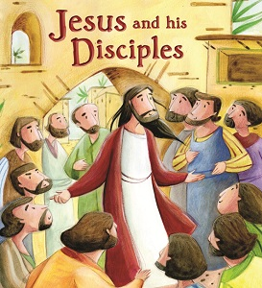
A promise made
Jesus made a promise to his disciples.
One day when Jesus was talking to his disciples he said to them, “If I go away I promise to send you a helper, a counsellor.

Slide 4
He told them, “when this helper comes it will be a Spirit of Truth and will guide you.”
The Disciples didn’t really understand what Jesus was saying but after he died they remember his promise.

Slide 5
A Promise Kept
After Jesus died the Disciples were really scared and gathered together to talk about what had happened. They shut the doors because they were afraid someone might come to arrest them too.

Slide 6
Suddenly Jesus came and stood among them.
Jesus said “Peace be with you.”
Why do you think he said this? How do you think the disciples felt?

Slide 7
He showed them his hands and his side.
The disciples were glad when they saw the Lord. Jesus said to them again, “Peace be with you.”
He then gave them an instruction: “As the Father has sent me, even so I send you.”

Slide 8
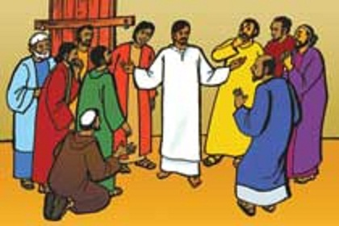
He then breathed on them, and said to them, “Receive the Holy Spirit. If you forgive the sins of any, they are forgiven;

Slide 9
What do you think is important in this story? What are the main points in the story? What was the promise? Who kept it? What did this mean to the disciples? How did they feel? What does this mean for Christians today?

Slide 10
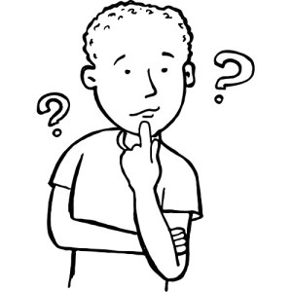
Thinking Deeper
Many artists have tried to imagine this story.
Think about the story as you look at these pictures. Try to think about why the artist has drawn them in this way

Slide 11
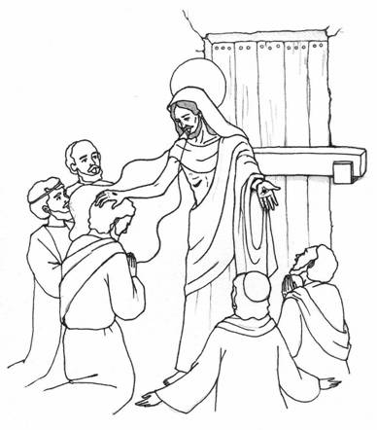
Which part of the story do you think this is? How do you know?
Why are the disciples shown kneeling?

Slide 12
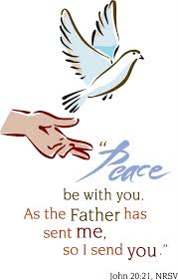
This is a quote from the story.
Why do think there is a dove here?

Slide 13
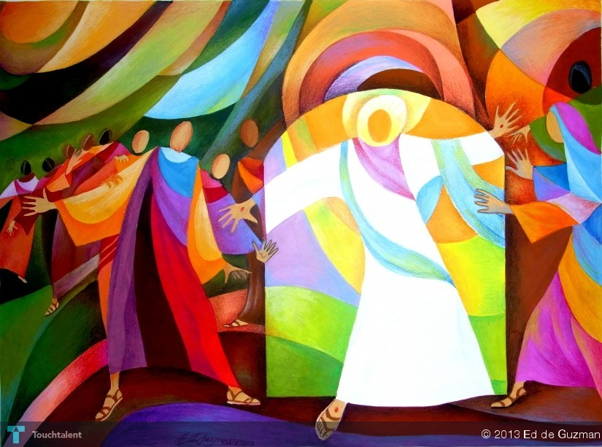
Which figure do you think Jesus is? Why?
What colours has the artist used? Why?
Can you tell how the disciples are feeling? How?

Slide 14
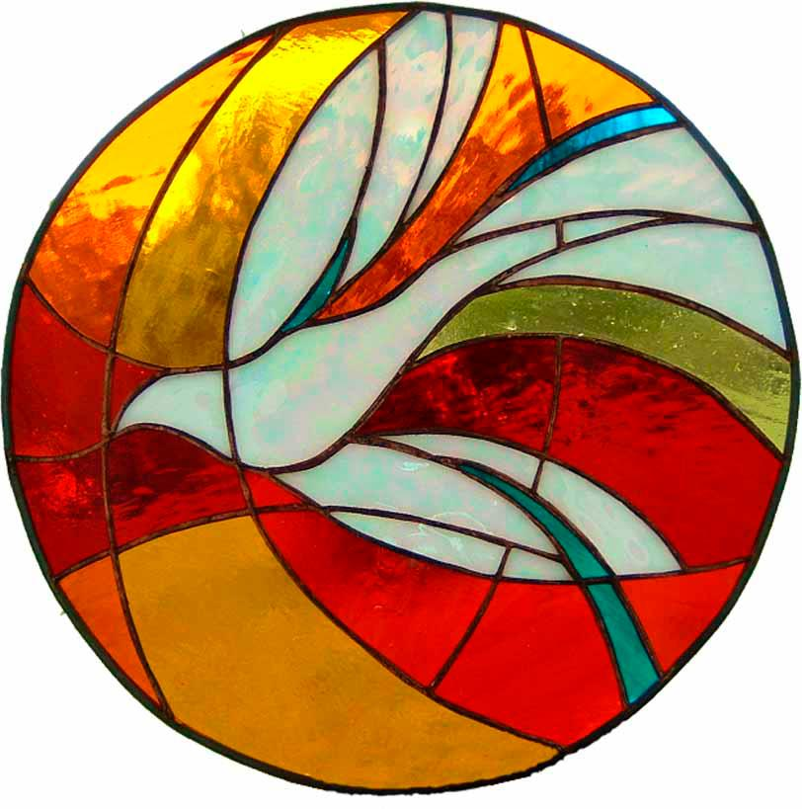
This is from a window in a church.
Why is there a dove?
What do you think the colours are trying to show?

Slide 15
What colours and symbols can you see?

Slide 18
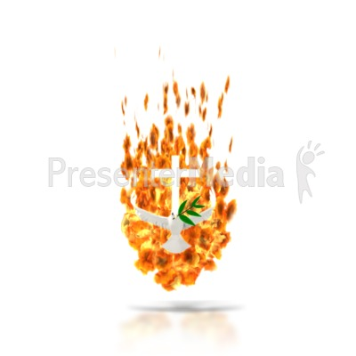
REFLECTION What does this promise mean to you today?
The Spirit came and your Church was born, in wind and fire and words of power. The Spirit came blowing fear aside, and in its place weak hearts were stronger. The Spirit came and is here today, to feed the hearts of a world that hungers.

Slide 19
For the Spirit of Peace
that calms our mind and stills our life, we give you thanks.
For the Spirit of Love
that touches hearts and reaches out, we give you thanks.
For the Spirit of Joy
that lifts our soul and gives us faith we give you thanks.
For the Spirit of Power,
that gift of grace for this your people, we give you thanks.

