Slide 1
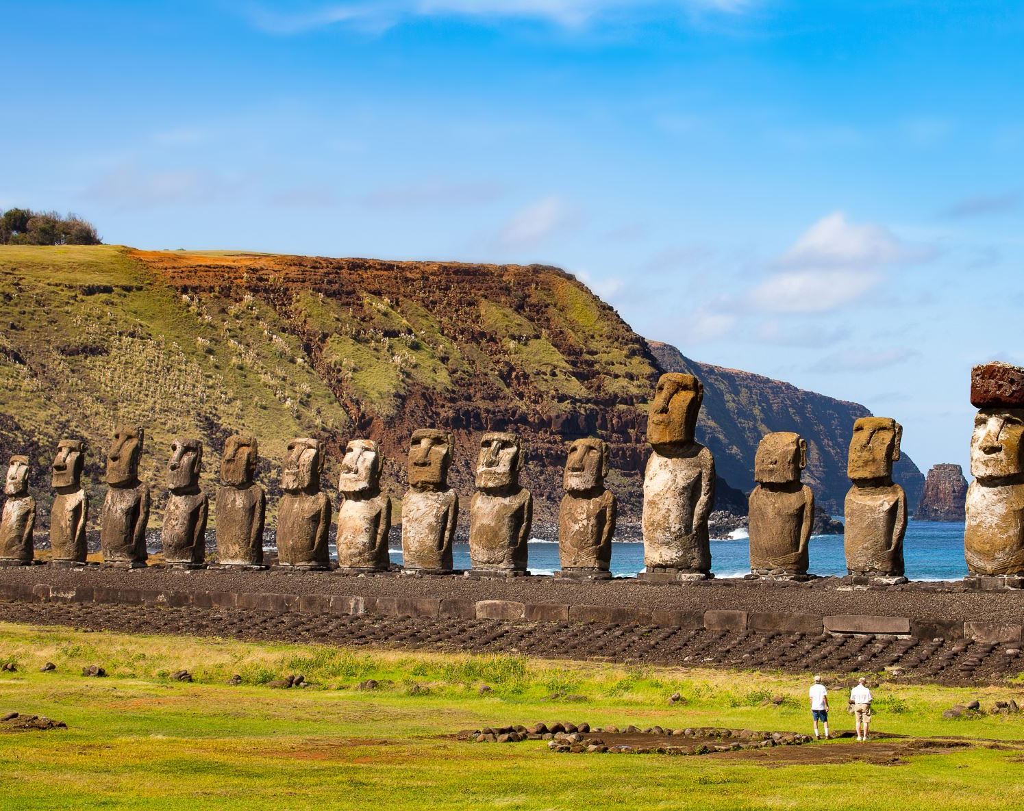
3 archaeological sites

Slide 2
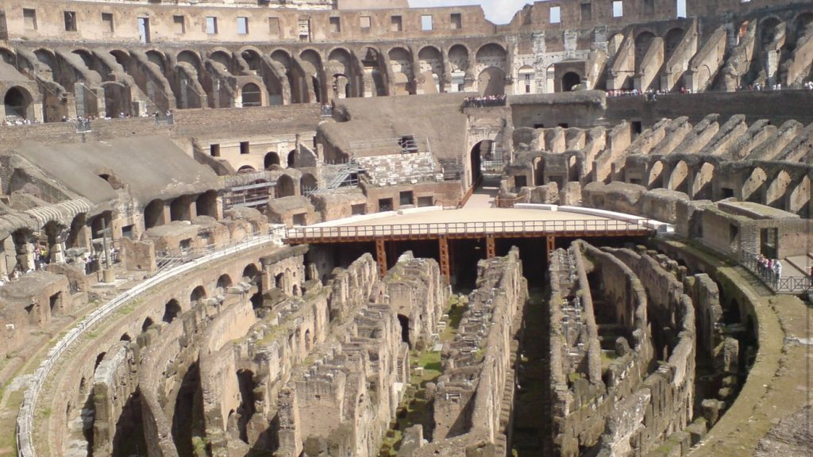
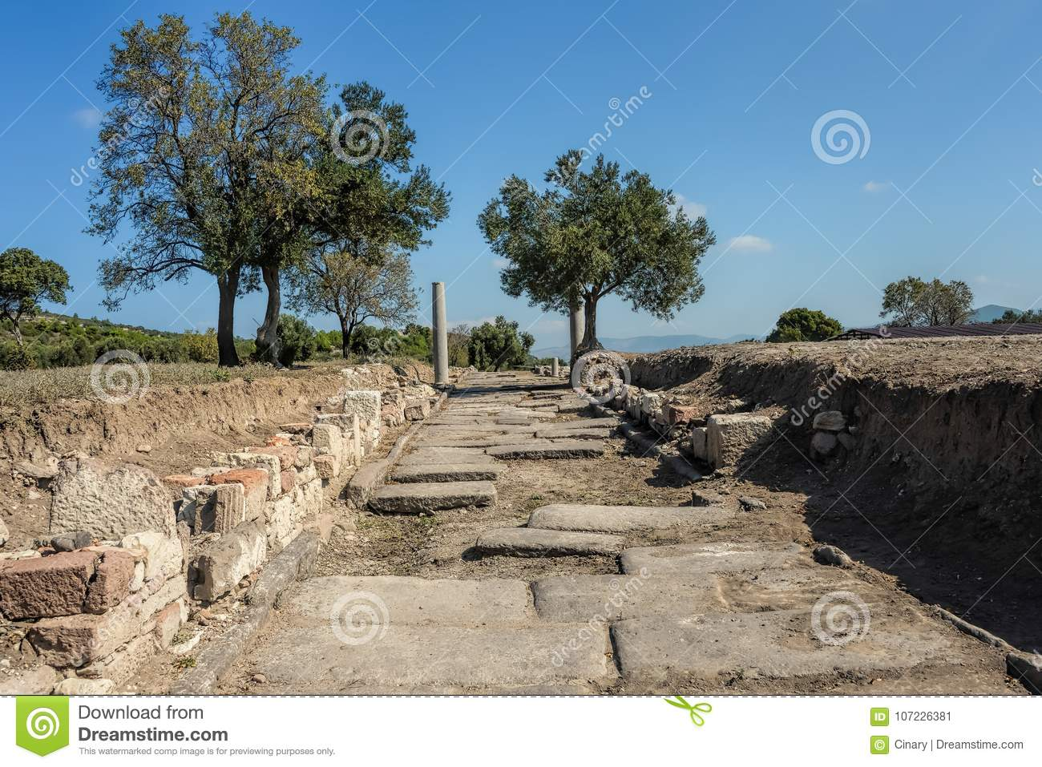
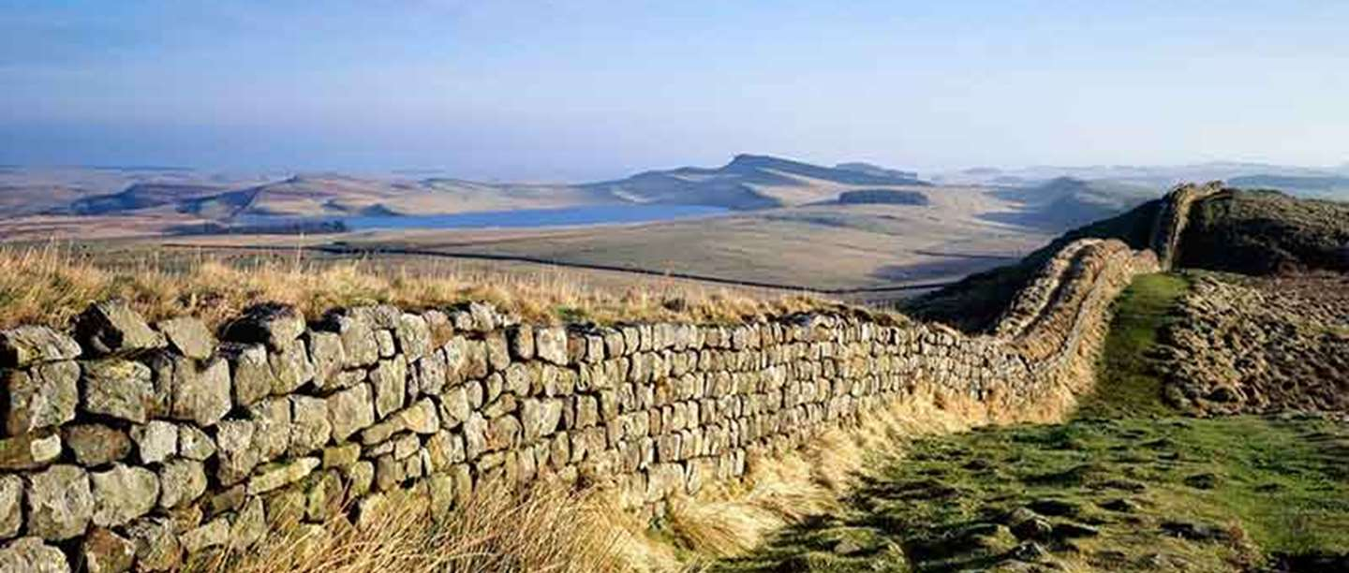
Via Appia Rome built in 312 bc it was a street from Rome to the south of Italy
Hadrian’s wall built by Romans AD122
Colosseum Rome made in AD80 and was used for fights!

Slide 3
Hadrian's wall was about 15 feet tall and was 84 miles long in England but extended to Africa!!!!!!!!!!
The appia way is about 62 Km long and is a roman road going from Rome to north Italy.
The Colosseum in Rome, Italy, is a large amphitheater that hosted events like gladiatorial games

Slide 4
Prehistoric Britain

Slide 5
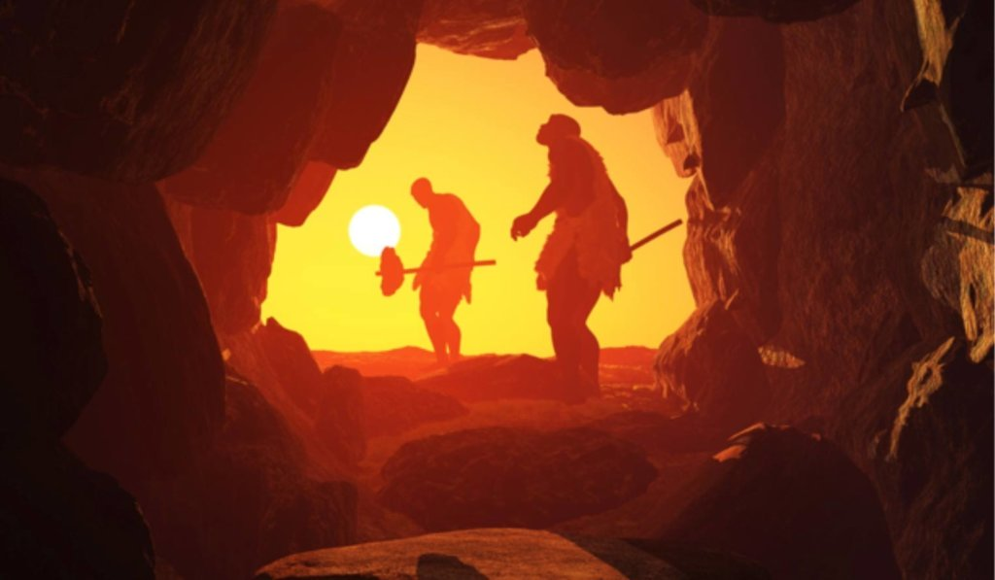
Stone age, from 2.6 million years ago until about 3000 BC.

Slide 6
Bronze age from 3000 BC to 1200 BC

Slide 7
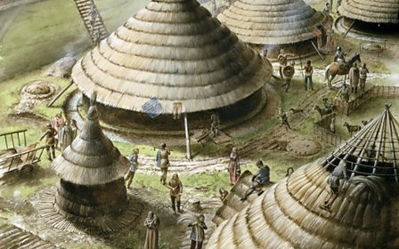
Iron age from 500 BC to 332 BC

Slide 8
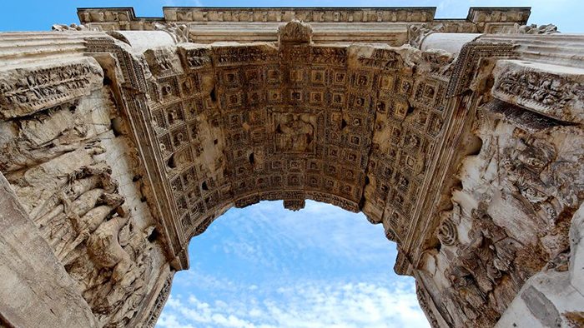
Thank you for looking at my presentation!!!!
I did this with out eany help just to say

