Slide 1
Autumn days

Slide 2
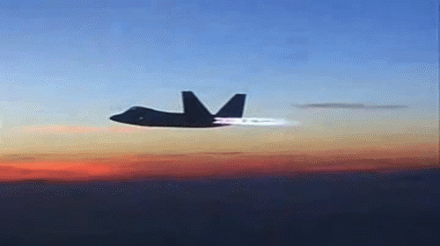
Autumn days, when the grass is jewelled
And the silk inside a chestnut shell
Jet planes meeting in the air to be refuelled
All these things I love so well

Slide 3

So I mustn’t forget
No, I mustn’t forget
To say a great big thank you
I mustn’t forget.

Slide 4
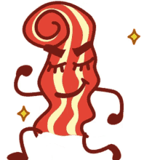
Clouds that look like familiar faces
And a winter’s moon with frosted rings
Smell of bacon as I fasten up my laces
And the song the milkman sings.

