Slide 1
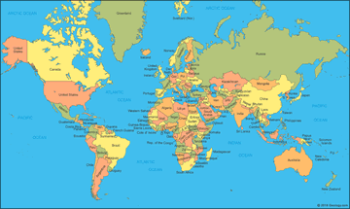
Maps and contours by Arthur Perchard

Slide 2
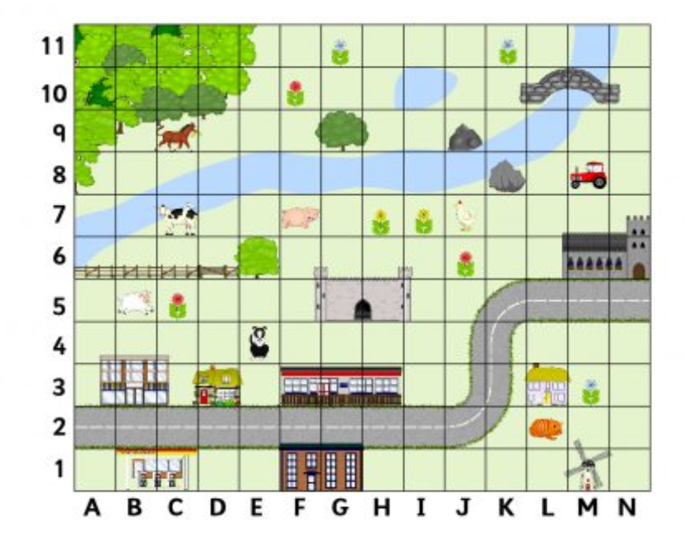
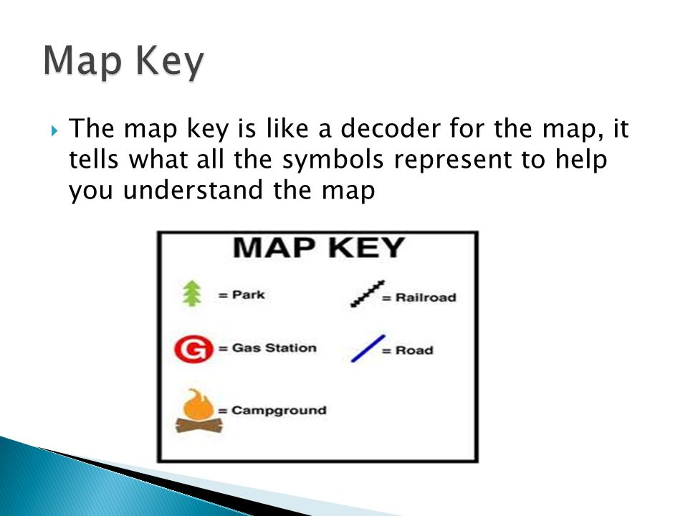
So, how do you understand maps?
Well, coordinates can help a lot. They show you exactly where a place is. In this map the tractor is in square M9
Keys also help. They’re patterns and signs that show for example : x_x_ is a foot path and --------- is a road that horses can ride on.

Slide 3
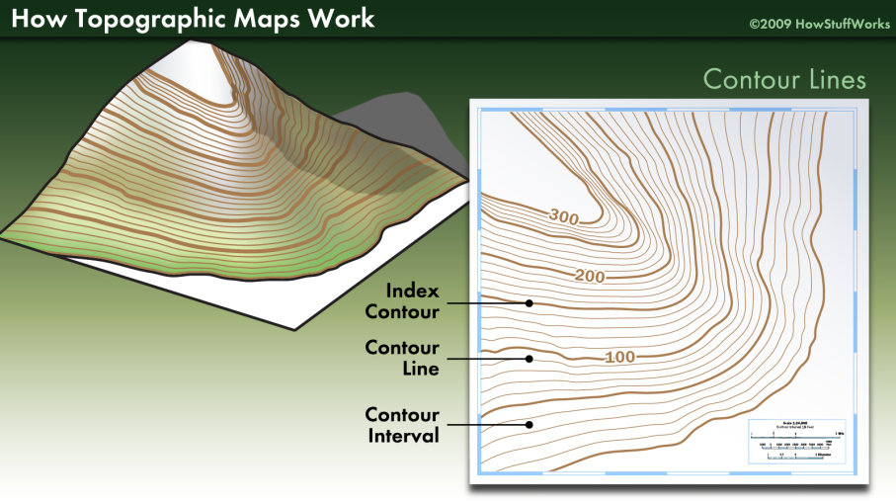
And what does “contours” mean?
Contours are lines that show you how steep or flat a hill or mountain is . They can be very useful sometimes for example, if you want to go on a bike ride with NO hills!

Slide 4

Great, so then why do we have a G.P.S and sat navs
All of these devices have just as much information as maps and atlases but it would be a bit weird if you suddenly pulled an atlas out of your pocket in the middle of nowhere wouldn’t it !
Also, satnavs are intelligent pictures from satellites so they can tell exactly where you are in the world and how to get to your destination. With maps, we have to work that out for ourselves.

Slide 5

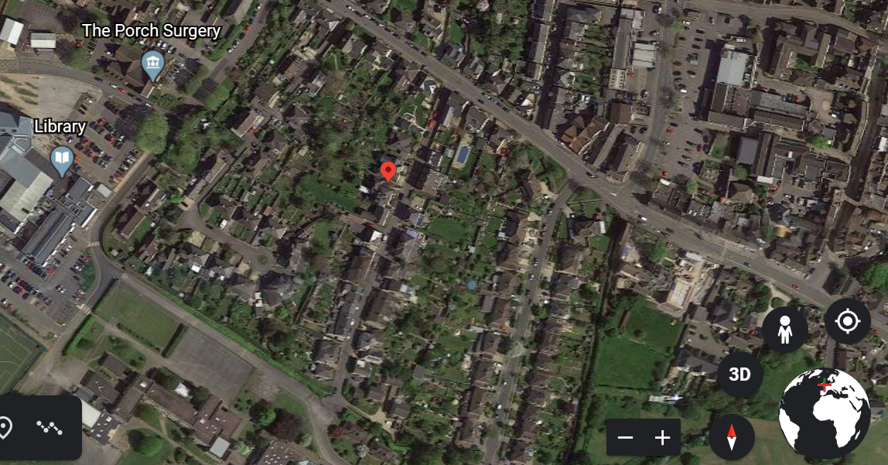
Cool, so can satellites see my house from space?
You can go onto Google earth and if you know your address just type it in and there you go! You can see your house from space!!! The red marker shows our house in Corsham.

Slide 6
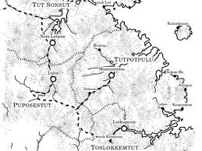
Wait, so I can make my own map?
Sure you can, you could do one of your own
garden or your house!!

Slide 7
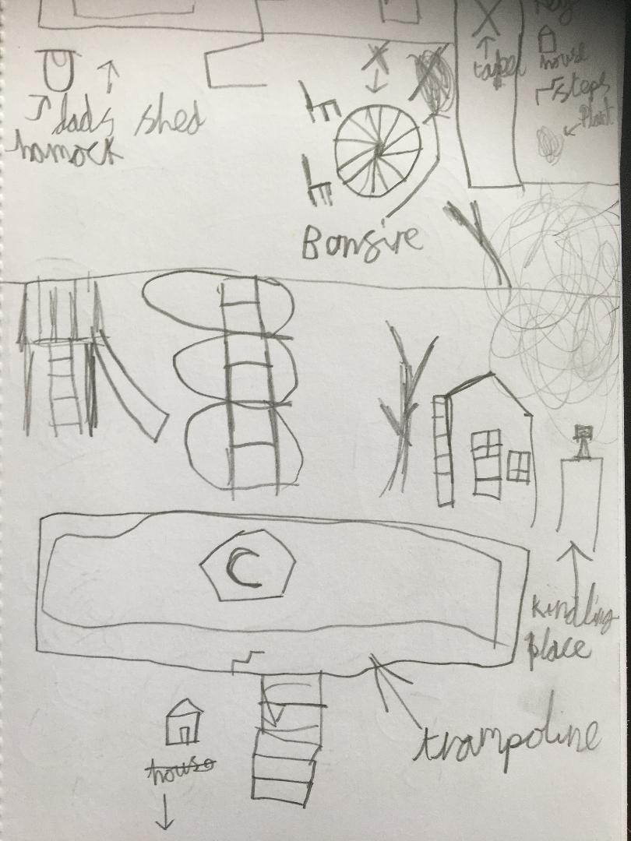
A map of my garden

Slide 8
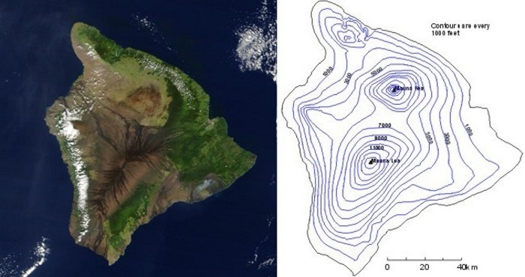
Thanks for watching bye!!!!!!!!!

