Slide 1
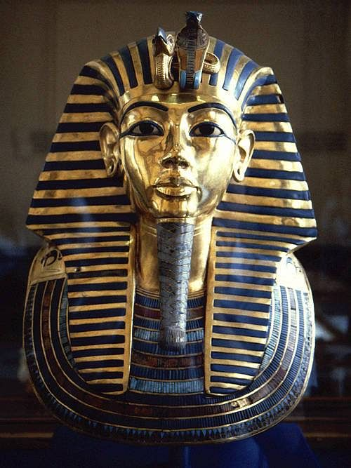
Tutankhamun and his golden mask
Fact 1. Tutankhamun’s golden mask covered his head and it was made of solid gold, precious stones such as lapis lazuli and weighed 25 pounds!!!!!!!
Fact 2. Tutankhamun had problems with his body and people said he was a child of a sister and brother.
Fact 3. Tutankhamun used a walking stick because he had a curved spine, a broken leg and problems with his immune system.

