Slide 1

One more step along the world I go

Slide 2
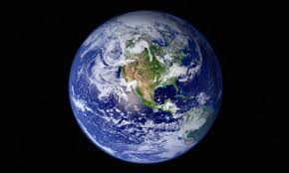
One more step along the world I go,
One more step along the world I go;
From the old things to the new
Keep me traveling along with you
And it's from the old I travel to the new;
Keep me traveling along with you.

Slide 3
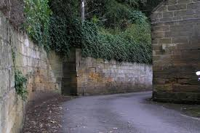
Round the corners of the world I turn,
More and more about the world I learn;
And the new things that I see
You'll be looking at along with me
And it's from the old I travel to the new;
Keep me traveling along with you.

Slide 4

As I travel through the bad and good,
Keep me traveling the way I should;
Where I see no way to go
You'll be telling me the way, I know
And it's from the old I travel to the new;
Keep me traveling along with you.

Slide 5

Give me courage when the world is rough,
Keep me loving though the world is tough;
Leap and sing in all I do,
Keep me traveling along with you
And it's from the old I travel to the new;
Keep me traveling along with you.

Slide 6
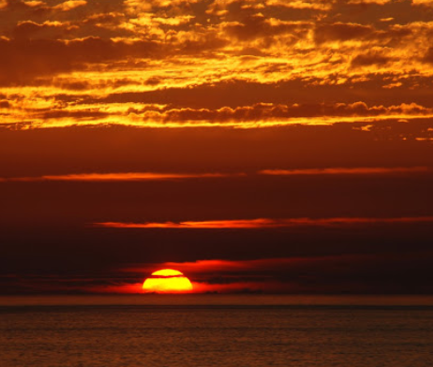
You are older than the world can be,
You are younger than the life in me;
Ever old and ever new,
Keep me traveling along with you
And it's from the old I travel to the new;
Keep me traveling along with you.

