Slide 1
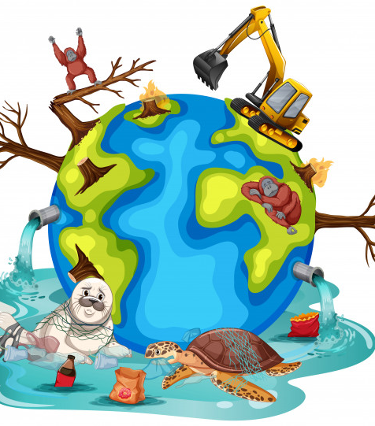
Save our planet rap

Slide 2
Save our planet its already sick, we’re all dying from the mess we made
Let me tell you some facts about this planet
you don’t know what your doin’.
People are putting fertilizers on their farms
it might seem good but its not
even though the plants grow faster
bees don’t find enough flowers but need the flowers to live
Save our planet its already sick, we’re all dying from the mess we made
we need them because they pollinate and make fruit grow.
So now you know what you’re doin’ to bees
but there's much more to learn so we could be here all night!!
.

Slide 3
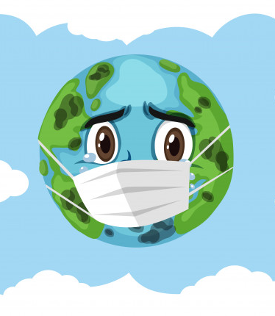
Save our planet its already sick, we’re all dying from the mess we made
Cut down on fuel yeah that’s right
walk or cycle to the place you’re goin’
Fuel is oil from the sea
You burn it and then you pollute the air
Plastic ends up in the sea so please recycle it’s free
ice caps melting, polar bears near to extinction
Save our planet its already sick, we’re all dying from the mess we made

