Slide 1




Year 1 - Autumn - Block 1
Place Value (within 10)

Slide 2


Two children are discussing how some objects have been sorted.
Dora
Jack
Who is correct? Convince me.
These objects have been sorted into cubes and counters.
These objects have been sorted into green and yellow.

Slide 3











How many different ways can the objects be grouped?

Slide 4



Eva has counted the toy cars.
Explain what mistake Eva could have made.
There are 3 cars.

Slide 5
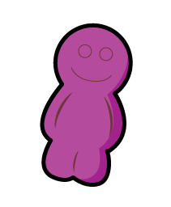
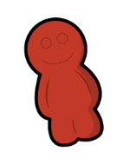











How many different ways can you find to group the objects and find the total?

Slide 6


How many ways can you represent 6 glasses of apple juice?
How many ways can you show me less than 4 sweets?
How can you show me that there are more green cars than blue cars?

Slide 7
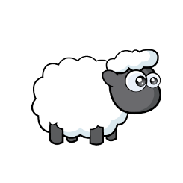
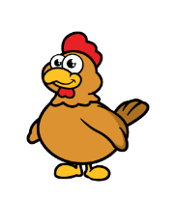
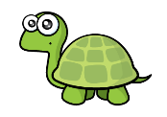




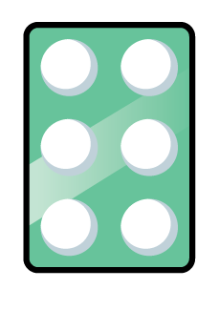

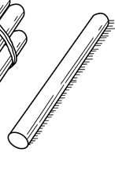

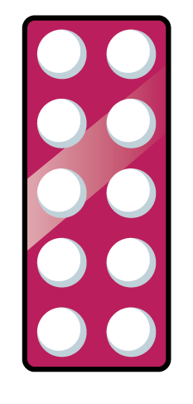

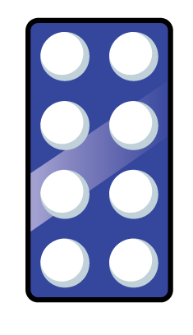
Which representation matches which group?
Explain how you know.

Slide 8


Spot the mistakes and correct the sequences.
0, 2, 3, 4, 5
0 1 2 3 4
1
2
3

Slide 9


Whitney says,
Do you agree?
Explain why.
0 | 1
1 | 2
When counting forwards, we always count from 0

Slide 10

Alex is counting.
How do you know that Alex is counting backwards?
9, 8, 7, 6, 5
1 | 2

Slide 11
How many different starting points could you have if you wanted to count backwards and stop at 3?
 |  | 3

Slide 12
Using number cards 0 to 10, how many different ways can you complete the boxes below?
one more
0
2
9
6
8
10
3
7
5
1
4

Slide 13






Teddy rolls the number that is 1 more than the dice below.
He says that he rolls 2
Explain his mistake.

Slide 14

Mo says,
How old is Mo?
Who is the oldest?
Explain why.
I am one year older than my sister.
My sister is one year older than my brother.
My brother is 7

Slide 15
True or False?
One more than 7 is the same as one less than 9
Use a number track to help you.
Can you think of another statement like this?

Slide 16
Complete the sentence stems.
One less than 9 is ______
One less than ______ is 7
One less than ______ is 6
What pattern do you notice with the numbers?
What would the next sentence be?

Slide 17


There are 4 children going to the beach.
Can every child have a bucket and spade?
If not, why not?

Slide 18

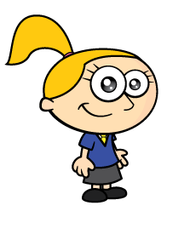
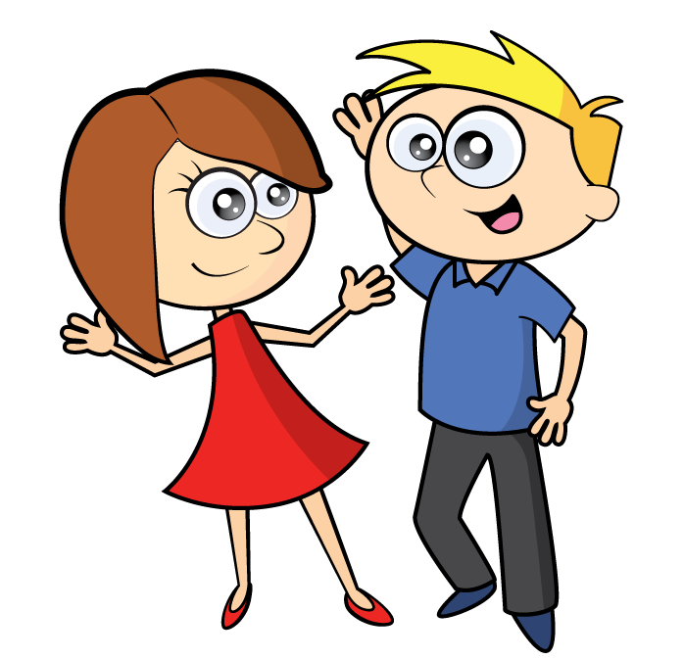
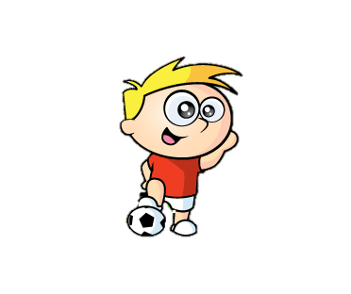


Can the family all travel in a 5 seater car?
Explain how you know.

Slide 19

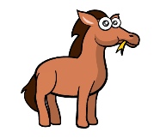



Which group of carrots matches the horses?
Explain why.

Slide 20
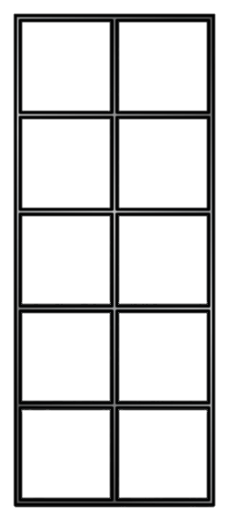
Move three counters so that all the ten frames show the same amount.
Create your own problem like this.

Slide 21

Whitney has this many cubes in one hand.
She has fewer cubes in the other hand.
How many cubes could she have in her other hand?

Slide 22

Circle all the numbers from the track that cannot go in the box.
Explain why.
6 $<$
1 | 2 | 3 | 4 | 5 | 6 | 7 | 8 | 9

Slide 23
Complete the blank dominoes.
>
<

Slide 24


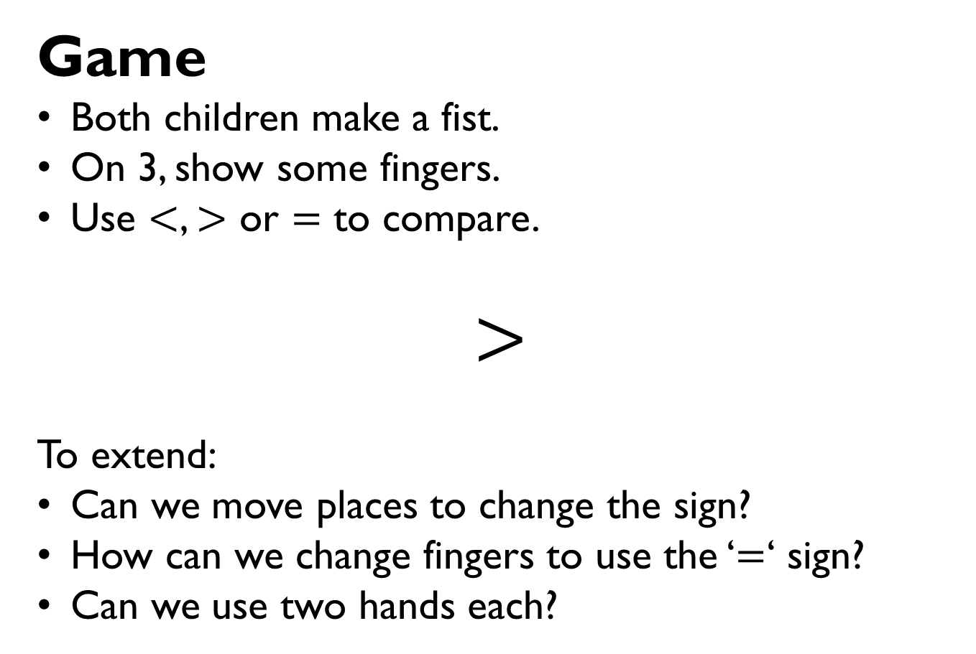
Game
Both children make a fist.
On 3, show some fingers.
Use $<$, $>$ or $=$ to compare.
$$>$$
To extend:
Can we move places to change the sign?
How can we change fingers to use the ‘$=$‘ sign?
Can we use two hands each?

Slide 25

One of these statements is incorrect.
Use cubes to prove which one.
8 $>$ 4
7 $<$ 10
3 $>$ 6

Slide 26
Using number cards 0 – 10, how many ways can you make the statement correct?
______ is more than ______
0
2
9
6
8
10
3
7
5
1
4

Slide 27
Roll two dice and fill in the total in the blank boxes.
Choose the correct inequality symbol to compare the numbers.

Slide 28




Whitney is ordering these three ladybirds from the greatest amount of spots to least.
She says,
Do you agree? Explain why.
I can just compare the first two to work out the answer.

Slide 29




Jack has 6 flowers.
Rosie has more flowers than Jack.
Amir has more flowers than Rosie.
Who has the least amount of flowers?

Slide 30
Draw counters on the ten frames so that they are ordered from greatest to smallest.
How many ways can you find?
Greatest
Smallest

Slide 31
Use 10 cubes. Place them into 3 piles.
Order the piles from greatest to smallest.
How many different ways can you find?

Slide 32



Jack says,
Do you agree with Jack?
Explain your reasoning.
I have ordered the numbers from smallest to greatest.

Slide 33
Two children have used the instructions to make a pattern.
There are four shapes. The first is a circle.
The last is a square. The other two shapes are a triangle and a rectangle.
Here are their patterns.
Amir
Dora
Who is correct?

Slide 34



Tommy, Teddy and Alex take part in a race.
The results are:
Teddy Alex Tommy
1st 2nd 3rd
Fill in the blanks:
Tommy finished behind _____________.
Teddy finished in front of _____________.
Alex finished in front of _____________ but
behind _____________.

Slide 35

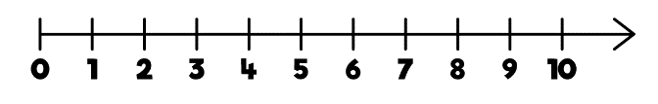
Game
Roll a die. Place a counter on the number line covering the number shown by the die.
Work out how many jumps to 0 and how many to 10
Which is closer?
If you rolled a 6 and did three jumps, what numbers could you land on?
Can you roll a number where there are 7 and 3 jumps to 10 or 0?
Which numbers could they be?

Slide 36


Mo points to a number on the number line.
Which of these could not represent this number?

