Slide 1
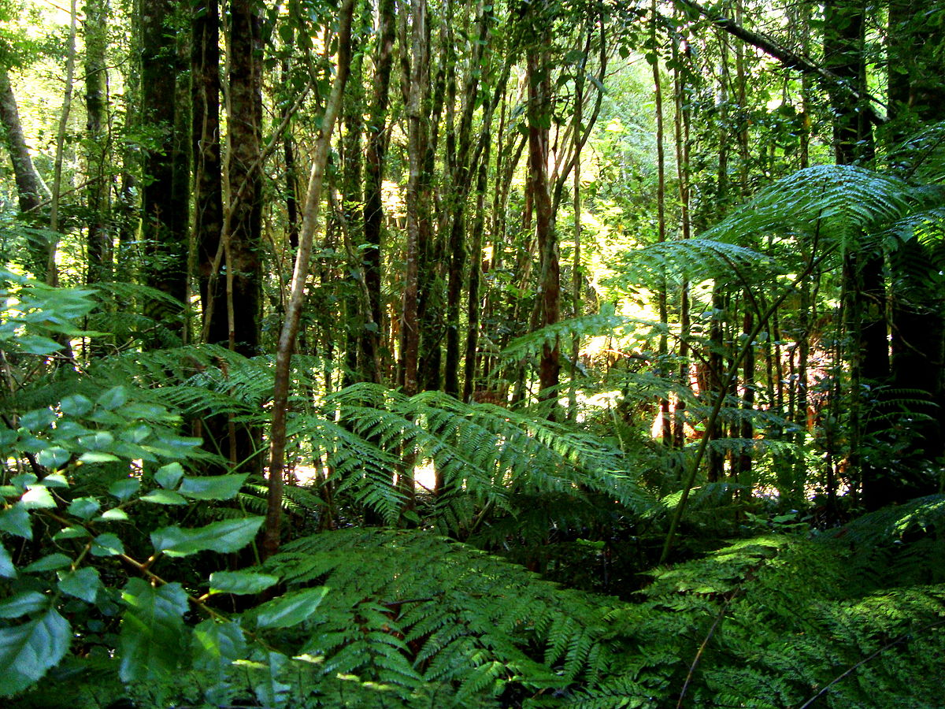
The rainforest
By Mabel
This Photo by Unknown Author is licensed under CC BY-SA

Slide 2
Name three animals that live in the rainforest and three plants?
Jaguar
Monkey
Toucan
Kapok tree
Coffee plant
Orchids

Slide 3
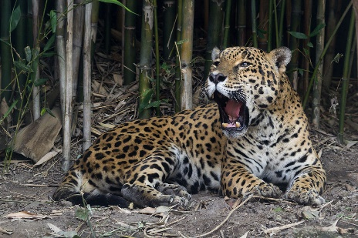
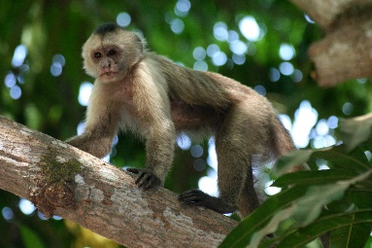
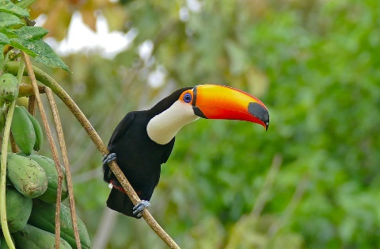
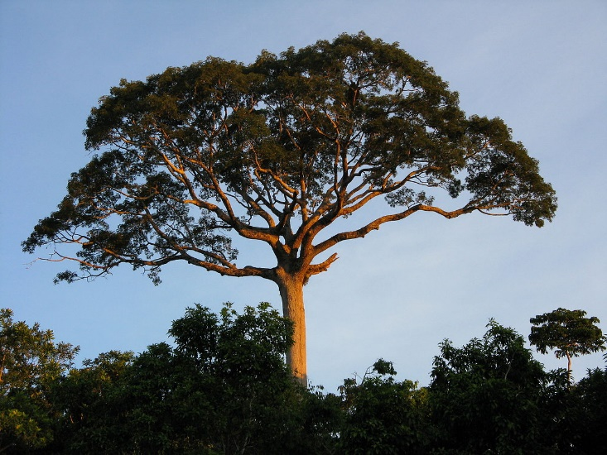
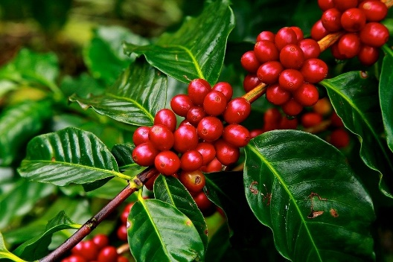
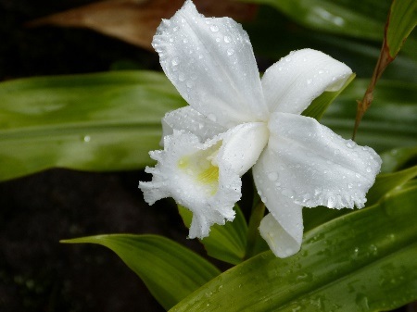
Match the names to the pictures
This Photo by Unknown Author is licensed under CC BY-SA
This Photo by Unknown Author is licensed under CC BY-SA
This Photo by Unknown Author is licensed under CC BY-SA

Slide 4
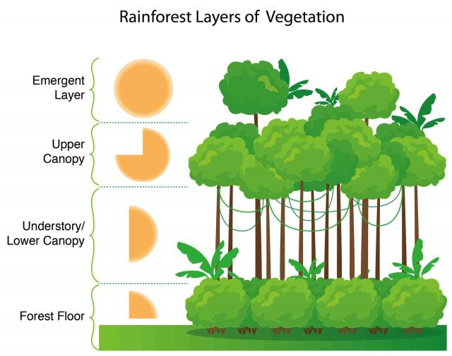
Tell me all the layers of the rainforest
This Photo by Unknown Author is licensed under CC BY-SA-NC

Slide 5
Give me three reasons why the animals don’t want the man to cut the Kapok tree down
It produces oxygen
It’s their home
It is beautiful

Slide 6
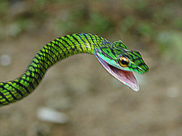
What animals live in the understory?
snakes
This Photo by Unknown Author is licensed under CC BY-SA

Slide 7
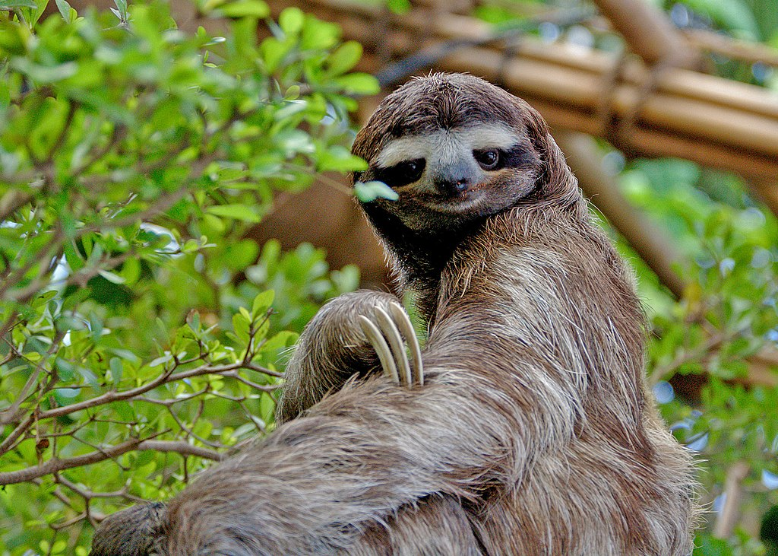
Which layer do sloths live in?
The canopy
This Photo by Unknown Author is licensed under CC BY-SA

Slide 8
The end

