Slide 1
We three kings

Slide 2
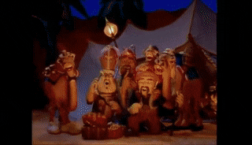
We three kings of orient are
Bearing gifts we traverse afar
Field and fountain
Moor and mountain
Following yonder star

Slide 3
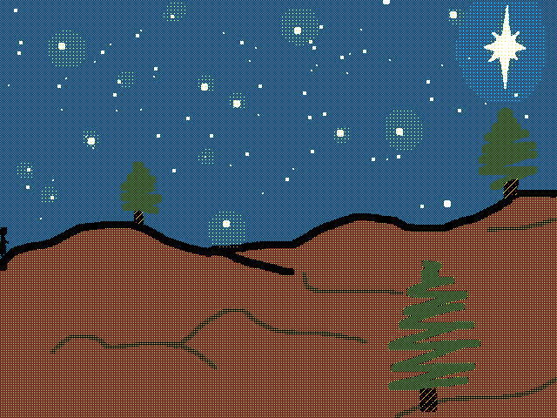
O star of wonder, star of night
Star with royal beauty bright
Westward leading, still proceeding
Guide us to thy perfect light

Slide 4
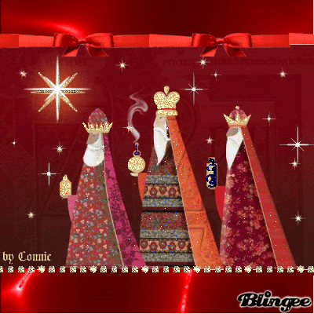
Born a King on Bethlehem's plain
Gold I bring to crown Him again
King for ever, ceasing never
Over us all to reign

Slide 5
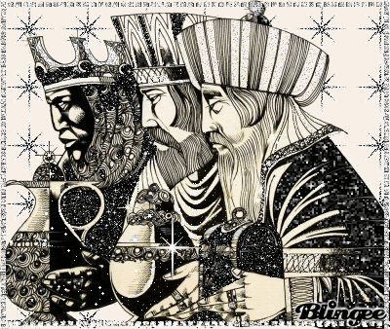
Frankincense to offer have I
Incense owns a Deity nigh
Prayer and praising
All men raising
Worship Him, God most high

Slide 6
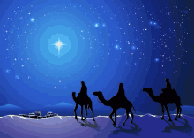
O star of wonder, star of night
Star with royal beauty bright
Westward leading, still proceeding
Guide us to thy perfect light

Slide 7
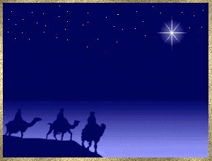
Myrrh is mine
It's bitter perfume breathes
A life of gathering gloom
Sorrowing, sighing, bleeding, dying
Sealed in the stone cold tomb

Slide 8
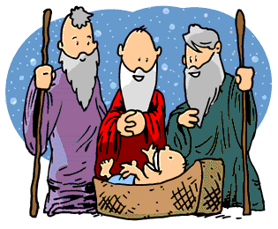
Glorious now behold Him arise
King and God and Sacrifice
Al-le-lu-ia, al-le-lu-ia
Heaven to earth replies

Slide 9
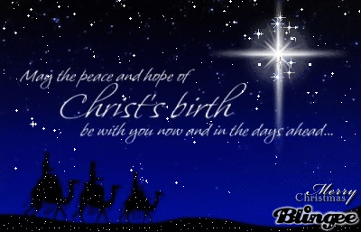
O star of wonder, star of night
Star with royal beauty bright
Westward leading, still proceeding
Guide us to thy perfect light

Slide 10
