Slide 1
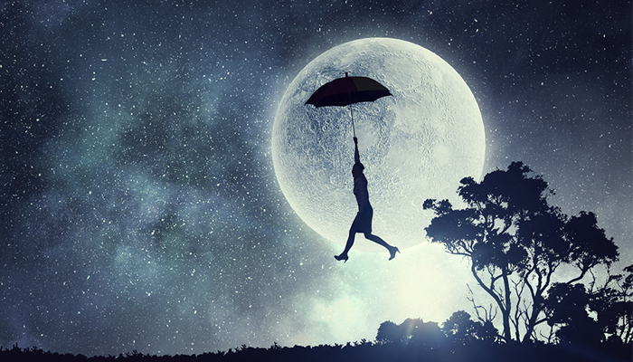
Last night I had the strangest dream the no I ever dreamed before

Slide 2
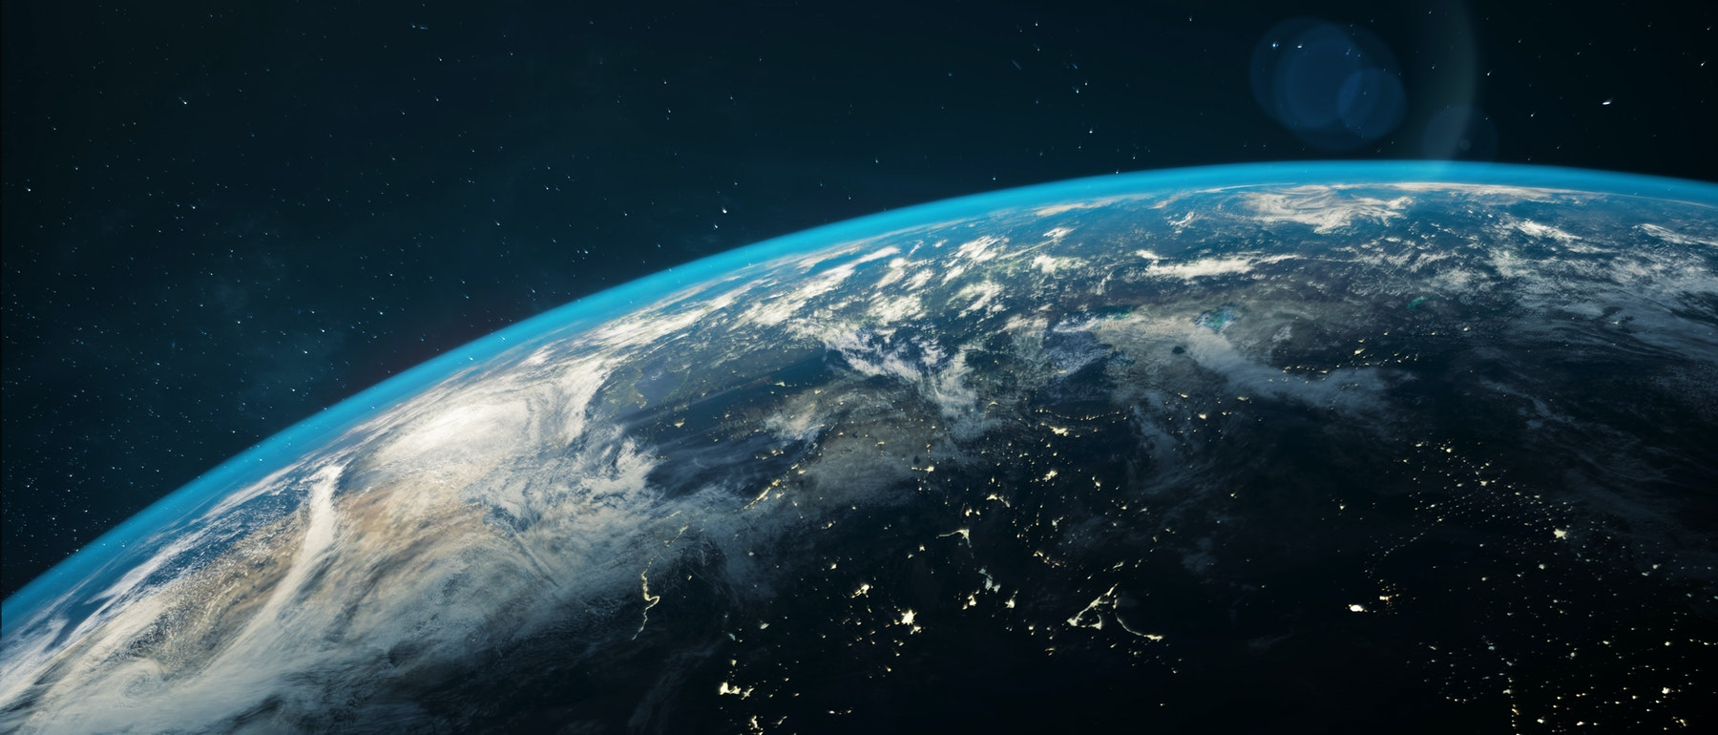
I dreamed That all The world agreed

Slide 3
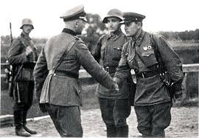
To put an end to war

Slide 4
