Slide 1

Phonics Workshop
Spring Term 2018

Slide 2
What is phonics?
Phonics is one way your child learns to read and write.
Children are taught basic letter sounds and alternative letter sounds.
The children are taught to read the sounds in words and to blend these sounds to decode words.
They are taught to segment the sounds in words and write the sounds that they can hear.
The children are taught to read and write tricky words.
Notes:
charly

Slide 3
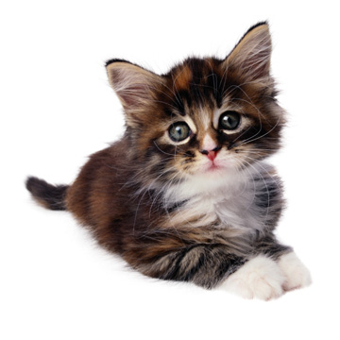
What is a phoneme?
A phoneme is the smallest sound in a word
How many sounds in cat?
C A T
. . .
Notes:
Charly

Slide 4
Letters and Sounds
Letters and Sounds is the phonics scheme produced by the government for pre-schools and schools.
It is broken into 6 phases.
Phase 1 is taught in pre-school
Phase 2 and 3 is taught in Reception
Phase 3,4 and 5 are taught in Year 1
Phase 5 is revisited and phase 6 is taught in Year 2
Notes:
Charly

Slide 5
Phase 1
Your child will be learning to:
  Have fun with sounds
  Listen carefully
  Develop their vocabulary
  Speak confidently to you, other adults and children
  Tune into sounds
  Listen and remember sounds
  Talk about sounds
  Understand that spoken words are made up of different sounds
Notes:
Anna

Slide 6
Phase 2
Overview: By end of phase 2 children should be able to read some VC and CVC and spell them using magnetic letters or on whiteboards.
Children will learn these sounds:
1. s a t p
2. i n m d
3. g o c k
4. ck e u r
5. h b f ff
Teach these tricky words: the to I go no
What can you do at home? www.ictgames.co.uk (sound and word recognition games)
Look at the cbbc website for lots of letters clips and word games
Simple Simon Says
Use the local environment to spot sounds!
Notes:
Anna

Slide 7
Phase 3
Overview: By end of phase 3 children should know another 25 graphemes e.g. oa and continue to practice cvc blending and segmenting.
Children will learn these sounds:
6. j v w x
7. y z zz qu
They will be introduced to a range of graphemes: ch, sh, th, ng, ai, ee, igh, oa, oo, ar, or, ur, ow, oi ear, air, ure, er.
Teach these tricky words: he, she, we, me, be, was, my, you, they, her, all, are.
What can you do at home? www.ictgames.co.uk (sound and word recognition games)
Look at the cbbc website for lots of letters clips and word games use you local environment to spot sounds!
Shopping lists provide interesting tools to write with https://www.youtube.com/watch?v=P-eTO8L3t40
Notes:
Anna

Slide 8
Phase 4
Overview: By end of phase 4 children will consolidate knowledge of graphemes in reading and spelling words using blending and segmenting skills.
Teach these tricky words:
said, so, have, like, some, come, were, there, little, one, do, when, out, what.
Practise reading and writing simple sentences.
What can you do at home?
Praise your child for trying out words
Give your child a tricky word list to support them with their writing
Continue to play games
Magnetic words and letters on the fridge
Notes:
Anna

Slide 9
Phase 5
Overview: By end of phase children will broaden their knowledge of graphemes and phonemes for use in reading and spelling.
Introduce graphemes: ay, ou, ie, ea, oy, ir, ue, aw, wh, ph, ew, oe, au, a-e, e-e, i-e, o-e, u-e.
Split digraphs:
Decode these HF words that include a split digraph: like, make, came, made
Teach these tricky words: oh, their, Mr, Mrs, looked, called, asked, would, should, could, water, where, who, again, thought, through, work, mouse, many, laughed, because, different, any, eyes, friends, once, please.
What can you do at home?
Continue to play games practise the tricky words read
Notes:
Charly

Slide 10
Phonics Test
What is expected of the children?
The check is very similar to tasks the children already complete during phonics lessons.
Children will be asked to ‘sound out’ a word and blend the sounds together.eg d-o-g - dog.
The focus of the check is to see which sounds the children know and therefore the children will be asked to read made up ‘nonsense’ words. Zong, Phrang and zog are all examples.
What can you do to support your child?
Encourage your child to ‘sound out’ when reading or writing. Focusing particularly on spotting more unusual sound patterns. E.G spine and night.
Encourage your child to use a sound mat when writing to find the sound they need (in the back of your pack).
Play games! www.phonicsplay.co.uk
Remember phonics is not the only thing needed to be a fluent reader!
The most important thing is to ENJOY READING!
Notes:
Charly

Slide 11
New Curriculum Requirements
Year One Summer Term 2
Adding -s and -es to words, looking at plurals of nouns
Adding endings -ing, -ed, -er when the verb doesn’t need to change e.g jumping, stamped, buzzer
Adding -er and -est when no change to the root word is needed e.g fresher, quickest
Adding the prefix un- e.g unhappy
Compound words e.g play + ground = playground
In the previous curriculum this was taught in year 2. We recognise that children develop at different rates and this may not be suitable for all children in year one.
Notes:
charly

Slide 12
Phase 6
Overview: By end of phase children should know most of the common grapheme- phoneme correspondences. They should be able to read hundreds of words.
Children learn to add a suffix
Using past tense, add suffix (-ed) . Decode without suffix, then add. e.g. round, help, turn, beg, hiss, want, sort, hum, wade, hate, grease, live, rob, rock, laugh, call, roast.
Experiment with other suffixes: s and es: cats, bushes. ed and ing: hoped, hoping
Also ful, er, est, ly, ment, ness.
Learn all contractions e.g. let’s and can’t
Children learn memory strategies:
Syllables: I can break words into smaller bits to remember base words: I can find its base word (smile + ing =smiling)
Compound words: e.g. play + ground= playground
Analogy: I can use words I already know to help me e.g.could = should, would
Mnemonics: I can make up a sentence to help me remember people e.g. people eat orange peel like
Visual spelling patterns and spelling rules.
Notes:
Heather

Slide 13
New curriculum requirements
Year 2
Spelling words ending in –dge and –ge
Alternative sounds e.g the c in city and race
-le/-al/-il at the end of the word
The possessive apostrophe e.g the child’s
Words ending in –tion
Words that sound the same but are spelt differently and have different meanings e.g their and there
Notes:
Heather

Slide 14
Key Points
All children learn at different rates. They will be taught the phase that is most appropriate for them.
Phonics doesn’t stop in Year 2. Previous phases will be revised. Children will continue to learn at the appropriate phase and when ready, move onto spelling rules.
Notes:
Heather

Slide 15
Phonics in Key Stage 2
Key stage 2, phonics continues as whole class lessons teaching specific sounds that benefit the whole class.
Certain children will have phonics interventions for the phase that they are requiring support with.
Phonics is addressed for everybody in their spelling lesson to help understand and learn word families and new common exception words.
Greater depth e.g applying and independence
Notes:
Heather

Slide 16
Example of Phonics Lesson
Notes:
Heather

Slide 17
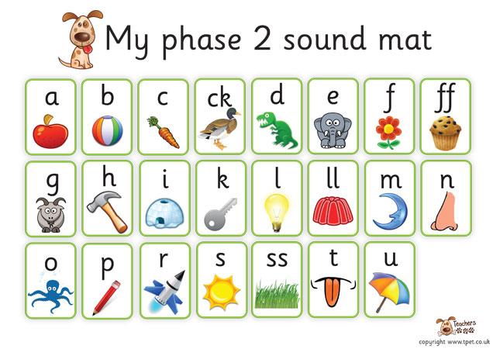
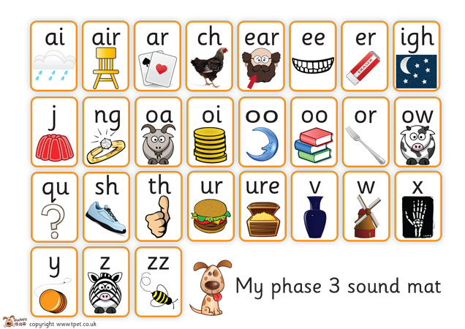
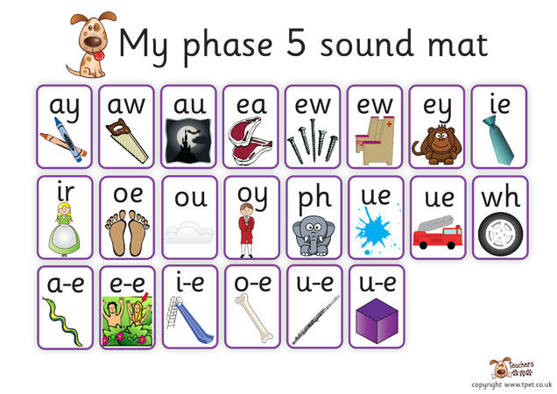
Notes:
Heather

Slide 18
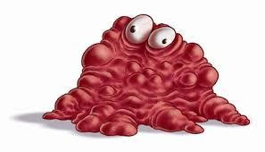
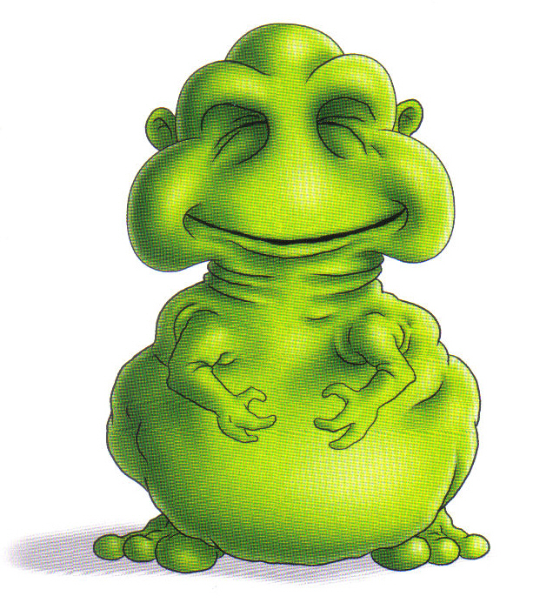
glairm
poit
Notes:
Charly

Slide 19
Read the key words and tricky words with a friend
in went go we
Notes:
Anna

Slide 20
Teaching the New Sound
Then a new sound is introduced or alternative spelling for the lesson, there will be picture clues for the children to work out the sound or alternative spelling.
We discuss the sound/alternative spelling in the words
Watch a video teaching us more about the sound.
Notes:
Charly

Slide 21



Notes:
charly

Slide 22
Key Points
All children learn at different rates. They will be taught the phase that is most appropriate for them.
Phonics doesn’t stop in Year 2. Children will continue to learn at the appropriate phase and when ready move onto spelling rules.
The children who haven’t ‘passed’ the phonics test will informally do it again in year 2 so that the teachers are aware of developments.
Notes:
Heather

Slide 23
What can you do to support your child?
Encourage your child to ‘sound out’ when reading or writing. Focusing particularly on spotting more unusual sound patterns. E.G spine and night.
Encourage your child to use a sound mat when writing to find the sound they need (in the back of your pack).
Play games! www.phonicsplay.co.uk
Remember phonics is not the only thing needed to be a fluent reader!
The most important thing is to ENJOY READING!
Notes:
Charly

Slide 24
Thank you for Attending our Phonics Workshop
We appreciate all your help and support.
Notes:
Charly

