Slide 1



Reading
Jenny Violette
Ramsbury English Hub

Slide 2
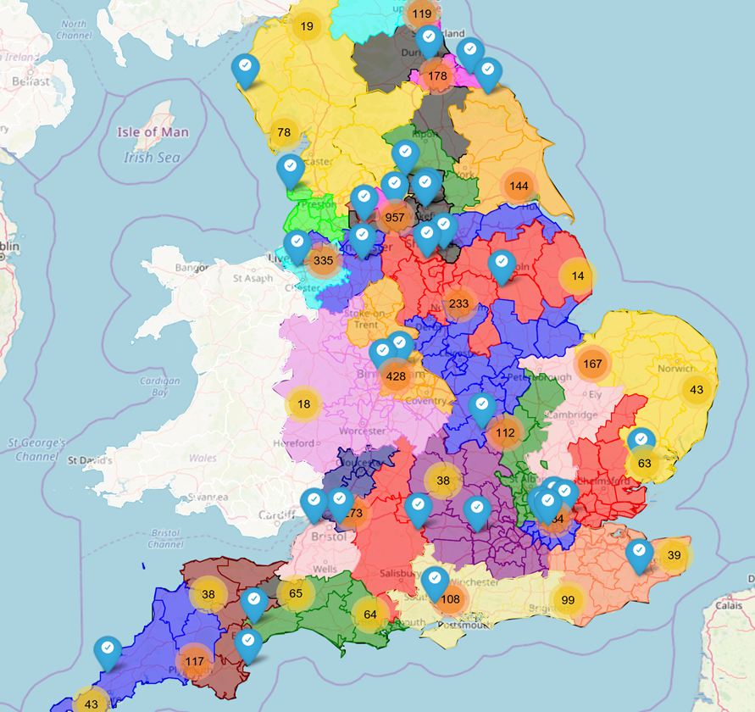
*English Hubs
*Evidence-based Research
*Literacy Specialists
*Disseminate training

Slide 3
English Hub Priorities
* Age-appropriate Phonics Provision
* Early Language Development
* Developing a love of reading
Notes:
Significance of phonics as a starting point for independent reading also highlighted within English Hub priorities.

Slide 4
Aims:
* To explain what underpins effective reading
* To introduce the new reading format
* To look at the evidence supporting effective reading
Notes:
Ultimate aim is reading for pleasure – children who choose to read.
Long term benefits.
Requires orchestrated approach – phonics is not the whole picture but it is a key component.

Slide 5
Creating a Climate for Reading for Pleasure
Phonics
Decoding: sounds and words including common exception words
Language and Vocabulary
Growing a wide vocabulary and understanding language structures including sentences
Reading for Pleasure
fluency and fun
Comprehension
Understanding plot, character and setting and learning how to make inferences
Knowledge of the World
Making connections with prior knowledge and experience and with other books
Notes:
Ultimate aim is reading for pleasure – children who choose to read.
Long term benefits.
Requires orchestrated approach – phonics is not the whole picture but it is a key component.

Slide 6
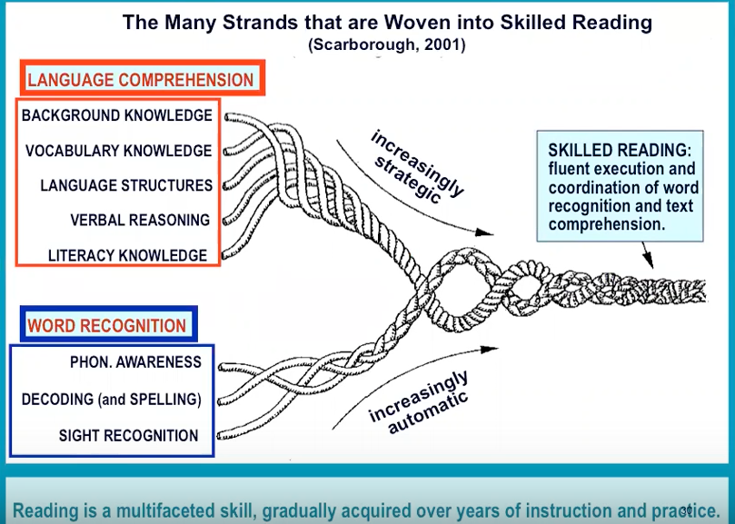
Notes:
Language Comprehension:
Background Knowledge-This refers to the knowledge your child already has about the information being read or that can be applied to the information being read. A good way to work on this with your child would be to take new opportunities while in the community to discuss new concepts and ideas with your children (See those bees by the flowers, do you know what they're doing?). Watching educational programming with your children also helps to increase their background knowledge and familiarity with different concepts.
Vocabulary-This includes the child's vocabulary breadth (see the label Vocabulary for more info and advice).
Language Structures-This includes syntax and semantics, or your childs knowledge of how to construct a sentence with proper grammar and meaning (see the label Syntax for more info and advice).
Verbal Reasoning-This involves your child's ability to make inferences and construct meanings from the text that is being read. Understanding metaphor meanings and references is also an indicator of verbal reasoning skills.
Literacy Knowledge-This includes your child understanding print concepts such as reading from left to right and top to bottom, how to hold a book, and that periods complete one sentence before moving to the next. By giving your child access to books from the time they are infants, you can help them to understand print concepts. It is helpful when reading to your child to use your finger to guide along to demonstrate to your child that your are reading from left to right and top to bottom.
Word Recognition:
Phonological Awareness-This refers to the amount of awareness your child has of the sound form of language. This includes their knowledge of syllables, as well as sentence intonation (a rise in voice when asking a question, for example). See the label Phonology for more info and advice.
Decoding- This includes your childs understanding of the alphabetic principle, that is that each letter of the alphabet represents a sound, and those letters are put together to form words. A good knowledge base about the sounds that letters make can help children to sound out or decode the meaning of unfamilar words. Children can use their knowledge of sound patterns and letter combinations when trying to decode.
Sight Recognition-Some words may be considered "sight words" for your child, which they easily recognize when reading without having to attempt to decode for meaning or pronunciation. These words may include "the", "who", and "what". Sight words typically result from seeing the words frequently in text. Over time, with more exposure to reading materials and practice, many or most words become sight words for skilled readers.
These "threads" all work together to create a skilled reader. The concepts under "Language Comprehension" become more strategic over time, as your child learns and practices using different aspects of background knowledge, vocabulary, language structures, verbal reasoning, and literacy knowledge. The concepts under "Word Recognition" become more automatic with practice. These threads combine to create a knowledge and strategy base which skilled readers use to read fluently.

Slide 7

Education Endowment Fund:
Key Recommendations for Improving Reading in KS1
Use a balanced and engaging approach to developing reading which integrates both decoding and comprehension skills
Effectively implement a systematic phonics programme
Teach pupils to use strategies for developing and monitoring their reading comprehension
Notes:
Outlines 8 recommendations for improving Literacy – 3 specifically around Reading
Highlights VERY EXTENSIVE evidence for the positive impact of implementing a SSP

Slide 8

Early Reading
A systematic synthetic phonics approach to reading is the
fastest way for child to learn to read.
Children can learn to read at a quick pace.
But…
They need opportunities to apply these skills.
Notes:
Many reasons that Phonics is the fastest – learn how to decode and it doesn’t rely on memory of sight words

Slide 9
Decodable Books
* Only contain words that children are able to read based on their
existing phonics knowledge
* Progressive – build in increasing number of GPCs and CEW and
introduce increasingly complex words (e.g. adjacent consonants)
as children move through scheme
* Must be matched to chosen phonics programme
Notes:
Explain what is meant by decodable books

Slide 10

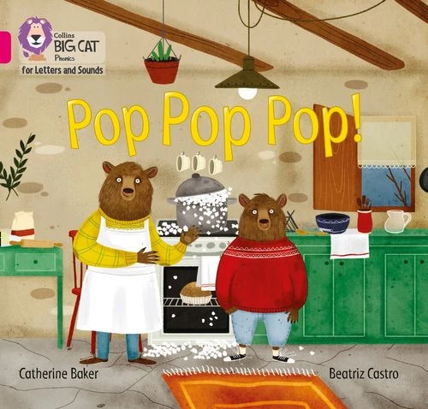
Decodable Readers
Links to Letters and Sounds Phases 1-6
1 – Nursery (FS1) and Reception (FS2)
2 – Reception
3 – Reception
4 – Reception / Year 1
5 – Year 1 / Year 2
6 –Year 2 /3

Slide 11


Decodable Readers

Slide 12
The importance of fluency
for
They
gradually
ascended
half
a
mile
themselves
at
the
top
then
found
of
a
wood
considerable
where
the
eminence
and
the
eye
ceased
was
instantly
caught
by
Pemberley
House
situated
on
the
opposite
side
of
the
valley
,
the
into
which
wound
road
with
some
abruptness
.

Slide 13
Is comprehension possible?
What did they climb?
Where did the characters find themselves?
At what point did they first see Pemberley
House?
Where was the house in relation to the characters?
How did the author describe the road?

Slide 14
Comprehension depends on reading speed
They gradually ascended for half a mile then found themselves at the top of a considerable eminence where the wood ceased and the eye was instantly caught by
What did they climb?
Where did the characters find themselves?
At what point did they first see Pemberley House
Where was the house in relation to the characters?
5. How did the author describe the road?
Pemberley House situated on
the opposite side of the valley, into which the road with some abruptness wound.

Slide 15
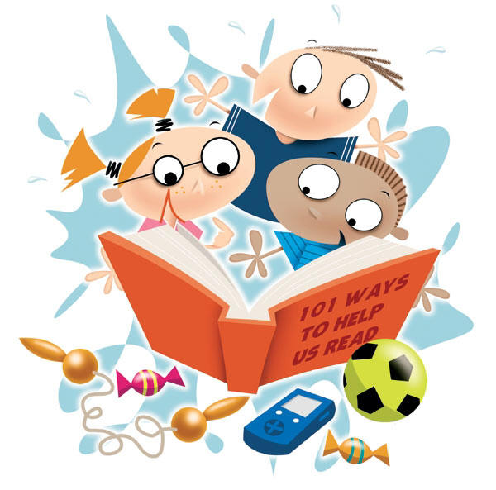
Fluency: reading quickly, accurately, and with expression
Combines rate and accuracy
Requires automaticity
Includes reading with prosody
Pupils need to be able to access 90-95% of a text to be a fluent reader.
Notes:
Automaticity – speedy word recognition

Slide 16

What’s going on in memory?
Long-term Working
Accuracy
Fluency
Prior knowledge
Vocabulary
Stories
Inferences
Clarifications
Hypotheses
Predictions
Fast, automatic,
invisible
Requires attention
& effort
Background knowledge is what you think with
not about.

Slide 17

Metacognitive Strategies
Reducing cognitive overload
* Identifying clear links between what children are learning now and what they already know
* Building-in frequent opportunities for children to practise what they have been taught in a range of planned contexts
* Setting appropriate challenges
Notes:
Key research around effective teaching and learning
Approach to teaching reading that is mindful of the need for children to develop skills of decoding and comprehension separately, especially in the early stages when they are developing proficiency with both.
Also applies to teaching of reading and writing skills.
Ensuring new learning is clearly linked with prior knowledge and that there are frequent opportunities for practise and consolidation as well as application across a range of contexts are crucial within any effective teaching sequence but perhaps particularly important bearing the importance of cultivating proficient readers and the complexity of what we have to teach.

Slide 18

What does the research say?
“For years, book bands have provided an easy reference point to help teachers choose reading books for children. While classifying books from pink to lime and beyond may appear useful, the grading is based simply on factors such as the length of words, sentences and texts, the range of punctuation used, and the size of print.”

Slide 19
Supporting Evidence Based Research
* they are fully decodable and match phonics teaching so far; children can read independently and with confidence
* the only strategy required for reading visually unfamiliar words is all-through-the-word sounding and blending
* no guessing is required so children have a secure and confident start
* children can use their phonics to read familiar words and discover new ones, helping to increase vocabulary knowledge
* decodable books do not need to rely on repetitive, predictable text, which can often be boring for children
* books with a phonics focus reinforce the knowledge and skills required for spelling
* progress is rapid when children can practise and apply the specific knowledge and skills as they are taught in class

Slide 20
Supporting Evidence Based Research
Ultimately, the aim of phonics teaching is to enable children to become confident, capable readers, who can decode and understand whatever they choose to read.
Good decoding is a prerequisite of good comprehending.

Slide 21

Good practice in early reading
Practise reading aloud, be it to teachers, parents or other helpers, exclusively with books matched carefully to phonic learning which do not require children to use any alternative strategies.
Such books will already be graded by their particular scheme listing the letter/s-sound correspondences (the alphabetic code) introduced incrementally.

Slide 22
What is different?
All books are fully decodable with some common exception words
Pupils are assessed and aligned with books matched to the phonics phase they are working at
Pupils will read with at least 90-95% fluency

Slide 23
What is different?
Colour bands are out – phases are in
Pupils will bring home books that they CAN read fluently so that success can be celebrated by all
Books will be kept for a week – repetition is key

Slide 24
Decoding
Pre-tutor specific phonic content of text
Grapheme and CEW flashcards or post-it notes
Rehears relevant blending strategy
Model decoding words and sentences and support children to try for themselves
Move into independent reading with all children reading the text and adult ‘tuning’ in to one child at a time to check / support accurate and fluent decoding

Slide 25
Prosody
In reading, prosody refers to the expressiveness with which children read. It is the intonation, rhythm, and emphasis given to words and sentences when reading out loud.
Adult reads some of the text to the children modelling intonation, expression and emotion and children copy (my turn, your turn approach)
Move into independent reading with all children reading the text and adult ‘tuning’ in to one child at a time to check / support fluent reading particularly on the pages that have been rehearsed
Notes:
NB prosody could be third lesson
Comprehension needed for prosody BUT prosody can also support comprehension particularly in early stages of independent reading

Slide 26
Comprehension
Share specific focus of session based on content domain
Read some of text children modelling thought processes leading to comprehension and asking pre-prepared questions linked to comprehension focus
Move into independent reading with all children reading the text and adult ‘tuning’ in to one child at a time to check / support fluent reading and accurate comprehension

Slide 27
Ideas for reading at home
Look at the graphemes and words at the beginning of the book
If a child can read the word there is no need to decode
To encourage fluency get your child to read in their head
Get your child to read the sentence back for fluency
Think the book out loud
Get into a routine
Pick your battles!

Slide 28
Ideas for reading at home
Vary the reading experience
  Echo reading - MTYT
  Read alternate pages
  You read the book to them
  Make up actions
  Child to ‘jump in’ with one word

Slide 29
Good practice in early reading
Shared reading with adults (adults reading books aloud to/with the children, discussing, retelling, exploring through art, play and the wider curriculum) of the widest possible range of high quality (‘real’) books.
These also do not need book banding as they will be mediated by adults and therefore need not be of any particular ‘level’. Indeed, the wider the diversity of content, style and language, the better.

Slide 30

Questions?
Notes:
Final note!

