Slide 1
PSHE Term 6 - Key Stage 2
Changing Me

Slide 2
How have I changed?
With an adult, look at some pictures or videos of you since you’ve been at primary school and then talk about;
What changes can you see? (e.g. I’ve
got glasses, my hairstyle’s changed, I’ve got
my ears pierced, I have some spots on my face)
What things have changed that you
can’t ‘see’? (e.g. I know why personal
hygiene is important, I understand more about
the consequences of my actions and choices)
Which are your favourite changes and why?

Slide 3
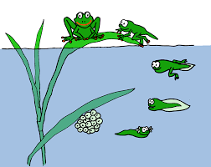
How am I going to change
Like the Frogs, you have a lifecycle, with important changes at every stage.
One of the life-stages you’ll go through
is called Puberty.
Puberty is a natural life-stage that all
children experience as they grow from
being a child to a young adult.
Every child’s experience of puberty is as
unique as you are.
Because so much changes in Puberty it is normal to have lots of questions – and it is normal and healthy, not embarrassing or rude to ask them.

Slide 4
A little Puberty quiz
With an adult, talk about each of the questions below and decide if you think they are true or false.
Puberty can start as early as 8yrs old or as late as
13yrs old and usually lasts for around 4yrs? True
Spots and acne can appear on your skin, quite commonly on your face? True
Your mood and feelings often change without you understanding why? True
Your body shape changes and you grow body and pubic hair? True
Puberty can be a difficult life stage, but can be easier with help and support from people you trust? True
Periods will start, usually about 2yrs after puberty starts? True

Slide 5
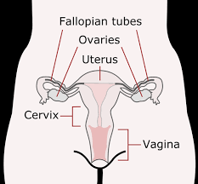
Periods – some basic information
Only people with female sex organs have periods, but everyone should learn about them.
Periods are part of the menstrual cycle. Each month one of the ovaries releases an egg. It travels down one of the fallopian tubes and into the uterus (womb, the bit where a baby would grow).
The womb lining thickens in case the egg has been
fertilised. If it hasn’t, the womb lining breaks down,
coming out of the body through the vagina as a
small amount of blood.
Sanitary products are used to soak up the blood.

Slide 6
Help I might need with this change
Talk with an adult about some of the things that have helped you change from a baby, into a toddler, a pre-schooler, and now a primary school pupil.
Now think about the help you might need whilst going through puberty. See if you can fit your ideas into these groups;
Physical things (e.g. using sanitary products, being hygienic, sleeping well)
Emotional and social things (e.g. help with friendship issues, supporting me to have good body image)
Communication and learning (e.g. being able to ask questions, having information I can read)

Slide 7
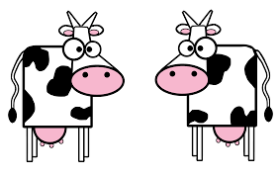
What else will be changing soon
Soon you will be moving to a new year group. Below are some examples of things that may be the same, and things that may be different. Can you think of any others?
Things that may be the same
Friends
Subjects (i.e. maths, English, P.E)
The school building
Start and finish time
Things that may be different
Classroom
Teacher or teachers
Support staff
Lunch and play times
Classmates

Slide 8
Changing me at school
One of the things you might have said would be
different about school next year is YOU!
From earlier conversations with your adult about
puberty you will be aware that lots of things
about you will be changing. It is normal to be worried about how these might effect you at school.
Write down anything that you might be worried about. This could be things like; getting upset or angry over things, feeling embarrassed about doing P.E or having to learn about ‘growing up’ stuff
Show your worries to an adult and find a special time when the two of you can talk about them

Slide 9
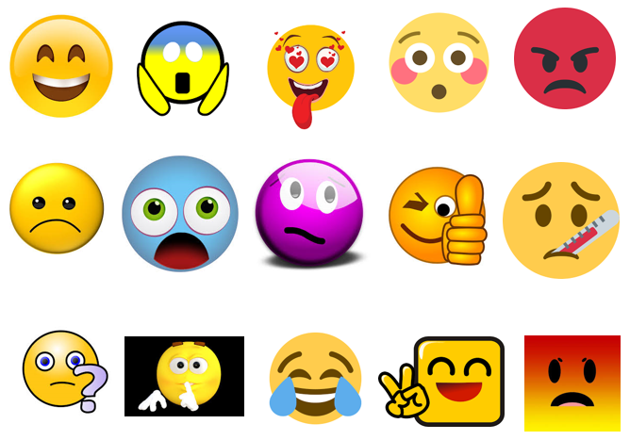
How I feel about these changes
Do any of these faces
match any of the
feelings you have
about changing year
group and class?
Remember, feelings
can be;
Good
Bad
A mixture of Good
and bad

Slide 10
How I can manage these changes
Can you think of something you have achieved or learnt recently that
you weren’t sure you’d be able to do?
It might have been; cooking a meal with no help, fixing something on
your bike or completing an online workout or activity
But…now you CAN do it!
Ask an adult to help you think about the skills, qualities and abilities you used to make this happen.
Can you think of ways in which these skills,
qualities or abilities might help you to manage
the school changes that are coming up?

Slide 11
Getting help if I need it
If you were feeling sad, nervous, worried, upset, anxious or scared about something at school that had recently changed – who might you be able to talk to about it?
Look at the 3 suggestions here →→→→
Can you think of 3 other people to go in the blank boxes?
Class teacher
Teaching Assistant
My friends

