Slide 1
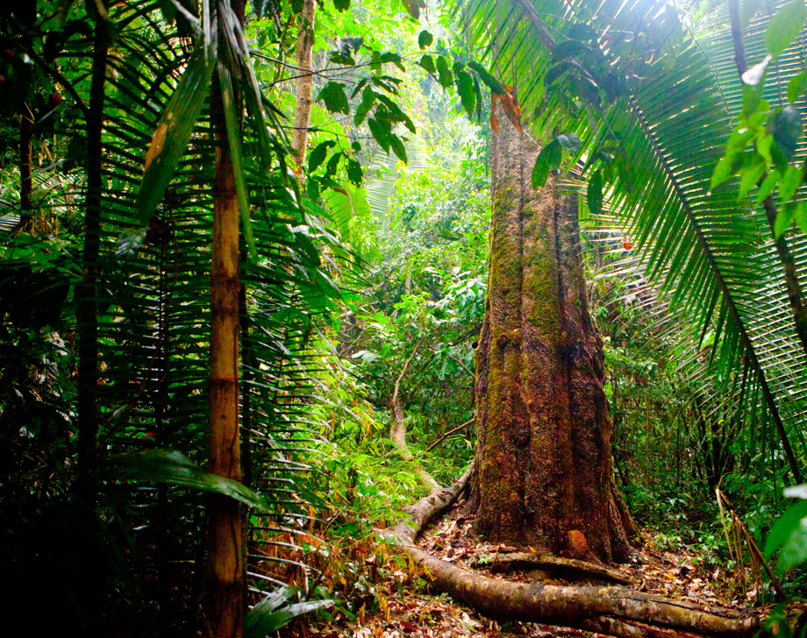
Non chronological report about
The viro

Slide 2
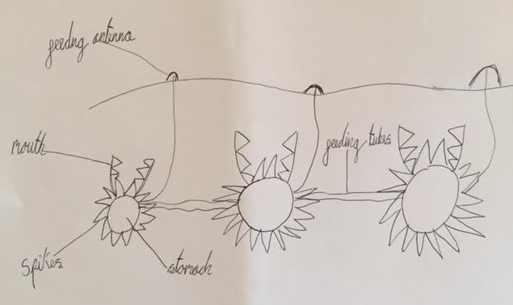
This mysterious creature lives in the deep underground in the rainforest and is called the Viro. Scientists believe that this creature won’t become extinct because it has a special ability to survive!!!!! Scientists have discovered this creature in 1601 but it has been forgotten. However, a scientist called Alan Ferry found this creature again in 1979. the Viro is one animal that is attached to lots of other viros by its slim feeding tube!
Introduction

Slide 3
Diet
The Viro is a carnivore and it eats by its feeding antenna which, when an animal touches it, snaps the animal with its powerful jaws and paralyzes prey in an instant. if it doesn’t get meat it throws the food out next to the feeding antenna. If the animal is full it still eats but it sends the food via its feeding and survival tubes to the one that didn’t have a lot of food. Therefore a Viro cannot starve!

Slide 4
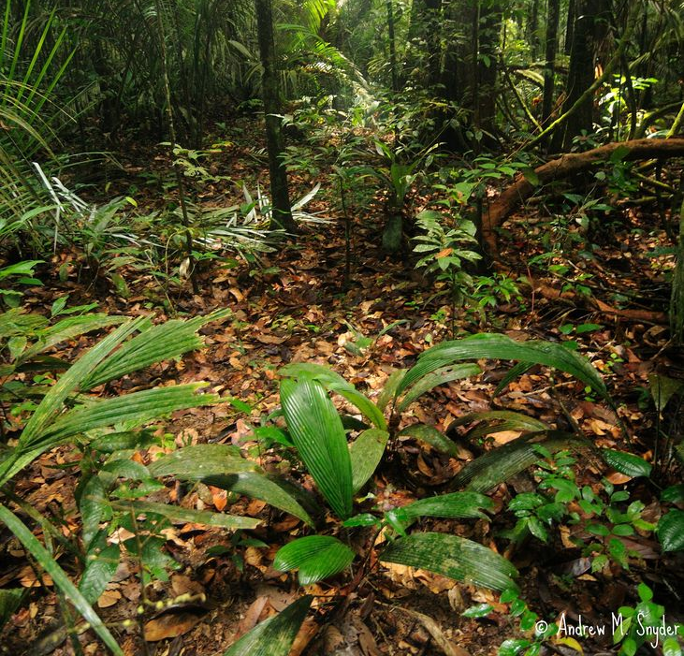
habitat
The Viro lives in a very strange place for a carnivore to live… it lives in the dark, humid underground!! It lives a good 3 metres under the surface all around the rainforest but its main body is never in the rivers of the amazon.

Slide 5
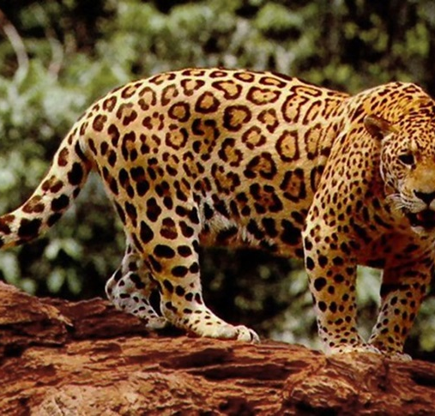
Survival
Can even survive the toughest of them all
When a person pulls out the Viro’s feeding antenna the viro quickly chops it off and it grows back in about 48 hours or so. In the meanwhile, the Viro gets food from the others via the feeding tube so it does not starve and that’s why scientists believe that this creature will not be extinct. If a viro does get pulled out [which it won’t] the whole Viro community will get pulled out therefore they will die out. There are tusk-like spikes on the viro. If an animal touches these they will instantly get paralyzed and die!

