Slide 1
Year 1 - Autumn - Block 2
Addition & Subtraction

Slide 2
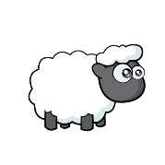
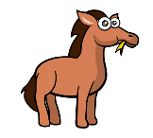
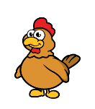
There are 6 animals.
How many different ways can you sort the animals?
Complete a part-whole model for each way.
Can you partition the animals into more than 2 groups?

Slide 3
4 is the whole.
How many different part-whole models can you draw to show this?
Use different numbers for the parts every time.
Are any the same? Why?

Slide 4
Work in groups of up to 8 children.
Can you split yourselves into different groups?
Think of different ways to group yourselves: hair colour, eye colour, gender, shoe size etc.
Complete a part-whole model for each way.
Can you partition into more than 2 groups?

Slide 5
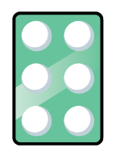
______ $+$ ______ $=$ 6
Which of the images could help to complete the number sentence?
Explain why.
Can you think of a number sentence for each of the other two images?

Slide 6
Using the numbers 0 – 9, how many ways can you fill in the boxes to make the calculation correct?
You can only use each number once.
How many different calculations are there?
What do you notice?
$$+$$
$$=$$
0
1
2
3
4
5
6
7
8
9

Slide 7
Eva has 3 number cards.
She has written two number sentences.
3 $+$ 5 $=$ 2 3 $=$ 5 $+$ 2
Explain what Eva has done wrong.
Correct her number sentences and complete the fact families.
3
5
2

Slide 8
What could the circle and the triangle be worth?
$$+$$
$=$ 4
$$+$$
$=$ 4
4 $=$
$$+$$
4 $=$
$$+$$

Slide 9
All the dots have fallen off 2 toadstools.
How many different ways can you put them back on?

Slide 10
Always, Sometimes, Never
The greater the number, the more number bonds it has.

Slide 11
Which number bond is the odd one out?
3 $+$ 4 5 $+$ 2 6 $+$ 1 3 $+$ 5
Explain your answer.

Slide 12
Jack found the following number
bonds to 8
3 $+$ 5 0 $+$ 8
1 $+$ 7 4 $+$ 4
2 $+$ 6
What order would Jack have found them in if he’d have worked systematically?

Slide 13
A butterfly’s spots have fallen off.
How many different ways can you put the spots back on?
Remember to be systematic.

Slide 14
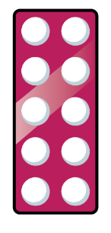
Always, Sometimes, Never
Number bonds to 10 have two different numbers added together.

Slide 15
Dora has 10 p to spend.
Which two items could she buy?
How many different ways can she do it?
5 p
6 p
4 p
5 p
6 p
4 p

Slide 16
Tommy needs to colour in all of the boxes using two different colours.
One box of each colour has been done for him.
How many different ways can he colour the boxes?

Slide 17
How many different ways can you complete the number sentence?
3 $+$ ___ $<$ 3 $+$ ___

Slide 18
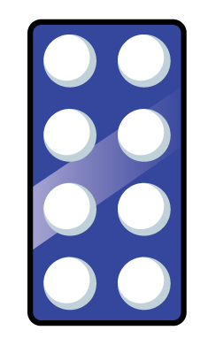
Amir and Whitney have both created their own number bonds.
Who do you agree with?
Explain your answer.
My total is greater because I have a 5 and a 3
My total is greater because I have 9 altogether.

Slide 19
Teddy has 5 counters in his hand and some in a cup.
Tommy has 3 counters in his hand and some in a cup.
They each have the same number of counters in total.
They each have less than 10 counters.
How many counters could be in Teddy’s cup?
How many counters could be in Tommy’s cup?

Slide 20
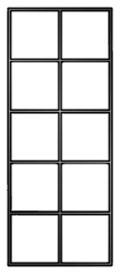
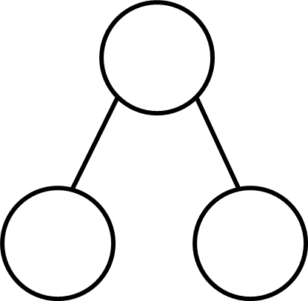
There are 8 cubes.
Some are red and some are yellow.
How many different ways can you make a total of 8?
You should show your working out on a ten frame and a part-whole model.

Slide 21
There are 9 sweets altogether.
3 have a red wrapper and 7 have a blue wrapper.
Is this correct?
Explain how you know.

Slide 22
Which sentence is correct?
A - 5 is a part, 2 is a part and 7 is the whole.
B - 4 is a part, 3 is a part and the whole is 8
C - 4 is a part, 3 is a part and 7 is the whole.
What mistakes have been made in the incorrect sentences?

Slide 23
True or False?
If I add 0 to a number, the number stays the same.
Can you use a number line or counters to help you explain your answer?

Slide 24
Mo has used the number track to complete 4 $+$ 2
He thinks the total is 5
What mistake has he made?
How could Mo use the number track to find the correct answer?
1 | 2 | 3 | 4 | 5 | 6 | 7 | 8

Slide 25
Sid has two bean bags. He is throwing them into jars.
The number on the jar shows how many points he gets for a beanbag landing in that jar.
One of his beanbags lands in jar 2
What is the highest score he can get by throwing the second bean bag and adding the scores?
What is the lowest score he can get by throwing the second beanbag and adding the scores?
Explain why he can’t get a total of 9
1
2
3
4

Slide 26
1 p
6 p
4 p
Eva spends 10p on a chocolate bar and something else. What else could she have bought? Explain how you know.
Jack spent 9p on a banana and a muffin. How much is a muffin? Explain how you know.
Rosie spent 6p on a chocolate bar and something for her brother. What did she buy for her brother? Explain how you know.
?
6 p
4 p

Slide 27
Using the digits 0 – 9, how many ways can you complete the part-whole model?
One of the parts always has to be 4
You can only use each digit once.
Explain why you can’t use 0
What other digits can’t you use and why?
4
0
1
2
3
4
5
6
7
8
9

Slide 28
Some frogs are on a lily pad. Three frogs jumped off and there are three frogs remaining.
Complete the sentences.
First there were ___ frogs. Then ___ frogs jumped off. Now there are ___ frogs on the lily pad.
In the ‘then’ picture, do the 3s show the same thing? Why not?
What if 4 jumped off, how many frogs would there have been at first?

Slide 29
Some cakes have been eaten.
There are 2 cakes left.
How many cakes could there have been, and how many could have been eaten to be left with 2?
Explain your reasons.

Slide 30
How many ways can you get an answer of 0?
What is the rule?
$$−$$
$$=$$
0

Slide 31
How many calculations can you complete?
Why can’t the digits 8 or 9 be used?
$$=$$
7
$$−$$

Slide 32
Think of two questions to ask your friend about the image.
Represent your questions and answers in a part-whole model and as a number sentence.

Slide 33
There are no more than 10 counters in total.
How many counters could be in the bag?
Why can’t it be six?

Slide 34
Explain the mistakes that have been made.
5 $+$ 2 $=$ 7 7 $=$ 5 $+$ 2
2 $+$ 5 $=$ 7 7 $=$ 2 $+$ 5
7 $−$ 2 $=$ 5 7 $=$ 5 $−$ 2
7 $−$ 5 $=$ 2 7 $=$ 2 $−$ 5

Slide 35
Amir has 5 counters in total.
Each of his counters are either
in a bag or a cup.
How many different ways could the counters be split between the bag and the cup?
Write 8 number sentences to go with each.
Are any of the sets of number sentences the same? Why?

Slide 36
Eva is calculating 7 $−$ 2 and does this by counting backwards on a number line.
She gets an answer of 6
What mistake has she made?
What should the answer be?

Slide 37
The answer is 2
How many ways can you get to this by counting backwards on this number line?

Slide 38
Game - Race to zero!
Start at 10 on a number line.
Roll a dice and subtract this amount.
The first person to land on 0 wins.
What would you like to roll? Why?
Why would you not want to roll a 1?

Slide 39
Two numbers have a difference of 4
The larger number is less than 10
What could the two numbers be?

Slide 40
Annie says,
Write a number sentence to show why Annie is correct.
The difference in number of spots on the lady birds is 7

Slide 41
True or False?
Rosie says,
Can you show this in more than one way?
The difference between 7 and 4 is 3

Slide 42
Would you rather have 6 sweets and 2 more sweets, or 8 sweets?
Explain your answer.
Use cubes or draw an image to help you.

Slide 43
Using the numbers 0 – 10, how many different ways can you complete the boxes?
___ $+$ 7 $=$ ___
___ $+$ ___ $>$ 4
___ $+$ ___ $<$ 9

Slide 44
What signs are missing?
7 $+$ 3 10
9 3 $+$ 7
9 $>$ 10 3
Explain how you know.

Slide 45
Tommy says,
Is he correct? Explain why.
5 $+$ 2 is greater than 4 $+$ 4 because 5 is greater than 4

Slide 46
Use the digit cards to complete the sentences.
___ $+$ ___ $=$ ___ $+$ ___
___ $−$ ___ $=$ ___ $−$ ___
___ $−$ ___ $>$ ___ $−$ ___
___ $−$ ___ $>$ ___ $+$ ___
Can you write any more number sentences using these cards?
2
3
4
5

