Slide 1
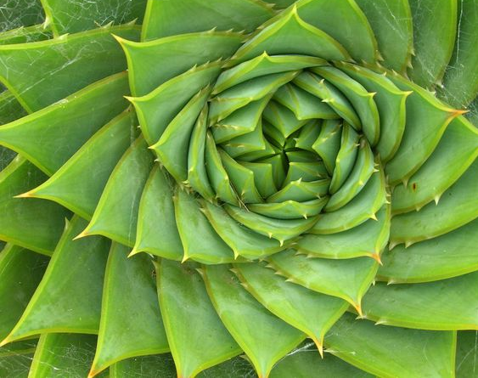
THE BENEFITS OF PLANTS!!!!!!!!!!!!!!!!!!!!!

Slide 2
Why do we need plants to live???????????
2.If they didn’t help us with carbon dioxide it would be much, much to warm for us to live on earth!!!!
1.Because they they breath out oxygen and help reduce green house gases.
3.If plants didn’t exist it would also be terrible for the animals because plants are the start of the food chain

Slide 3
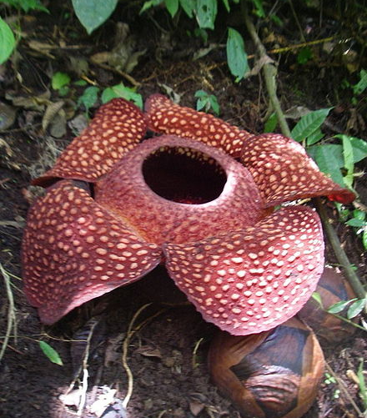
Thanks for looking at my presentation!!!

