Slide 1

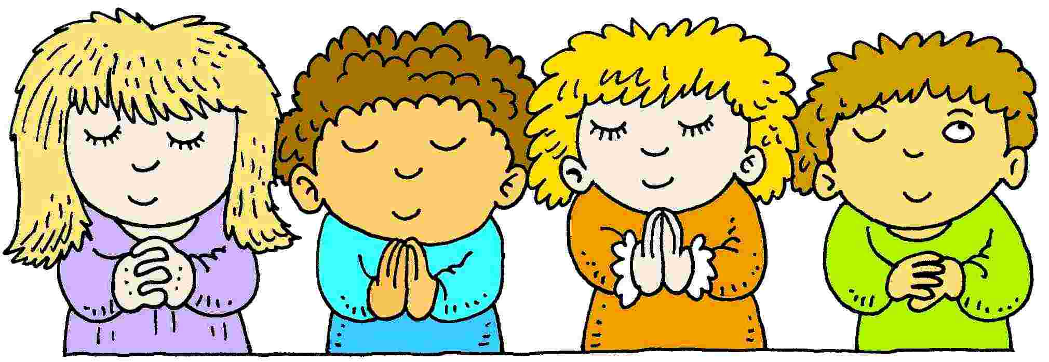
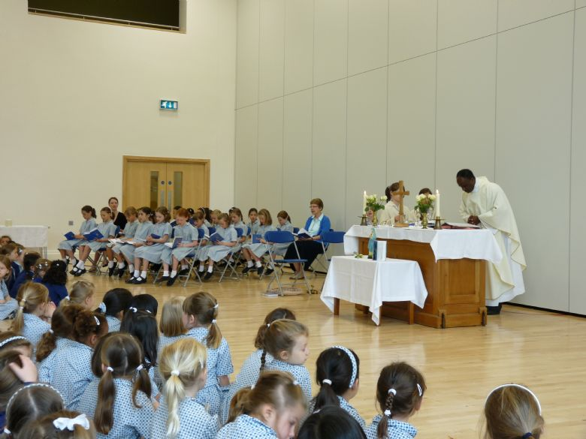
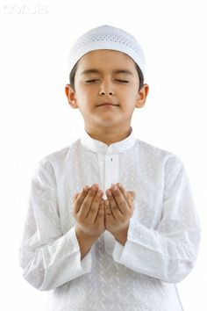
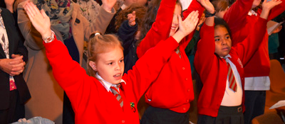
What are these children doing?

Slide 2
What do you think Prayer is?
PRAYER IS
Talking to
And
Listening to
GOD
https://www.youtube.com/watch?v=B945ocM54dA

Slide 3


What kinds of things do you think people want to talk to God about?

Slide 4
They could
Want to say thank you
Want to say what they worry about
Want to tell God they are sorry
Want to ask God to be with them
Want to praise God
Want to tell God about their day

Slide 5
Where can you pray?
ANYWHERE! but sometimes people pray
In Church
In School
With their friends
With their families
By themselves

Slide 6
In School
We invite people to pray together at special times
When do we pray in school?
What prayers do we say?

Slide 7
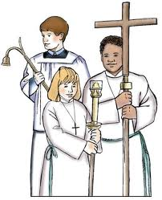
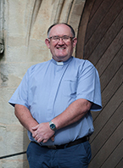
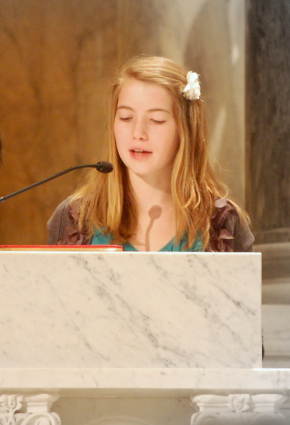
Christians go to church to pray together . In church at mass you may see the following people:
  To
A Priest
This is Fr Liam
Who is your priest?
Altar Servers
What do they do?
This Person is reading At mass.
Do you know what they are reading?

