Slide 1

“To live, love and learn like Jesus”
St Patrick’s Catholic Primary School
Year 2 Curriculum Afternoon
Thursday 26th September 2019
Mrs Robertson & Mrs Tate

Slide 2
What will we be doing this term?
SCIENCE – SOUND. Night and day-sun and moon. Electricity
ICT –Coding, e-safety,
RELIGION –Mission, vocation and ‘Missio’
Remembrance. Advent.
GEOGRAPHY –Mapping and routes. Countries in the UK. Continents and oceans.
HISTORY- man on the moon. Remembrance Day
ART /DESIGN AND TECHNOLOGY – Drawing , and painting. Cutting out shapes. Sticking.
PSHE – Class rules. ‘We are unique and special’. Gem project (Ruby and Diamond power),
Learning skills. Road and fire safety.
P.E –Multiskills and team games eg hockey. Dance.
MUSIC – Percussion instruments and rhythm. Music Week. Echo songs. Christmas music

Slide 3

Targets for this term
Maths
English
To be able to count, read, write and order numbers to 100.
To know by heart the number bonds to 10/20
Add and subtract quickly within 20
Begin to know 2, 5 and 10 times tables by heart.
Count in 3s and 4s
Doubling and halving
To use capital letters and full stops correctly.
To start sentences in different ways.
To write questions and statements accurately.
To choose vocabulary for effect.
To check sentences for sense and meaning.

Slide 4
Reading
Your child is expected to bring home their book everyday to read.
If your child has finished their reading book, they need to put their folder in the book box in class.
They will then have an opportunity to change their own books during the day.
If you notice they have brought home the wrong book, please let us know!
Please bring reading books everyday. We already have 3 adult helpers who kindly hear readers during the week. If the book does not need to be changed, children can keep it in their table drawer.
You can use the green Reading Record to note any concerns too.

Slide 5
Guided Reading: the teacher and TA each work with a group every day.
DEAR: children Drop Everything And Read!
To use a range of strategies to read new words (blending, breaking words down, picture clues, context).
To select and retrieve information (to be able to answer questions).
To be able to interpret events and information using evidence from the text (use of inference).
To give opinions about the text with reasons.
To comment on language choices, patterns in words, general features of a text, how the book is set out.
To be able to retell the story.

Slide 6
Reading: Parent Partnership
As part of your reading time, talk about the book. Ask questions to develop understanding and extract information.
Talk about new words and what they mean.
Share lots of different types of books – non-fiction, poetry and stories.
Suggestions: join/ visit the library, join book club, save for new books via the school book shop, look out for special events at the library …. Anything that encourages your child to read and makes reading fun!

Slide 7
Spellings: Parent partnership
Spellings are linked to our Phonics lessons that week or are vocabulary lists related to our topics.
Find out which of the spellings your child already knows.
One method you can use to learn new words is ‘Look, say, cover , write, check’. There is an example of a chart you can use in the pack.
Practise writing the spellings in sentences as this helps your child to transfer the knowledge into their everyday writing.
Other ideas are included in our pack.
Try and make it fun!!
We are working with the children so that they know the top 100 words, and are able to spell them. In your pack is a list of our ‘non-negotiable’ spelling words. Your help with this is invaluable!

Slide 8
Maths: Parent Partnership
Learning is a partnership and one of the ways you can help is by assisting the children to learn first of all the pairs of numbers that make 20 and possibly to make a hundred. 14,6 8,12 13,7 20,0 etc 30 +70
Telling the time is also something that you can particularly help with at home. O’clock, half past, quarter past then quarter to the hour.
We will be starting Times Tables this year-2x, 5x and 10x in year 2. (3x and 4x to follow on)

Slide 9
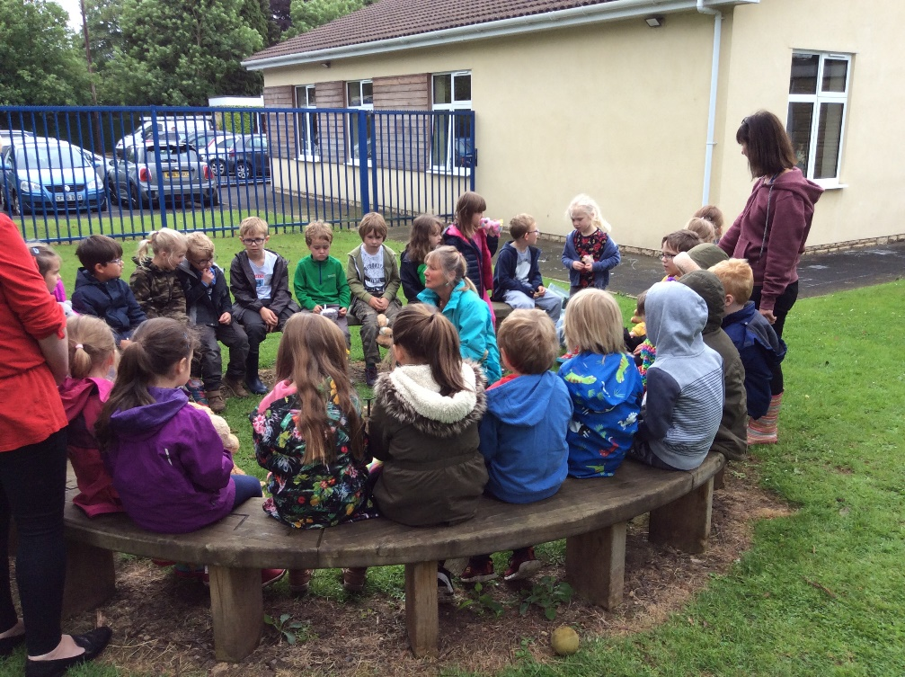
Forest Schools
Year 2 will be having forest school on a Thursday morning in the second half of the autumn term,
A Parent Mail will be sent
nearer the time.

Slide 10
Learning Gems
Ruby: Supporting each other
Diamond: Problem solving, being responsible.
Emerald: Sticking with it, even when it gets tough.
Sapphire: Keeping focused.

Slide 11

Mindfulness
Everyday, we ‘Stop and take 15’ through different activities such as mindfulness stories for relaxation, breathing exercises, colouring while listening to music and story telling to promote positive mental health and well-being.

Slide 12
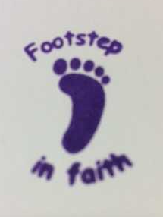
FOOTSTEPS IN FAITH CHALLENGE
Challenges to complete
In RE
In assembly, Mass, class reflection
In your homes
Around the school
5 tasks = 1 badge

Slide 13
Class rules
We made up our own class rules
1. Love one another and keep each other happy.
2. Look after our things and put them away.
3. Help each other.
4. Be kind and look after each other.
5. Walk and sit carefully. Remember to tuck in your chair.
6. Put your hand up when you want to say something.
7. Listen to everyone.
8. Remember to say 'please' and 'thank you'.
9. Look after our prayer table and show respect to God.
10. Do your best work.

Slide 14

Home Learning
We hope that you will continue to read regularly with your child and help them to learn their spellings. In addition, we will sometimes add maths activities (eg learning number bonds to 20, 2x, 5x and 10x tables), handwriting sheets or topic related activities.
We hope this will consolidate what we have been learning in school especially in reading and spelling each week – it’s definitely a partnership!
Your support and interest will help the children to embed their learning and the more practice of reading, spellings and tables that they can enjoy, the more they will learn.
The folder will be given out on a Friday, to be returned by the following Thursday when we will do our regular spelling test.

Slide 15
Enrichment
In Year 2 we like to ask children to enrich their learning by finding out extra information at home or doing a related activity to broaden their learning.
We also know that you will be greatly enriching your children’s learning experiences through family events, clubs and outings. We’d love to hear about these and hope that you will include them as enrichment activities in the Home Learning folder.

Slide 16
Key Stage 1 Testing: The National Picture
All children are tested against the new National Curriculum objectives
There will be children who will be working at the ‘Expected’ level but some will be ‘Working Towards’ that level and some ‘Exceeding’ it.
These tests will be in Reading and Maths
If your child didn’t pass the Phonics Test in Year 1, they will be tested again in June.
Writing will continue to be teacher assessed against national expectations.

Slide 17
Assessment and recording at St. Patrick’s
Children will be teacher assessed against objectives from the National Curriculum.
Within school we are continually assessing against objectives for the end of each Stage using the terminology: Working Below Expectations; Working Towards Expectations; Meeting Expectations; Exceeding Expectations.
We record assessments in order to be able to measure progress throughout the year.
We continue to collect data and share this information with you at the end of Autumn, Spring and Summer.

Slide 18
Personalised Learning
We value the starting point of each child and know that will vary.
Building foundations of knowledge, understanding and skill
Progress is individual
Each child learns and makes progress at different rates
Our aim is for children to be happy, secure and making progress.

Slide 19
ATTAINMENT: It is not expected that children will be Meeting Expectations for Year 2 until the Summer term.
PROGRESS: Regardless of starting attainment and/or Stage, all children should move from one band to the next in a whole year.
At Parent’s Evenings, pupil progress against Stage Objectives will be discussed.

Slide 20
Other Information
Daily routines
Named clothing
Water bottles
Absence
Marvellous Merits
P.E. (Currently Tuesday and Thursday)
Handwriting
Parent helpers
Speaking with Mrs Robertson/
Mrs Tate
Team teaching & Responsibilities

Slide 21

Do come and meet other parents and spend some time in the classroom with your child from 9am until 9.45 on Thursday 10th October.
We’ll be serving coffee and chocolate krispies!
(NB: Our Class Assembly is tomorrow at 2.15.)

Slide 22
If you have any queries, concerns or questions at any point during the year, please COME AND SEE US STRAIGHT AWAY!
Thank you very much for coming this afternoon.

