Slide 1
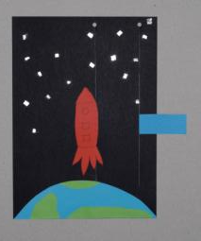
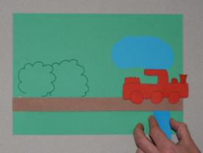
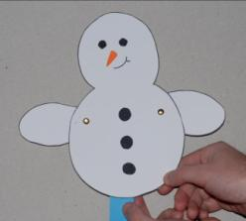
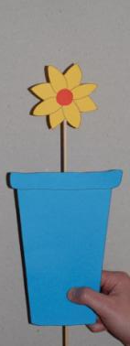
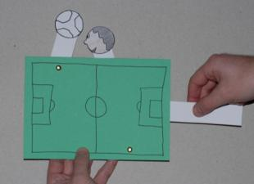
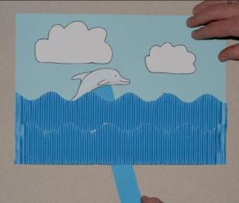
Let’s Get Practical!
Working with sliders and levers
Teachers’ version

Slide 2
Tools and materials
All of the projects can be completed with simple equipment: scissors, ruler, glue sticks, paper fasteners and masking tape. To create holes for the paper fasteners or to facilitate the cutting of slots a paper drill or hole punch is useful.
The main material is card (too thick and it will be hard to cut, too thin and it will bend rather than create movement).
Pictures can be drawn, cut out from wrapping paper or created in ICT using art programs or clip art.
Try to be resourceful and develop a sense of reducing and reusing by making some parts (the hidden sliders, for example) with old cereal boxes – saving the best for the presentation side.

Slide 3
Sliders
Using a straw and dowel

Slide 4
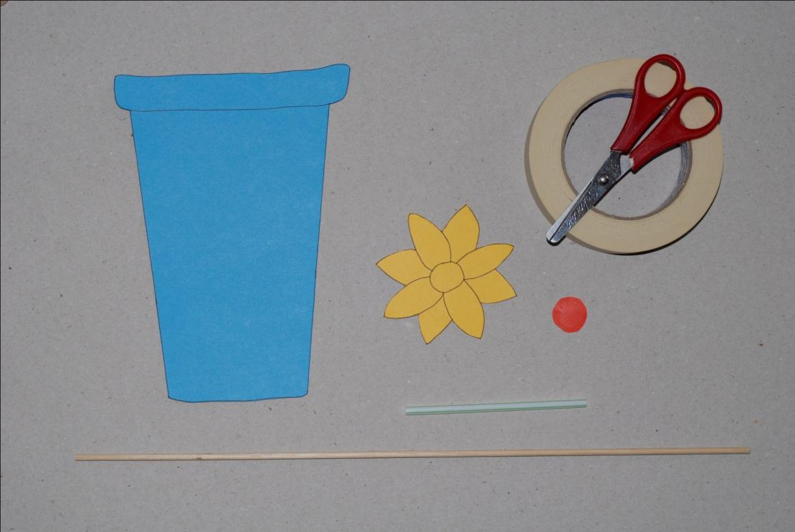
Tools and materials
Budget Busters:
Use old cereal boxes for free thin card.
Tips for Teachers:
A template is available for this flower!

Slide 5
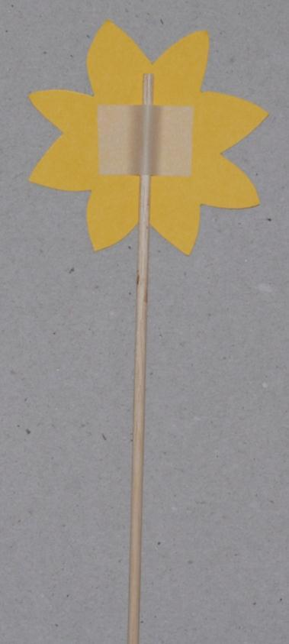
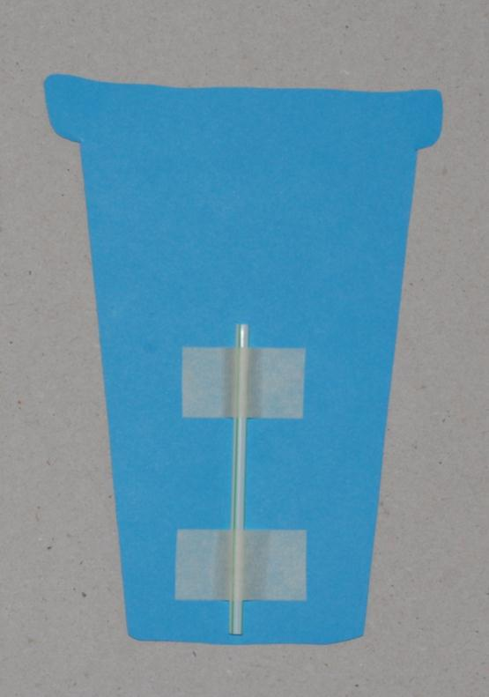
Creating the slider
Tips for Teachers:
Children find masking tape an effective and easy way to attach things.

Slide 6
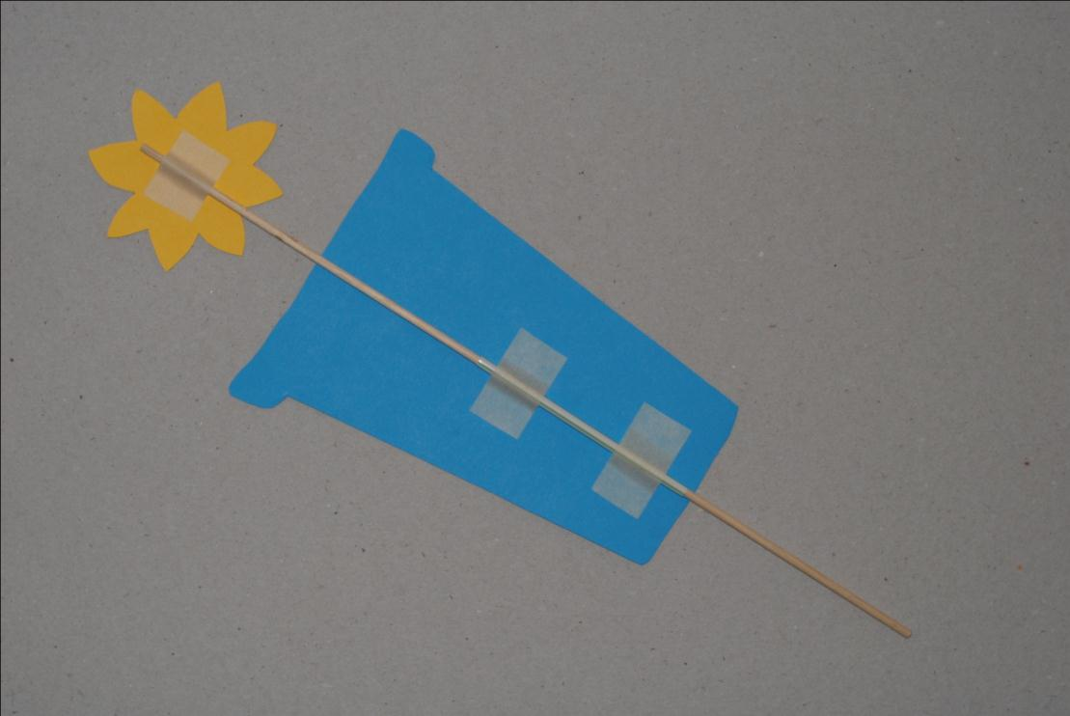
The final design (reverse)

Slide 7
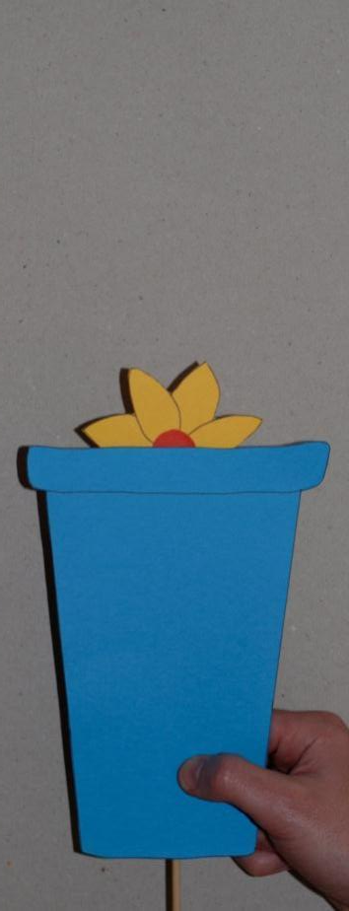
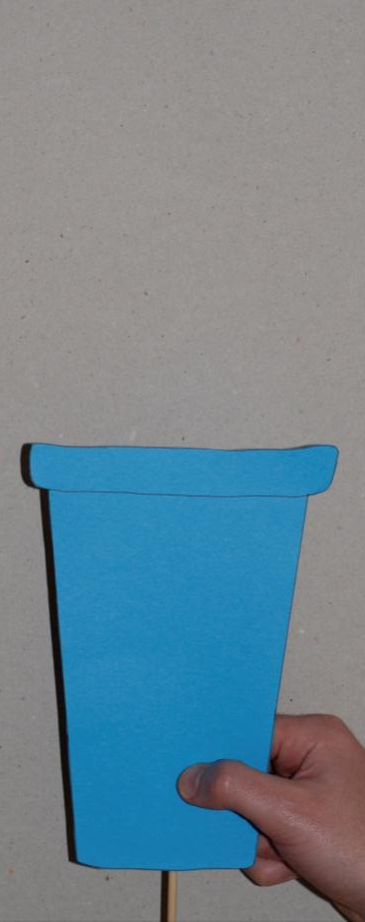
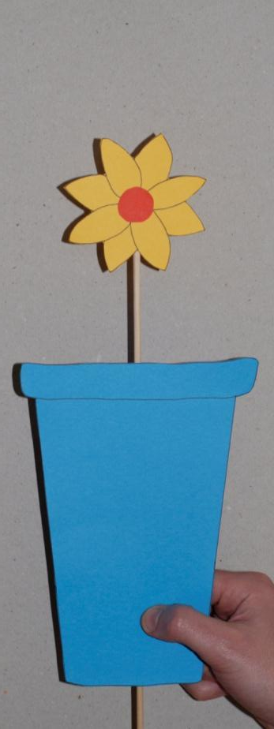
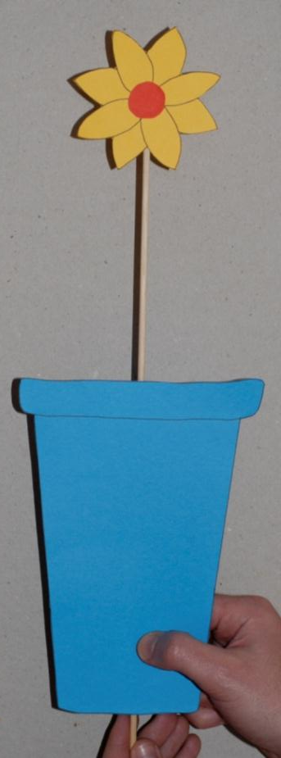
The final design in action
Inspiring Ideas:
How about a hat bobbing up and down from a head, a child on a space hopper or a person emerging from behind a wall?

Slide 8
Sliders
Cutting a slot for the slider

Slide 9
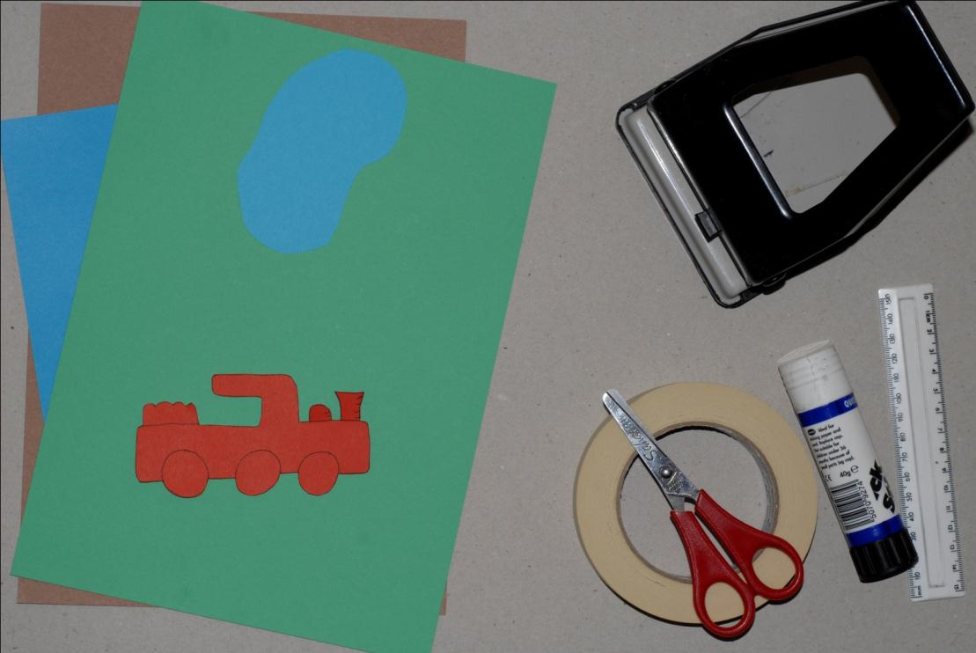
Tools and materials
Tips for Teachers:
A single hole punch may be easier to use for this project.
Tips for Teachers:
A template is available for this train!

Slide 10
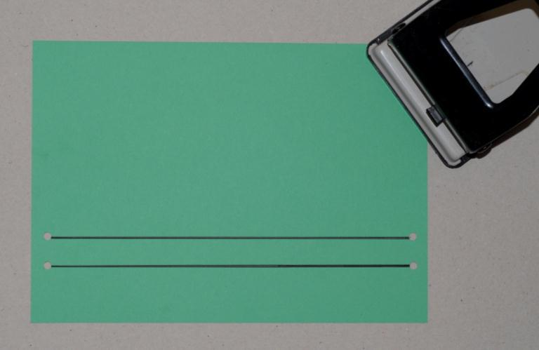
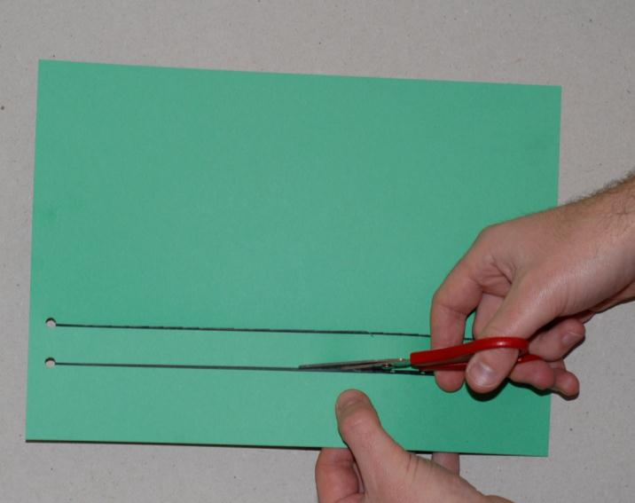
Cutting the slot
Tips for Teachers:
Punching a hole helps children to begin the cut and is much safer – they may want a practice first!

Slide 11
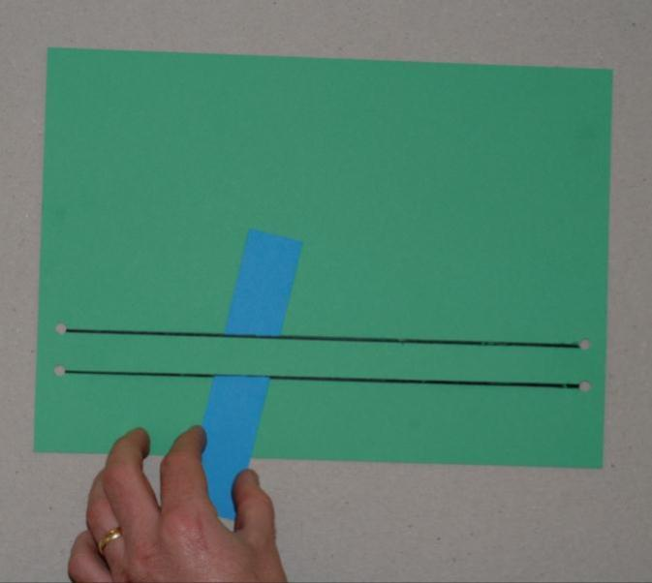
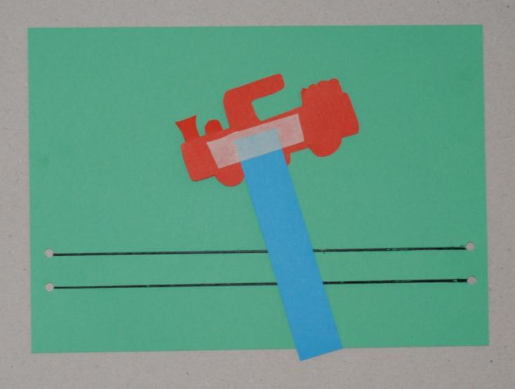
Making the slider

Slide 12
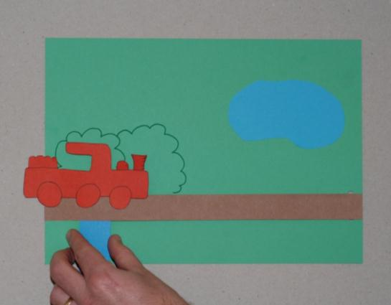
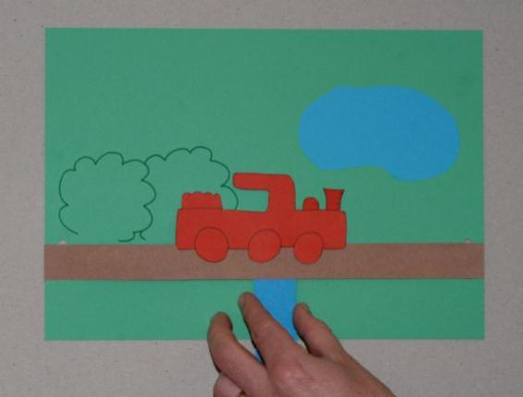
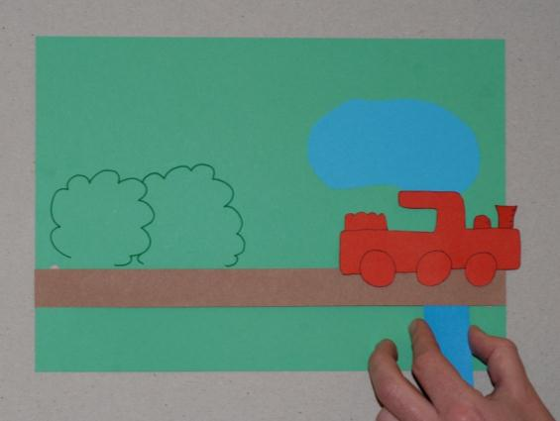
The final design in action
Tips for Teachers:
You could add a covering strip afterwards to add to the scene.

Slide 13
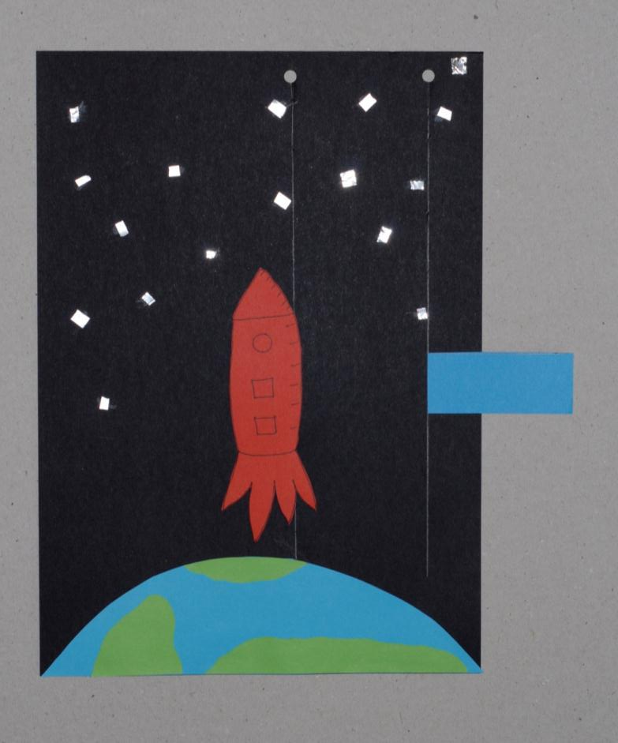
An alternative idea
Tips for Teachers:
A template is available for the rocket!
Budget Busters:
Use chopped up sweet wrappers rather than glitter or foil.
Inspiring Ideas:
How about a bus travelling along a road, a dog chasing a cat, a child running a race or a duck swimming along a stream?

Slide 14
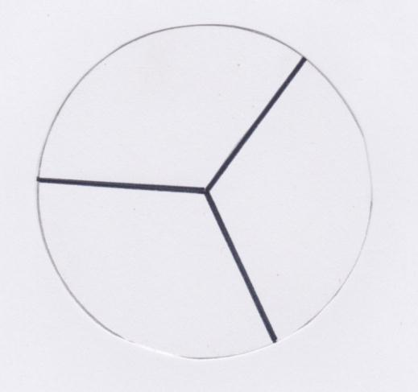
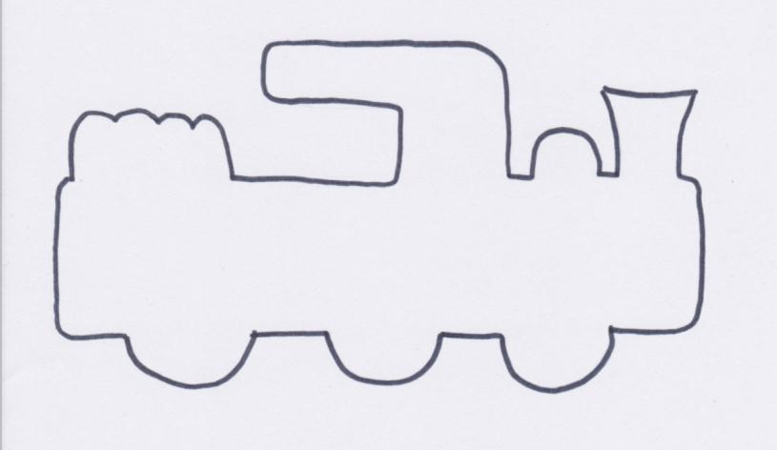
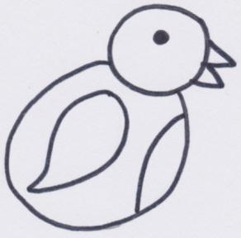

Slide 15
