Slide 1
We three kings
Powerpoint
Editition
By Alexander Early

Slide 2
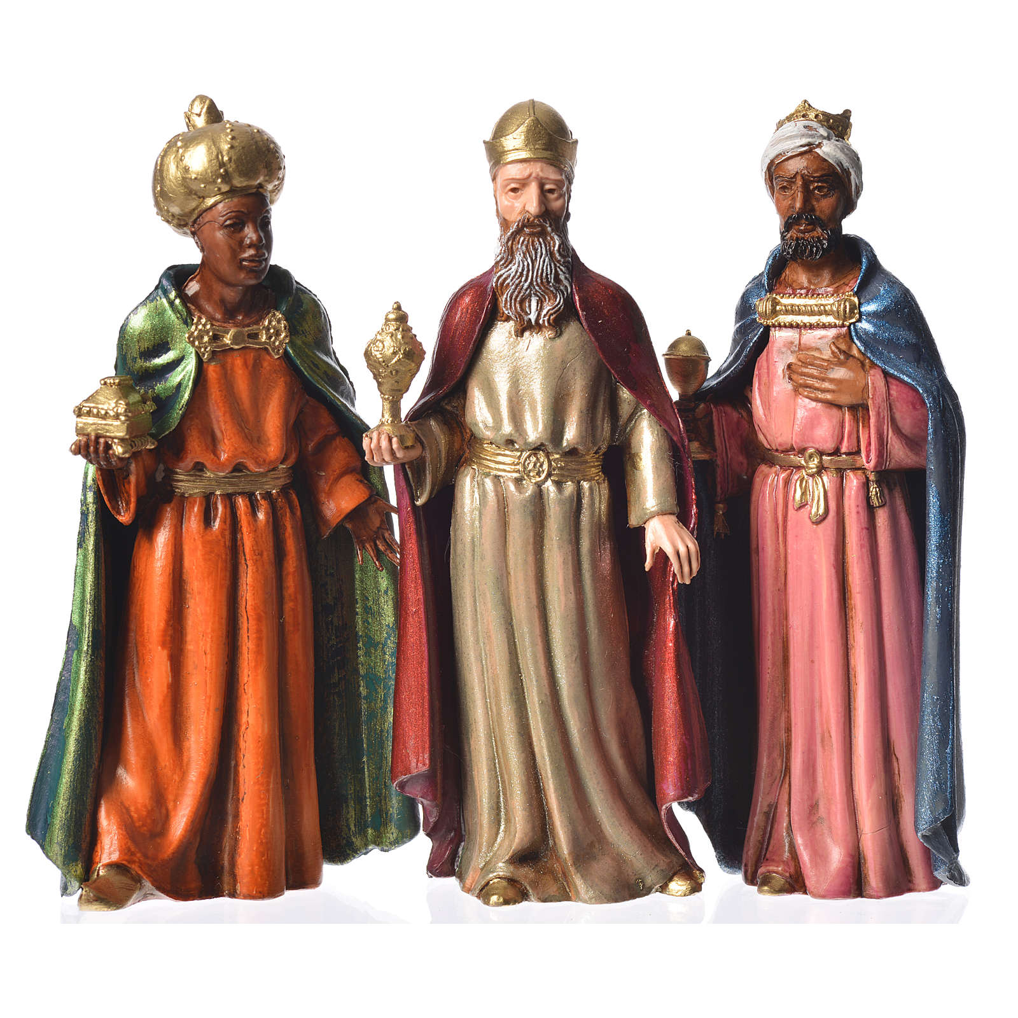
We three kings of orient are Bearing gifts we traverse afar Field and fountain Moor and mountain Following yonder star

Slide 3
O star of wonder, star of night Star with royal beauty bright Westward leading, still proceeding Guide us to thy perfect light

Slide 4
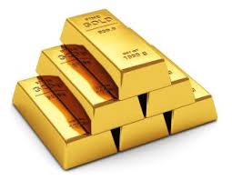
Born a King on Bethlehem's plain
Gold I bring to crown Him again
King for ever, ceasing never
Over us all to reign

Slide 5
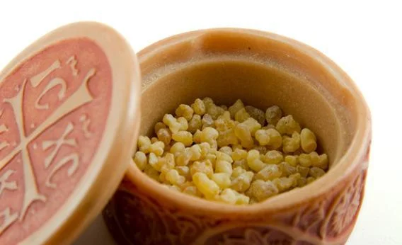
Frankincense to offer have I
Incense owns a Deity nigh
Prayer and praising
All men raising
Worship Him, God most high

Slide 6
O star of wonder, star of night Star with royal beauty bright Westward leading, still proceeding Guide us to thy perfect light

Slide 7
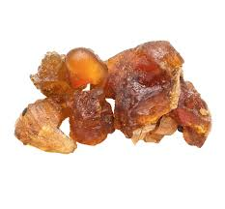
Myrrh is mine
It's bitter perfume breathes
A life of gathering gloom
Sorrowing, sighing, bleeding, dying
Sealed in the stone cold tomb

Slide 8
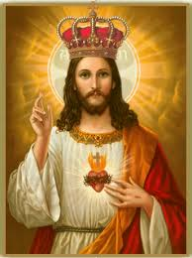
Glorious now behold Him arise King and God and Sacrifice Al-le-lu-ia, al-le-lu-ia Heaven to earth replies

Slide 9
O star of wonder, star of night Star with royal beauty bright Westward leading, still proceeding Guide us to thy perfect light

