Slide 1
Year 3 Curriculum Afternoon
Mrs OBORNE
Monday 22nd September 2025.
Welcome!
Please sign in next to your child’s name on the list as the clipboard comes around.

Slide 2

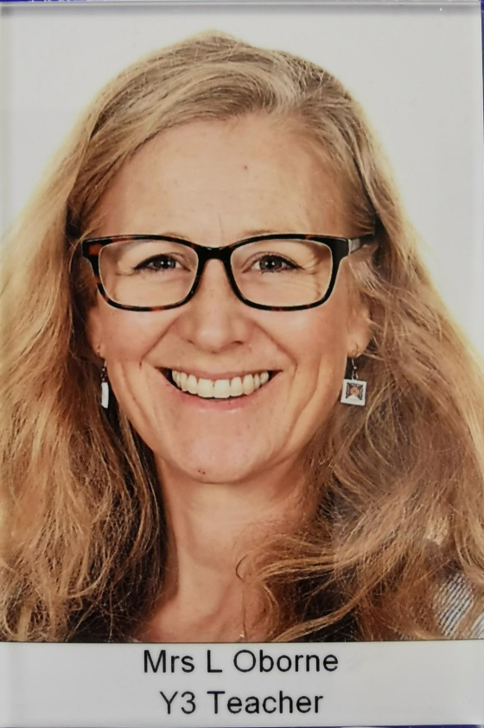
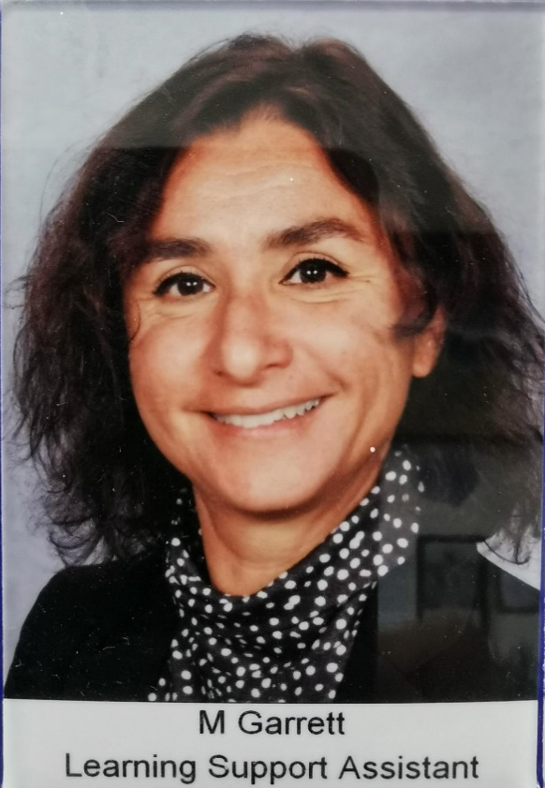
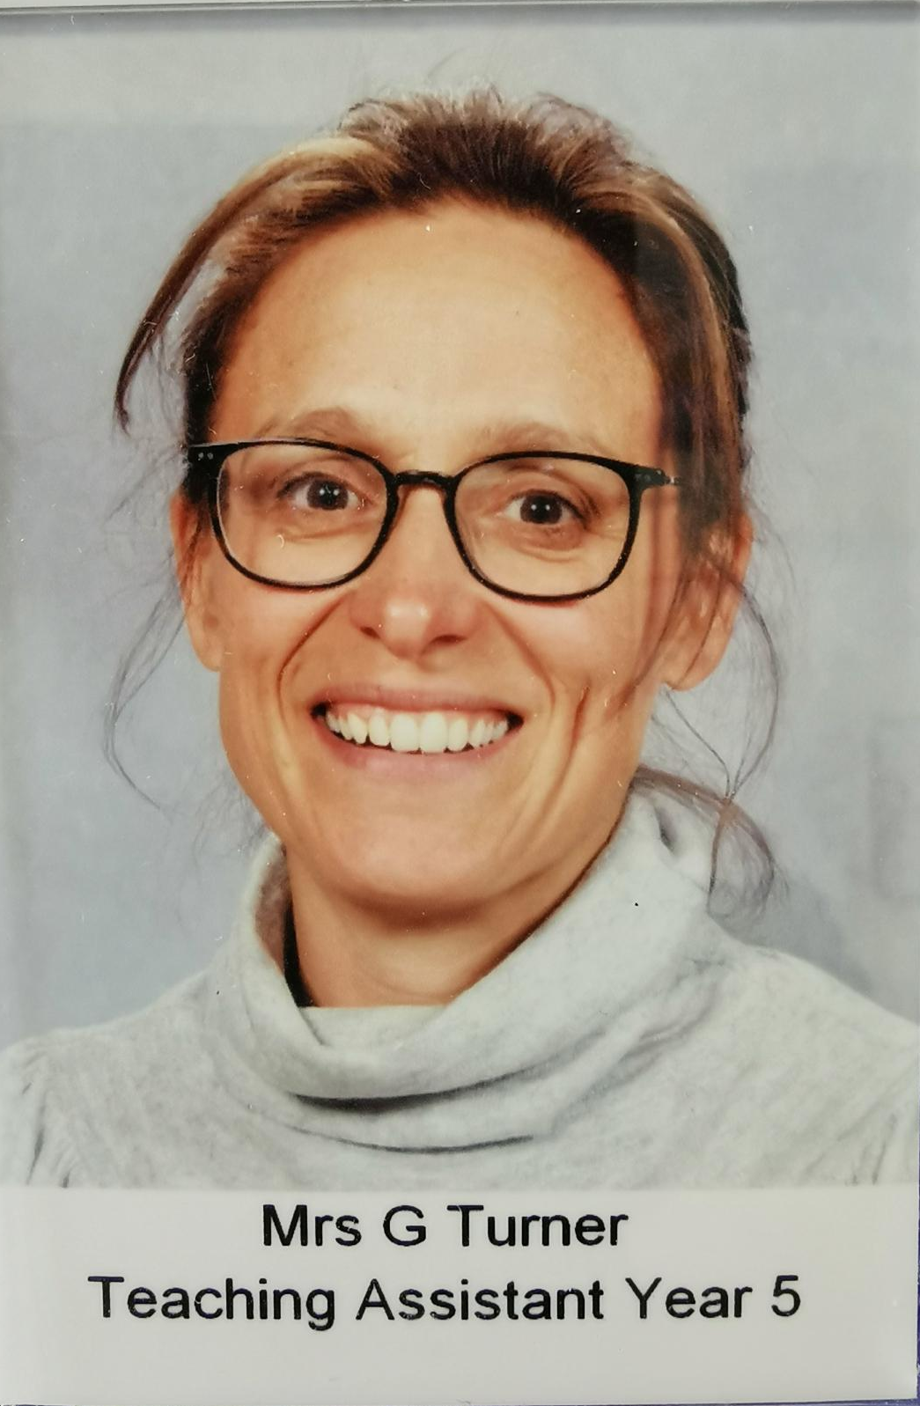
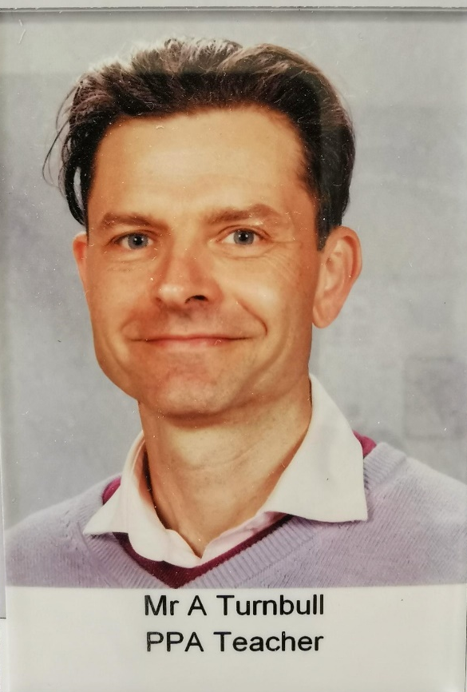
MEET THE Y3 TEAM
Monday to Friday
KS2 Gate Duty Wed 8:40am
Monday to Tuesday
Thursday 8:40am to 11:10am
Wednesday to Friday

Slide 3

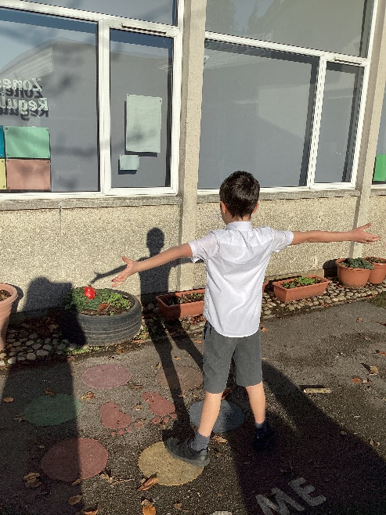
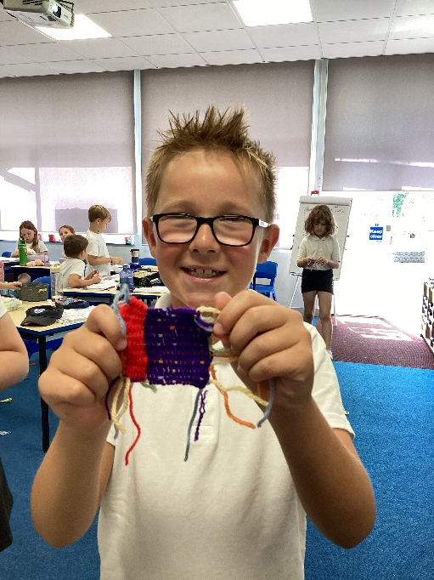
Who is Mrs Oborne?
Taught in the U.K. for 20+ years
Taught every age group, but prefer LKS2!
Curriculum Specialisms:
Maths, Reading and Writing
Science Subject Leader
Passionate about Humanities
Ukulele!

Slide 4
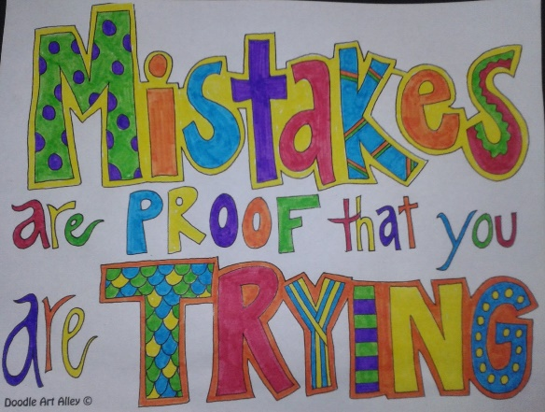
Year 3 Expectations
What makes an effective, happy learner?
Increased independence in KS2
‘Learning to learn’ (Gem Project).
Asking questions.
Listening to each other.
Class motto – “If you don’t know, have a go!”
“It’s OK to make mistakes because we are learning”
Being resilient – keep going even when things get hard
Making good choices.

Slide 5
Our Class RULES
Written by Year Three
1. Be kind, thoughtful and respectful.
2. Listen to each other.
3. Put your hand up to share thoughts and ideas.
4. Have fun and enjoy our learning.
5. Keep each other safe.
6. Respect the classroom. Keep it tidy!
7. Help each other.
8. Be healthy! Remember to drink water and have healthy snacks.

Slide 6





The GEM Project - encouraging positive learning behaviours
Ruby: Supporting each other. Listening to each other and giving praise.
Diamond: Problem solving, being responsible.
Emerald: Sticking with it, even when it gets tough. Knowing making mistakes is part of new learning.
Sapphire: Keeping focused. Ignoring distractions.
Topaz: Learning in a larger group.
Amethyst: Working with a partner.

Slide 7
Assessment and Recording
We use a variety of assessments to ensure every child makes progress on their personal
learning journey.
Within the Stage that the pupils are working on, we assess whether pupils are
Working Below Expectations, Working towards expectations, Meeting Expectations, or
Exceeding Expectations
ATTAINMENT – It is not expected that pupils will be Meeting Expectations until the summer term,
however, we will be able to report to you during the year whether or not your child is on track
to meet expectations.
PROGRESS – This looks at each individual’s starting points. We strive to ensure that each child
makes progress from their starting point over the year.

Slide 8
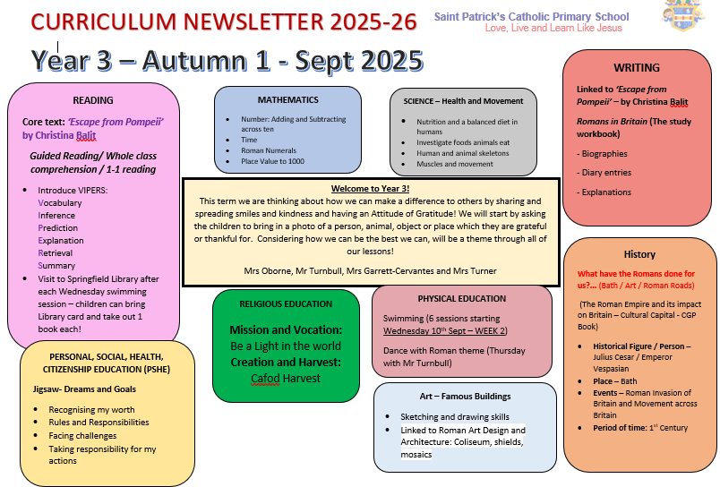

Slide 9
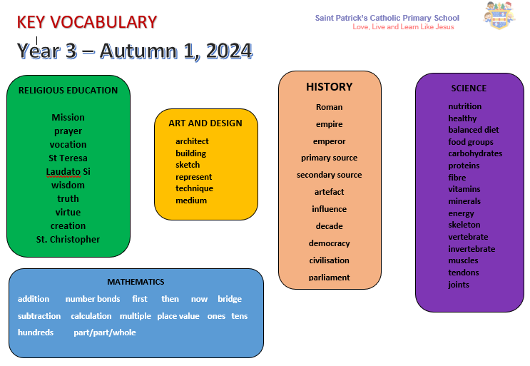

Slide 10

Mathematics
This year we will continue to develop a mastery approach to mathematics, teaching topic areas in blocks to allow depth and fluency. Pupils are encouraged to use number facts and develop their understanding by exploring numbers in lots of different contexts. We are working with numbers up to 1000. We are also teaching children more formal methods of recording.
How you can help:
It is important that pupils know ‘Key Instant Recall Facts’. Practice using calculations, counting and sequencing numbers.
Real-life opportunities for maths; telling the time, money, cooking etc.
Number bonds to 10/20/100
Times tables facts for x2, x5, x10, x3, x4, x8 (and inverse division facts)

Slide 11
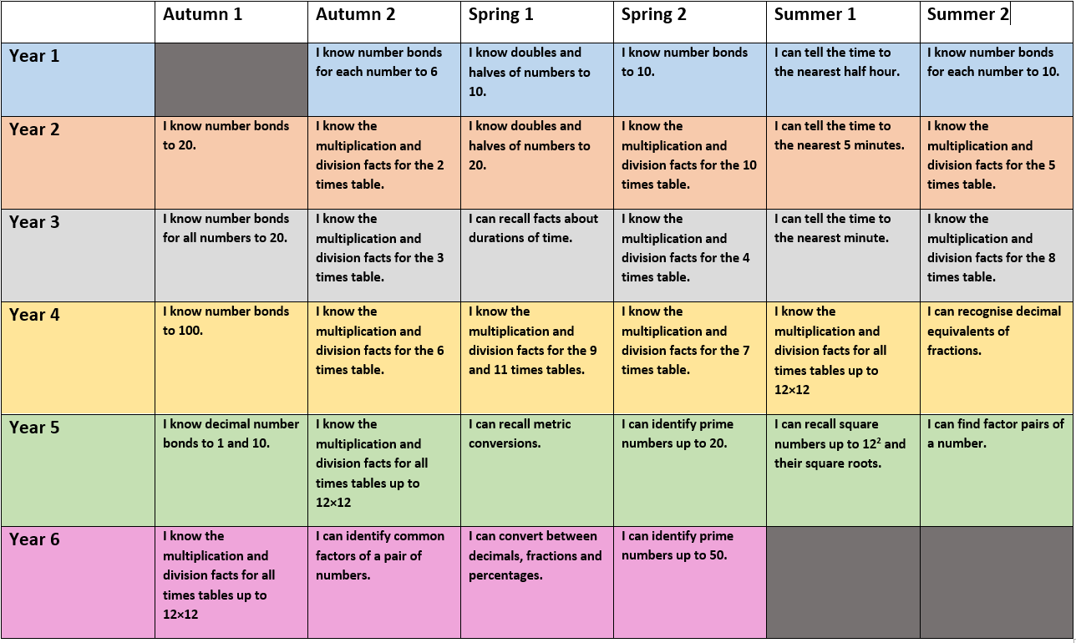
Key instant recall facts

Slide 12
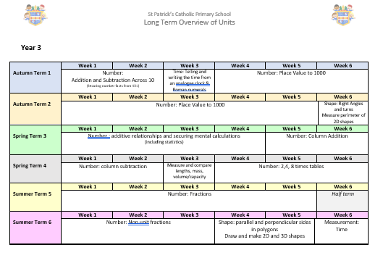

Slide 13
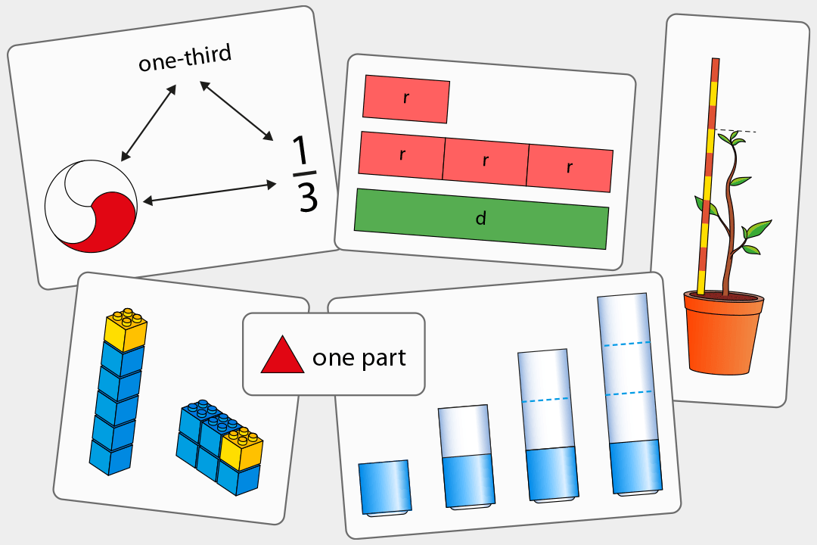
Maths
Our maths programme has been developed by NCETM
specialists and is guided by the following principles:
Coherence
Lessons are broken down into small connected steps that gradually unfold the concept, providing access for all children and leading to a generalisation of the concept and the ability to apply the concept to a range of contexts.
Representation and Structure
Representations used in lessons expose the mathematical structure being taught, We use lots of practical equipment to help to embed the understanding.

Slide 14
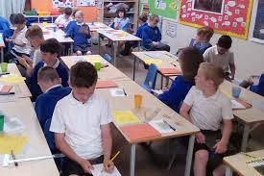
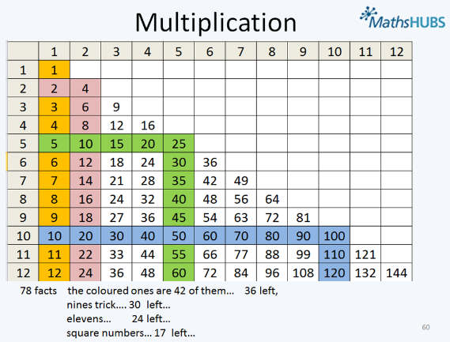
Mathematical Thinking
If taught ideas are to be understood deeply, they must not merely be passively received but must be worked on by the student: thought about, reasoned with and discussed with others
Fluency
Quick and efficient recall of facts and procedures and the flexibility to move between different contexts and representations of mathematics. This is where you can help! Make sure your children know their number bonds to ten and twenty and any times tables set by the teacher. Children will be taught key facts in daily sessions which are in addition to the maths lessons.
Variation
Variation is twofold. It is firstly about how the teacher represents the concept being taught, often in more than one way, to draw attention to critical aspects, and to develop deep and holistic understanding. It is also about the sequencing of the episodes, activities and exercises used within a lesson and follow up practice, paying attention to what is kept the same and what changes, to connect the mathematics and draw attention to mathematical relationships and structure.

Slide 15

English Skills:
Talk for writing
Writing in accurate sentences
Reading
-Decoding
-Comprehension
-Passion and enjoyment
Handwriting
-Formation
-Fluency
Spelling
- Strategies
- Phonics

Slide 16

THE IMPORTANCE OF TALKING!
Think, Pair, Share

Slide 17
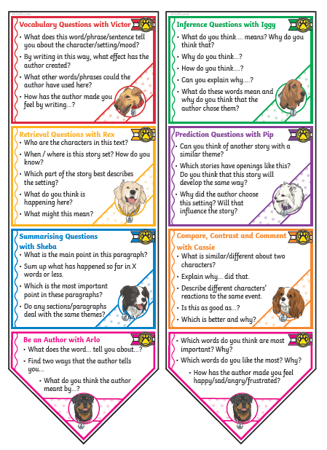
Reading
Reading In School
Reading records need to be in school each day
Children will be heard once a week in Guided Reading sessions by
the teacher. We will be working on a group text in these sessions.
There will be further opportunities throughout the week for them to be
heard by an adult.
If the child needs their book changed they need to tell an adult and
then change their book at the start of the day or during Guided
Reading.
Reading at home
Where possible, please listen to your child at least 3-4 times a week.
Please record any reading in the reading record
(children can also write in these)
Please talk to your child about what they are reading- see questions
on Reading Bookmarks
Developing a passion for reading is key!

Slide 18
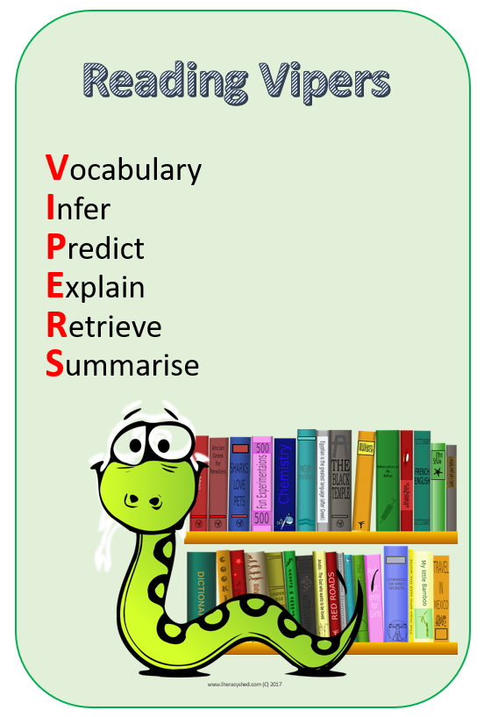
reading for meaning

Slide 19
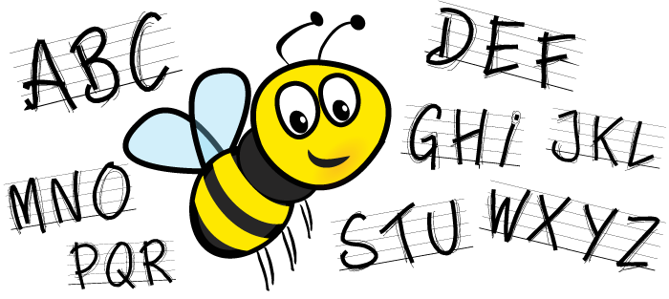
Spelling and Handwriting
Spelling and Phonics
Extra phonic support will be provided for those who need it.
- Pupils are taught a variety of ways to practice and learn spellings (see Spelling menu provided)
Weekly test will combine Y2 and then Y3 Key Words and spelling patterns taught in
class. Challenge by choice! Blue words easier, red words more challenging.
Handwriting
Pupils are working towards using a fluent joined style.
Our focus is to ensure everyone is forming letters correctly and sizing them correctly. Then we work towards joining letters, ensuring the joins are in the right place.
Please correct missing or unnecessary capital letters.
Use their Spelling Look, Cover, Write, Check sheet for practising neat, well-formed handwriting each night

Slide 20
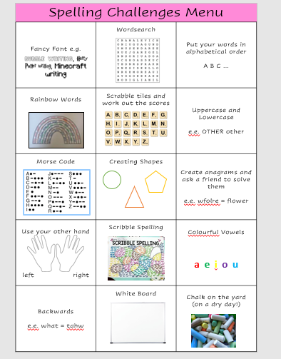
Spelling menu:
Pop on the fridge at home; there are lots of ways to help learn new spellings! Feel free to incorporate these into Spelling Home Learning if there a helpful way that your child enjoys.

Slide 21
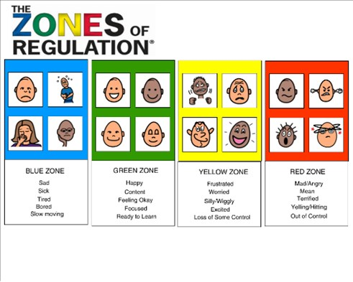

Slide 22
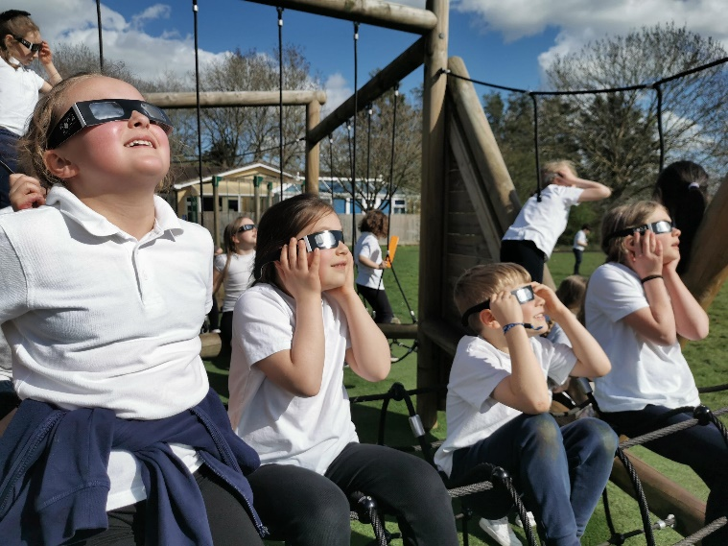
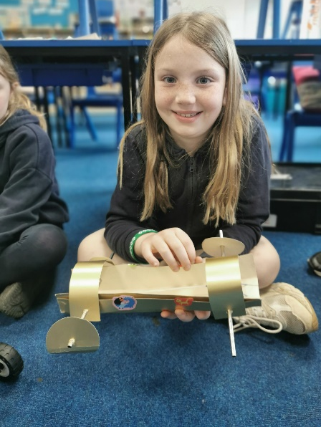
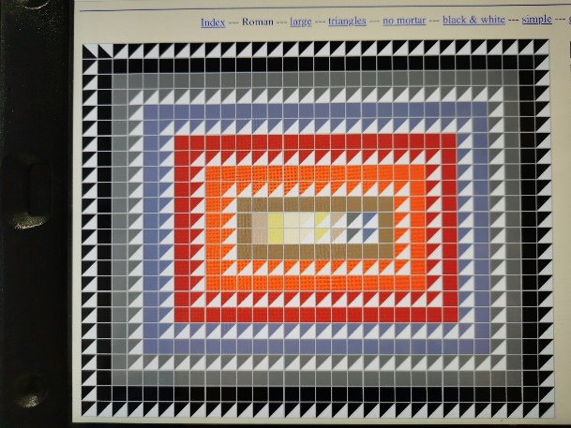
Home learning
Designed to support learning that goes on at school.
Sent home on a Friday, please return the following Friday.
Accessed through Google Classrooms- hard copies sent home if you are not yet on Google Classroom
Children will be set weekly:
1) Spelling Practice – hard copies will be sent home on a Friday.
2) Times Table or Key Instant Recall Fact Practice (if you do not know your Professor Assessor log in let us know)
3) Reading
4) Enrichment – pupils really benefit from engaging with enrichment activities. These often support our topic work and provide opportunities for research, mini projects, a game or a piece of Art.

Slide 23

Key INFORMATION
PE every Wednesday and Thursday.
Swimming every Wednesday until half term (Please wear PE kits to school)
Pupils can gain house points for their house team (House point cards).
Water bottles: Pupils are encouraged to drink water in class.
Please name all personal belongings.
If you have anything you would like to ask about, please do speak to us at the end of the day or speak to the office to arrange an appointment.
Please keep us updated if someone else is collecting your child.

Slide 24
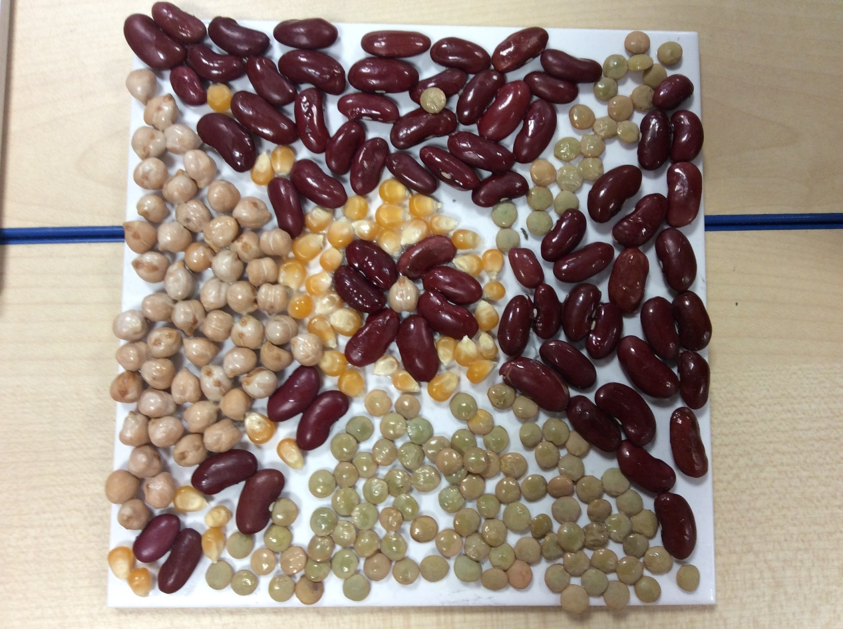
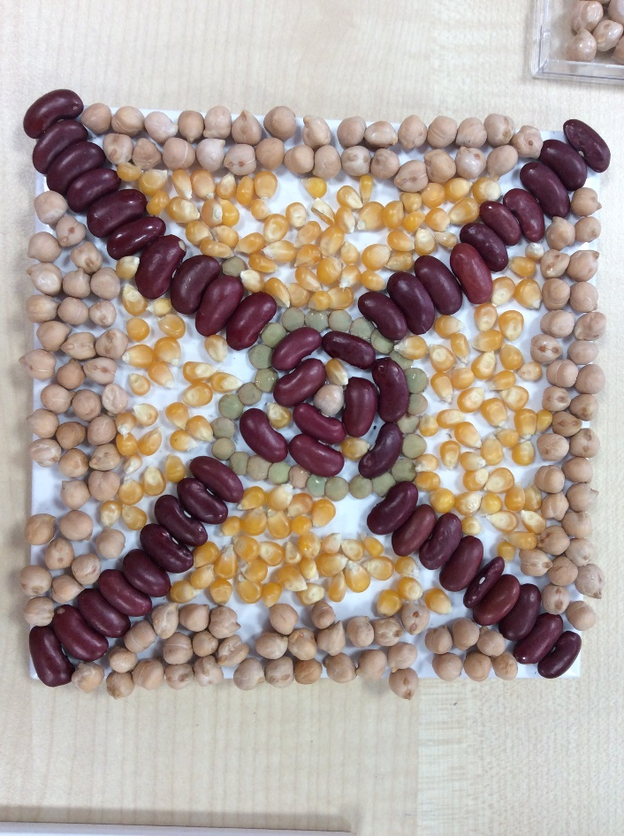
Request for c.d.cases or square tiles for roman mosaic art!

Slide 25


Thank you for coming!

