Slide 1

St Patrick’s Catholic Primary School
Meet the Teachers
Mrs Solomon and Miss Knight
Welcome to year 2
2025-2026
“Live, Love and Learn like Jesus”
Notes:
Miss Jones

Slide 2
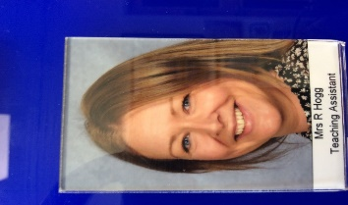
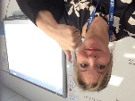
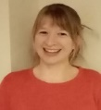
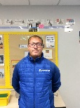
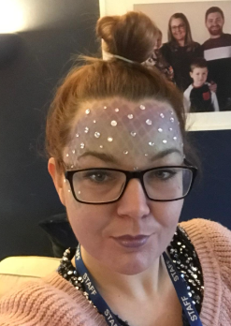
Our Wonderful Year 2 Team
Class Teacher
Mrs Solomon
Monday and Tuesday and Wednesday
Mr Cross
Tues – 1 hour and a half
Class Teacher
Miss Knight
Thursday and Friday
Miss Webb
Thursday – 1 hour
Support Staff
Mrs Hogg
Monday, Tuesday, Wednesday and Thursday
Mrs Pillinger
Wednesday, Thursday and Friday
Mrs Hogg and Mrs Pillinger
Support us throughout the week
Notes:
Mrs Solomon

Slide 3
Here is an outline of what we will be teaching in the first term:
Maths and mastery maths – Place Value, Addition and Subtraction (0-100).
English – Writing autobiographies, plotting and planning new stories.
Grammar focus: conjunctions, writing questions and exclamation sentences.
Phonics – Recap of phase 5 (practising all of the alternative sounds, segmenting and blending).
Science - Growth and Survival
Religion – Mission, Creation and Harvest as well as connecting to other faiths. Life to the Full- this will be put on Google Classroom.
History – A walk through history (History of Corsham).
Art – Self portraits with
PSHE – Gem project, Jigsaw scheme ‘Me in my world’ and creating our own missions/classroom promises, etc.
P.E – developing and applying a range of footwork and one leg balances through cooperative and competitive games. Developing Ball Skills (sending and receiving).
Notes:
Miss Knight

Slide 4

Key Stage One:
End of year expectations/ targets for Year 2
Please follow these links to learn more about the end of year expectations for English and Maths.
English - https://assets.publishing.service.gov.uk/government/uploads/system/uploads/attachment_data/file/335186/PRIMARY_national_curriculum_-_English_220714.pdf
Maths –
  https://assets.publishing.service.gov.uk/government/uploads/system/uploads/attachment_data/file/335158/PRIMARY_national_curriculum_-_Mathematics_220714.pdf
Notes:
Miss Knight

Slide 5
Assessment and Recording
We use a variety of summative and formative assessments to ensure every
child makes progress along their personal learning journey. Within the Stage that the pupils are working on we assess whether pupils are:
Working Below Expectations, Working towards expectations, Meeting Expectations & Exceeding Expectations.
ATTAINMENT – It is not expected that pupils will be Meeting Expectations until summer term,
however, we will be able to report to you during the year whether or not your child is on track to meet expectations. All children are tested against the National Curriculum objectives. These tests will be in Reading and Maths. Writing will continue to be teacher assessed against national expectations.
If your child didn’t pass the phonics test in Year 1, they will be tested again in
June (and informally at various stages during the year).
PROGRESS – This looks at each individual’s starting points.
Notes:
Miss Knight

Slide 6






Our English lessons are based on quality texts such as The Snail and the Whale by Julia Donaldson and The Koala who Could by Rachel Bright.
We start each English sequence off by starting with a hook to engage the children and then use the book to pick out key features of the text, e.g. expanded noun phrases, questions, exclamation sentences, the use of nouns, verbs, adverbs, etc so that the children can create links and see how they are used in a familiar text. We have a different writing focus each term (fiction and non fiction) and will be writing for a range of purposes – keep an eye on the website curriculum page to find out what we are covering each term.
Notes:
Mrs Solomon

Slide 7


Reading
Please use the green Reading Record to comment on your child’s reading and you could note any concerns there too.
Children who move off the phonics reading scheme will be encouraged to change their own reading book and to choose their next book within their reading level. Your child will need to let us know if they have finished their book as these may take longer to complete by the following Monday.
ENJOY lots of books. We want all children to have a passion for reading.
Your child is expected to take home their book everyday to read. Star Chart
Your child is expected to have their reading book in school every day.
Phonics books will be changed every Monday by a member of the year 2 team. Parents are encouraged to ensure that their child reads and re-reads their book to aid fluency and comprehension.
Notes:
Miss Knight

Slide 8

Guided Reading:
Mrs Solomon or Miss Knight will work with a group every day.
To use a range of strategies to read new words (blending, segmenting, picture clues, context).
To select and retrieve information (to be able to answer questions).
To be able to interpret events and information using evidence from the text (use of inference).
To give opinions about the text with reasons.
To comment on language choices, patterns in words, general features of a text, how the book is set out.
To be able to predict what might happen in a story and retell the story.
We have a range of reading opportunities to help children develop a passion for reading (library visits, end of day chapter book, guided reading and reading within English lesson as well as free time reading).
Notes:
Miss Knight

Slide 9
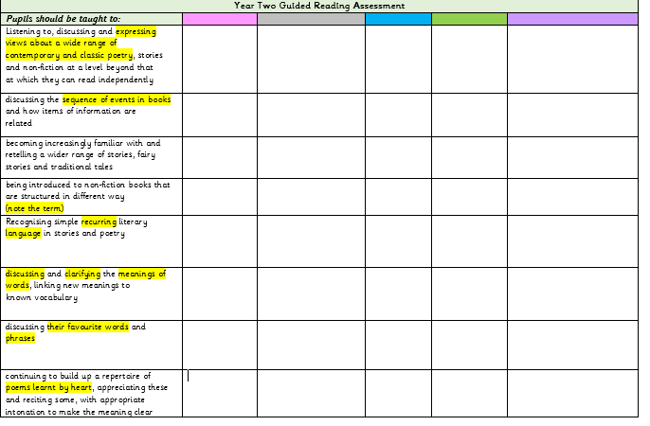
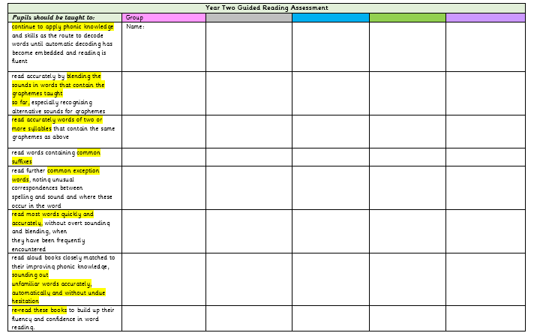
Guided Reading Assessment
Notes:
Mrs Solomon

Slide 10


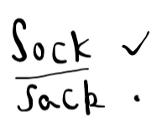
Our notes in the reading records
Notes:
Mrs Solomon

Slide 11
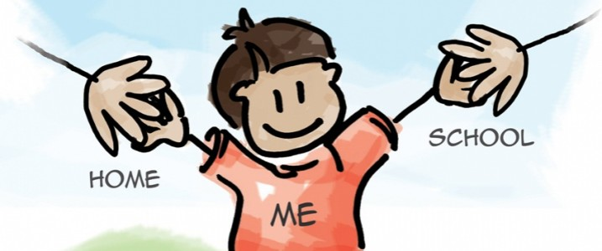
Reading: Parent Partnership
As part of your reading time, talk about the book. Ask questions to develop understanding and extract information.
Explain the importance of re-reading the story book your child has.
Talk about new words and what they mean.
Share lots of different types of books – non-fiction, poetry and stories.
Look all around for opportunities to read for information.
Join/ visit the library, look out for special events at the library ….
Do anything that encourages your child to read and makes reading fun!
Notes:
Miss Knight

Slide 12
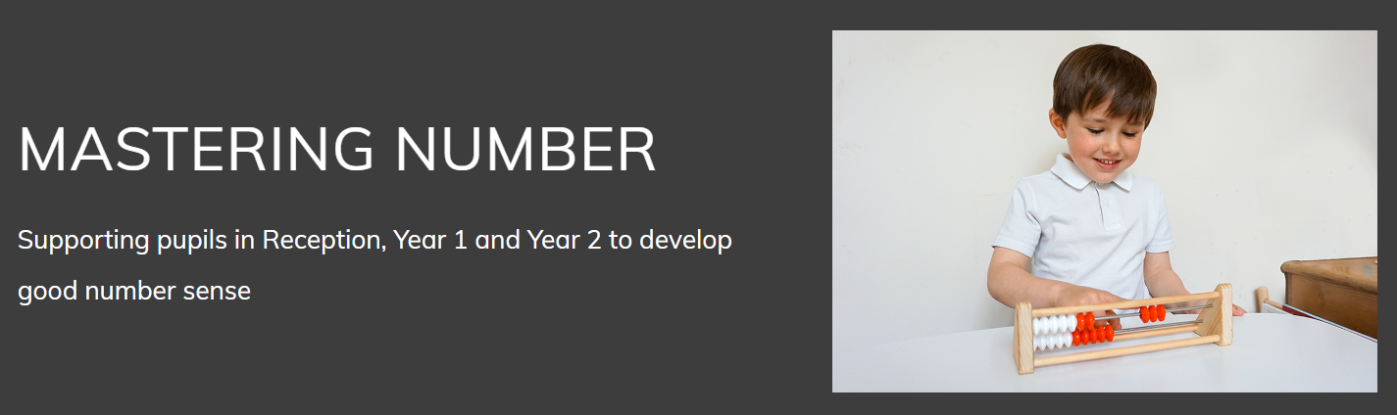
This project aims to secure firm foundations in the development of good number sense for all children from Reception through to Year 1 and Year 2. The aim over time is that children will leave KS1 with fluency in calculation and a confidence and flexibility with number. Attention will be given to key knowledge and understanding needed in Reception classes, and progression through KS1 to support success in the future.
Notes:
Mrs Solomon

Slide 13

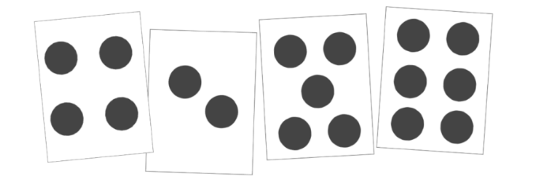
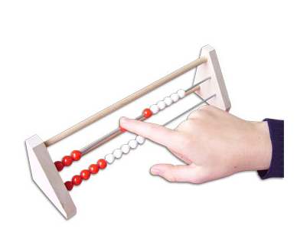
Mastering Number
Just as we have stand alone daily Phonics sessions we also have a daily Mastering Number Session.
This is a new daily scheme taken from The National Centre For Excellence In The Teaching OF Mathematics. It aims to give the children a solid ‘number sense’
By this we mean being able to visualise numbers better, being able to ‘Subitise’
To subitise is to identify the number of things in a set simply by quickly looking at them—not by counting them one by one.
E.g.
Two!
Simply put, subitizing is the ability to recognize a small group of objects without counting. It is a fundamental skill in the development of number sense.
Rekenreks
Notes:
Mrs Solomon

Slide 14
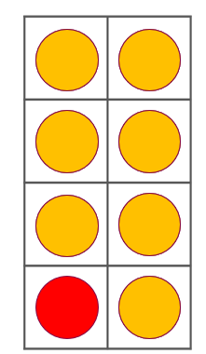
8 is made of _____ and _____ ;
_____ and _____ make 8.
Mastering Number 2021/22 ncetm.org.uk

Slide 15
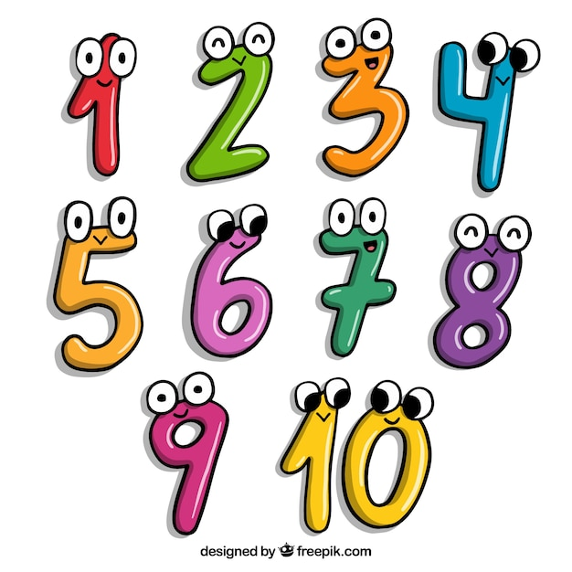
Maths: Parent Partnership
Learning is a partnership and one of the great ways you can help is by assisting the children to learn first of all the pairs of numbers that make 20 and possibly to make a hundred. 14,6 8,12 13,7 >>>>> 30 +70 35 and 65
Telling the time is also something that you can particularly help with at home. O’clock, half past, quarter past then quarter to the hour. You will need an analogue clock!
We will be starting Times Tables this year-2x, 5x and 10x in Year 2 (3x and 4x to follow on).
Notes:
Mrs Solomon

Slide 16

Spellings: Parent partnership
Spellings are linked to our Phonics lessons or they are from vocabulary lists related to our topics.
Find out which of the spellings your child already knows.
Practise writing the spellings in sentences as this helps your child to transfer the knowledge into their everyday writing.
We are working with the children so that they know the top Solity 60 words (see handout)
Thank you!
Notes:
Mrs Solomon

Slide 17


Home Learning
We hope that you will continue to read regularly with your child and help them to learn their spellings. In addition, we will sometimes add maths activities (eg learning number bonds to 20, 2x, 5x and 10x tables (later in the year) on Professor Assessor), handwriting sheets or topic related activities.
We hope this will consolidate what we have been learning in school especially in reading and spelling each week – it’s definitely a partnership!
Your support and interest will help the children to embed their learning and the more practice of reading, spellings and tables that they can enjoy, the more they will learn.
The work will be given out/put on Google Classrooms on a Wednesday, to be returned by the following Wednesday when we will do our regular spelling test.
Notes:
Mrs Solomon

Slide 18
Other Information
Named clothing
Absence
Marvellous Marbles
Handwriting
Communicating with Mrs Solomon/ Miss Knight
Regular hand washing and/or sanitising.
We are teaching the children good hygiene routines (such as catch it, bin it, kill it, hand washing after sneezing, coughing into elbows etc).
PE kits to be worn on Tuesday and Thursday.
Please remember water bottles and to label them.
Notes:
Miss Knight

Slide 19

If you have any questions or concerns at any point during the year, please CONTACT US STRAIGHT AWAY!
Thank you very much for joining us ☺
Notes:
Miss Knight

