Slide 1

Saint Patrick’s
Catholic Primary School
‘Our children have really enjoyed the enrichment opportunities, particularly the visits to Parliament and the Kilve Court and PGL residentials for Y5 last year and Y6 this year respectively. Other real highlights for us and our children have been the KS2 'Prince of Peace' performance and the KS1 nativity, which were so full of joy and energy. Our children really enjoy being a part of the chaplaincy team and we love that the school encourages them to be agents of change - writing to the Prime Minister, acts of kindness etc. The Catholic ethos of the school supports and reflects our family values well’ (Parent Survey 2024)
‘’Pupils’ behaviour is exemplary in the classroom and within prayer and liturgy. Pupils show a clear respect for each other and adults through the way they treat people with openness and friendship, hold doors open for others and speak with respect and politeness.’
(Sect. 48 Inspection May 2025)
‘Pupils are proud to attend St Patrick’s Catholic Primary School’ (OFSTED 2022)
‘Live Love and Learn Like Jesus’

Slide 2

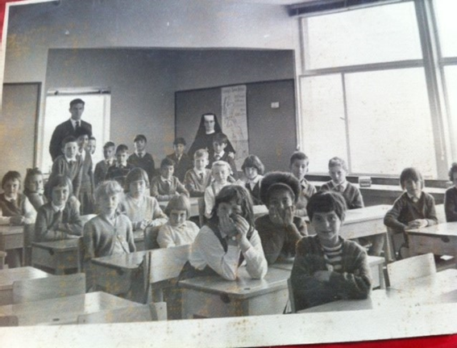
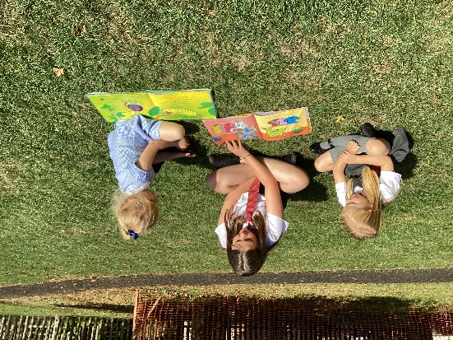
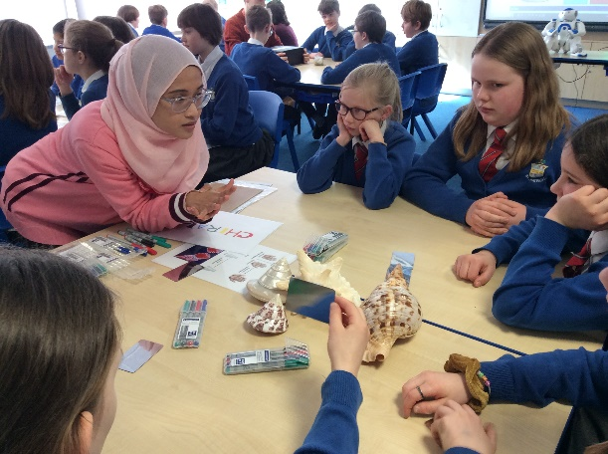
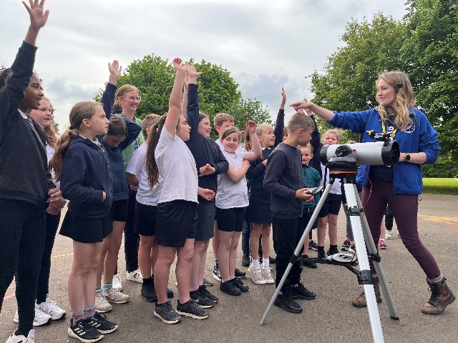


WHO ARE WE?
Opened in 1966 to serve the Catholic families of Corsham and Melksham parishes, and outlying villages.
We are part of the Corsham Hub of local LA schools.
We are part of the ‘Camino Partnership’ of local Catholic schools in the Clifton Diocese.

Slide 3
STANDARDS
We work collaboratively with other schools in the clusters e.g. planning and moderation.
School focus on growing pupils – and growing staff.
SEN and vulnerable support identified as pro-active and supportive.
Early Years provision recognised as dynamic and engaging.
Parents as Partners in Learning and Wellbeing.
Learners perform very well in statutory tests across the school, in comparison with national and local results
‘Staff are ambitious for all pupils, including pupils with special educational needs and/or disabilities (SEND).’
‘Pupils enjoy learning and want to do well’
(Ofsted 2022)
‘Pupils are able to make strong links between the school’s values, Catholic social teaching
and their own lives, due to their high level of understanding.’
(Sect. 48 Inspection 2025)

Slide 4
WHAT OUR PARENTS THINK…
Staff have high expectations of children. Extra thought is clearly put into making the school a place where children feel enthusiastic about learning.
We love the compassionate and passionate care the St Patricks provides our son. He is able to thrive in school due to a wonderful plethora of staff members who encourage and nurture.
“Each child is known as an individual with their individual needs catered for.”
Enrichment is a real strength of the school and it has been lovely to see some of these elements that make the school unique, return again. Our children particularly enjoyed 'Big Me Week' and 'Wish You Were Here' Day and it was clear that the staff had gone above and beyond to make these memorable experiences for the children.

Slide 5
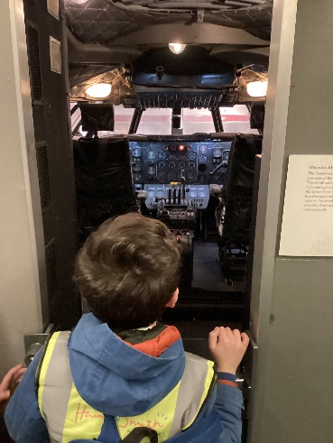
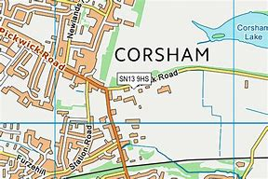
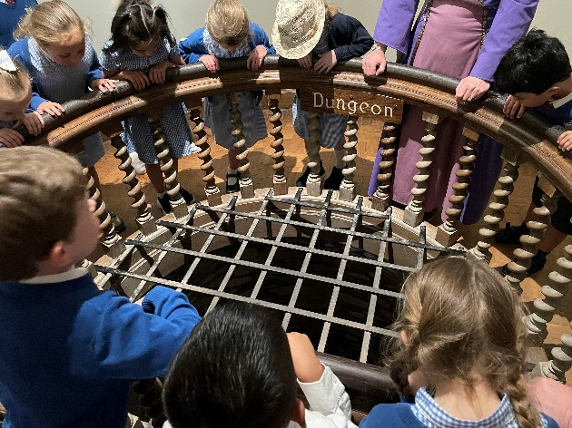
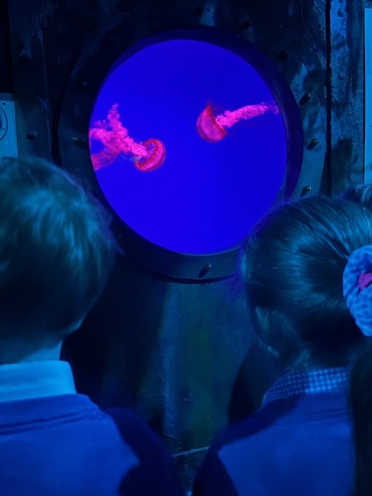
A CURRICULUM OF EXPERIENCES
Big Me (Careers) Week
Links to Colchester Zoo
Annual Art, Music, STEM, Maths, Anti Bullying Weeks
‘Wish You Were Here’ day
Sports enrichment – fencing / ballroom dancing / skipping days / orienteering / Paralympics sports day / climbing wall / archery
Agents of Change: Laudato Si, Laudate Deum – Pilgrimage
Music lessons
‘Cultural capital’ – School visits

Slide 6

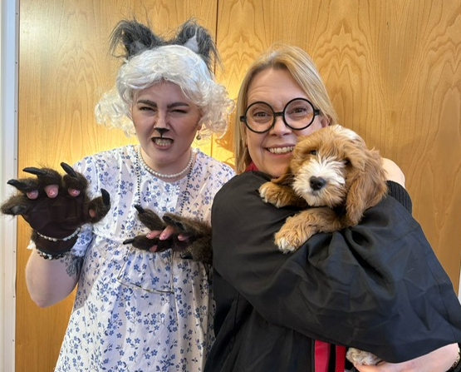
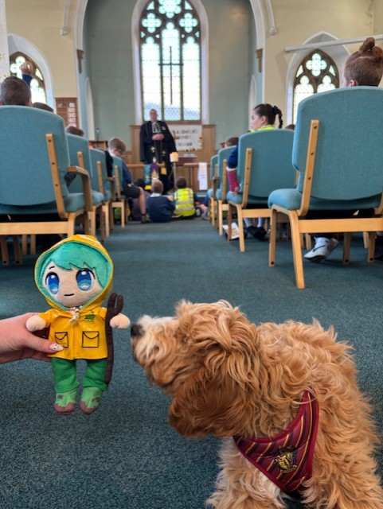
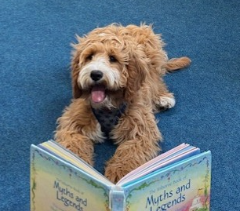
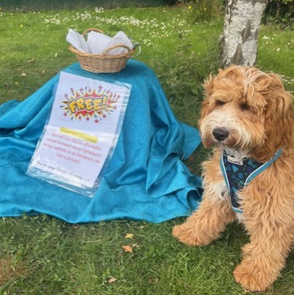
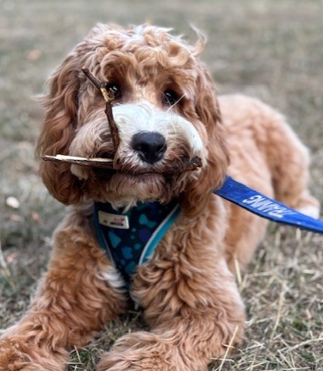
A NEW ARRIVAL IN 2025
We welcomed a new member of staff in 2025…Teddy!
Teddy is part of our wellbeing team at school. He is a Pawamedic (therapy dog) who brings joy, reduces stress, and boosts emotional wellbeing for children, staff and parents
He’s a ‘Dogs for Health’ Dog and is trained and fully supervised at all times
We have clear rules for how children can interact with him safely
Teddy helps our children learn the importance of emotional wellness, building confidence, and strengthening connections with their peers
Teddy visits classes and attends events, but children also visit Teddy to celebrate great learning!

Slide 7

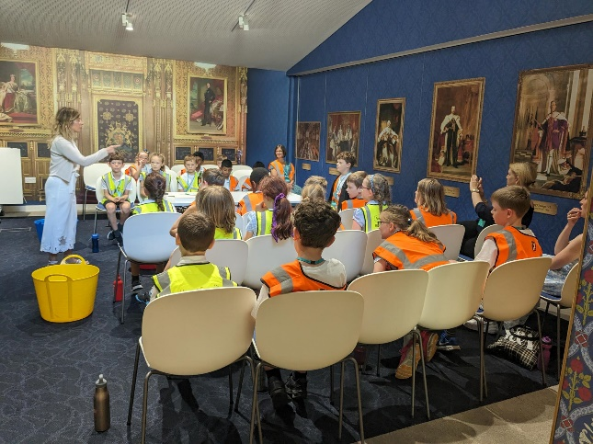
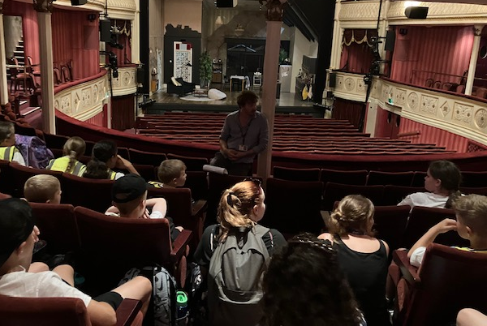
THIS YEAR….
Attitude of Gratitude – Community
Art week/ Music week / Maths Project – Cost of Living
Global Awareness / Agents of Change
Extra Sport provision (Up and Under/ Chance to Shine Cricket)
Cultural Capital –Cultures and Heritage of local and wider area
Parish / Community support projects
Community Safety – PC Redmond
Anti Bullying
Celebrating our Cultural Heritage / Black History
Trips and Residentials

Slide 8
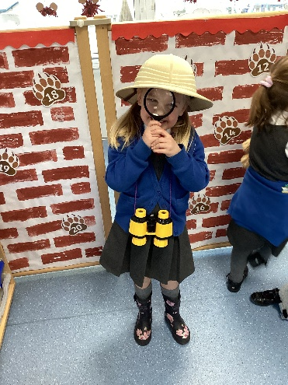
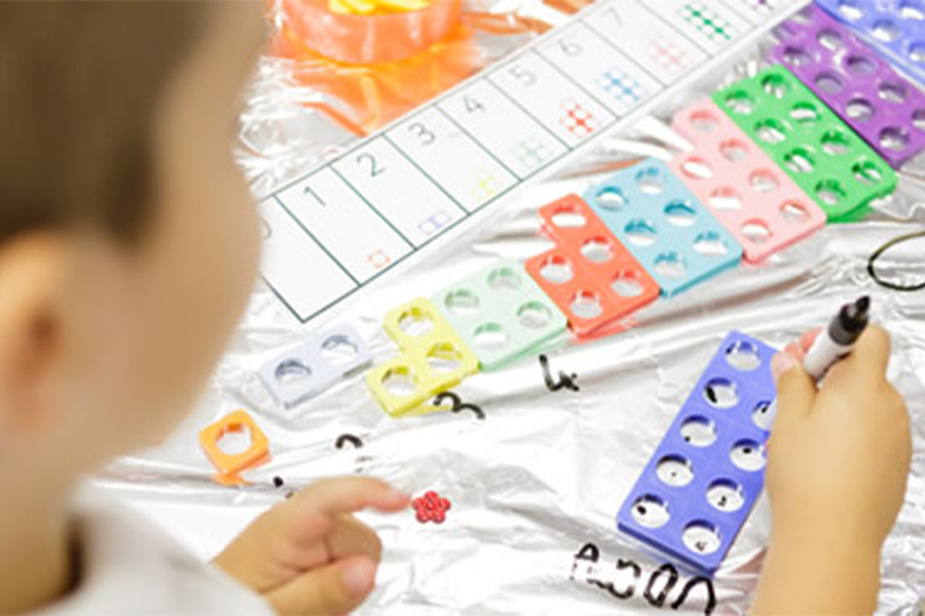
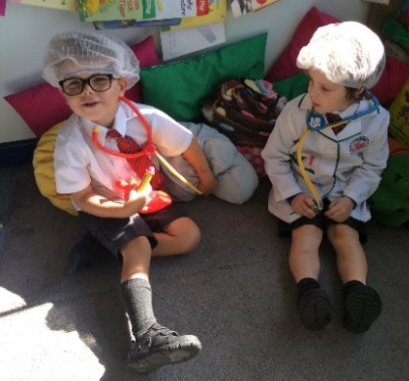
A FIRM FOUNDATION
All further learning in school are built on from the Foundation Stage curriculum
Establishing routines – social and emotional. Resilience.
Reading regularly and for enjoyment
The importance of talk – children who are ready to read and discuss their ‘reading’ are greatly advantaged in all areas of the curriculum
Number - the first few years of a child’s life are especially important for mathematics development.
PLAY
Legacy of COVID disruption - wellbeing
Children learn and develop more from birth to five years old than at any other time in their lives. If children are at risk of falling behind the majority, the best time to help them to catch up and keep up is in the early years. Every child can make progress, if they are given the right support.
When we give every child the best start in their early years, we give them what they need today. We also set them up with every chance of success tomorrow.
Development Matters 2023

Slide 9

WHAT ABOUT….?
After School Provision – Meerkatz breakfast and after school club
Lunches – cooked on site. Free to all pupils in Key Stage 1
Class sizes and staff – 30 pupils max. in each Key Stage 1 class. Learning Support Assistants. Staff committed to the school
Achievement – balance of support and challenge for all pupils Safeguarding – see policies on website
Meeting Specific Needs – work in partnership with pre-school provider and parents to ensure suitability of provision. Identify individual needs and starting points
Home / School Communication – Parents as Partners…

Slide 10
OUR CATHOLIC SCHOOL –
All Are Welcome in this Place
19% Catholic families
Christian and other world faiths or NO faith background
Ethos: Gospel Values = British Values
Worship and Spirituality
Other World Religions
Supporting Local Community e.g. Foodbank
Admission policy (*supplementary form)
We welcome children and families from Christian or other faith backgrounds, or no faith background, to join our happy, thriving school community.
Our Christian ethos permeates all elements of school life.
‘Pupils’ behaviour is exemplary in the classroom and within prayer and liturgy. Pupils show a clear respect for each other and adults through the way they treat people with openness and friendship, hold doors open for others and speak with respect and politeness.’
(Section 48, May 2025)

Slide 11

NEXT STEPS…
Look around our school and get a feel for what we are about. Feel free to make further contact with us if you wish.
Look around other local schools – see how they do things. Think about your child and what / where would suit them.
Applications to be in to Wiltshire Local Authority by 15th January 2026
If your child is Catholic, you must provide a copy of the Baptism certificate to the school by this date. Don’t be put off by criteria list!
Prepare yourself and your child to start school in a positive way – Don’t panic!

