Slide 1
Meet the Teacher
The Team: Mrs Henry-Chapman, Mrs Valentine, Mrs Turner and Mr Cross
Monday 5th October 2026

Slide 2
Who is Mrs H-C?
Qualified in 2021 from Bath Spa University and joined St. Patrick’s in September 2021.
I have experience teaching across both key stages as well as assisting in nursery school.
My hobbies include reading, music, world tv & cinema and travelling.
I have passion for Literacy, The Arts, History, Maths and global issues.
Head of History and Geography at St. Patrick’s, school trip co-ordinator and run the school social media.

Slide 3
What can my child expect in Year 4?
A step up from Year 3 but similar topics (e.g. they did ones, tens, hundreds and thousands but now they’re working with numbers to ten thousand).
Standard assessment three times a year on the Year 4 curriculum.
The Multiplication Check – May/June 2027
An environment to nurture talents, develop skills and continue to be happy and engaged learners!

Slide 4


What makes a happy, effective learner?
A love of reading
Growing confidence in an anxiety reduced workplace
Focus, concentration, personal and social skills
Opportunities for self-expression
Not being afraid to ask questions
A stimulating, interesting, helpful classroom
Not being afraid to ‘have a go’ or make mistakes
Not giving up

Slide 5
Assessment and Recording
We use a variety of summative and formative assessments to ensure every child makes progress along their own, personal learning journey.
Within the Stage that the pupils are working on we assess whether pupils are Working Below Expectations, Working Towards Expectations, Meeting Expectations, Exceeding Expectations.

Slide 6
Assessment and Recording
ATTAINMENT – It is not expected that pupils will be Meeting Expectations until the Summer term, however, we will be able to report to you during the year whether or not your child is on track to meet expectations.
PROGRESS – This looks at each individual’s starting points. We strive to ensure that each child makes progress from their starting point over the year.

Slide 7
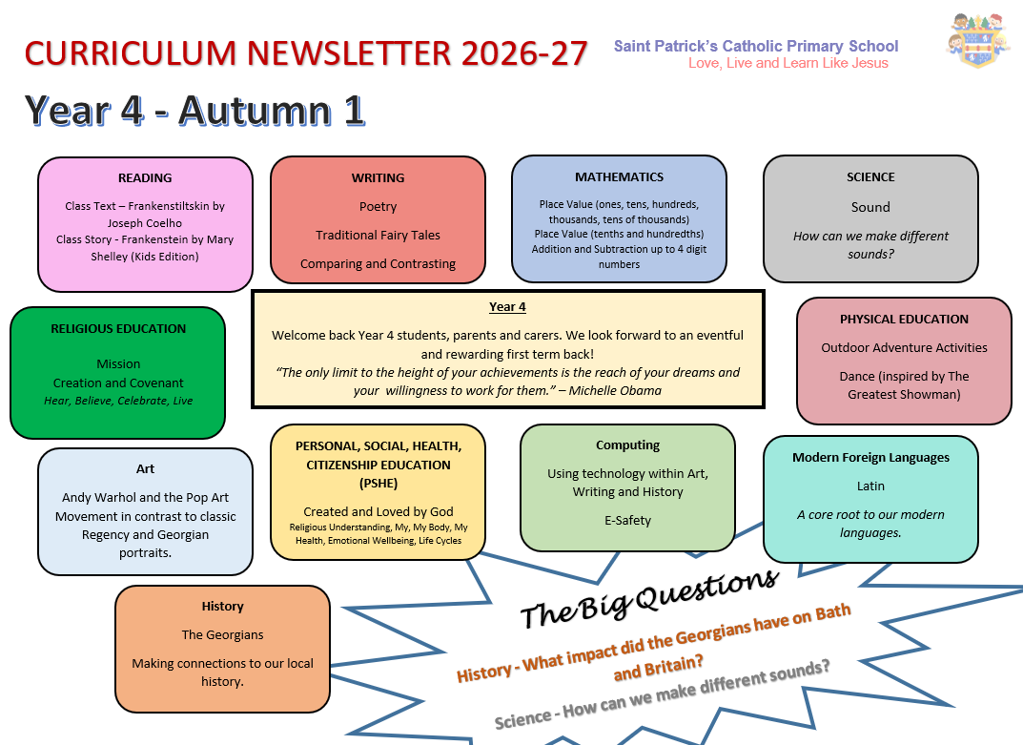
This is an overview of what we will be learning this term in Year 4.
Our curriculum newsletter is updated every term and you can always find this on the school website under ‘Year 4’ and on Google Classrooms.
There is also a key vocabulary section each term for each topic.

Slide 8

English Skills
Talk for Writing
Oracy
Performance
Reading
- Decoding
- Comprehension
- Passion
Handwriting
- Formation
- Fluency
Spelling
Strategies
Phonics

Slide 9

Reading
Reading In School
Reading records need to be in school each day
Children will be heard at least once a week during whole class Guided Reading sessions.
There will be further opportunities throughout the week for them to be heard by an adult.
If your child needs their reading book changed, they will have opportunities to do so with an adult’s help and with something they enjoy.
Reading at home
Where possible, please listen to your child at least 3 times a week.
Please record any reading in the reading record (children can also write in these!)
Please talk to your child about what they are reading, discuss characters, plot points, predictions…
Developing a passion for reading is key!

Slide 10

Spelling and Handwriting
Spelling and Phonics
There are daily spelling lessons using our spelling scheme where the class will learn how to apply their phonics skills to become confident spellers.
Phonics interventions will be given to children who require additional phonics support.
Pupils are taught a variety of ways to practice and learn spellings (ideas will be included in Home Learning)
Weekly test will combine Yr3 and Yr4 Key Words and spelling patterns taught in class.
  Some children may change spelling groups throughout the year depending on the spelling focus.
Handwriting – this is a main focus this year!
Pupils are working towards using a fluent joined style.
Our focus is to ensure everyone is forming letters correctly and sizing them correctly.
Let’s work together to correct missing or unnecessary capitals.

Slide 11
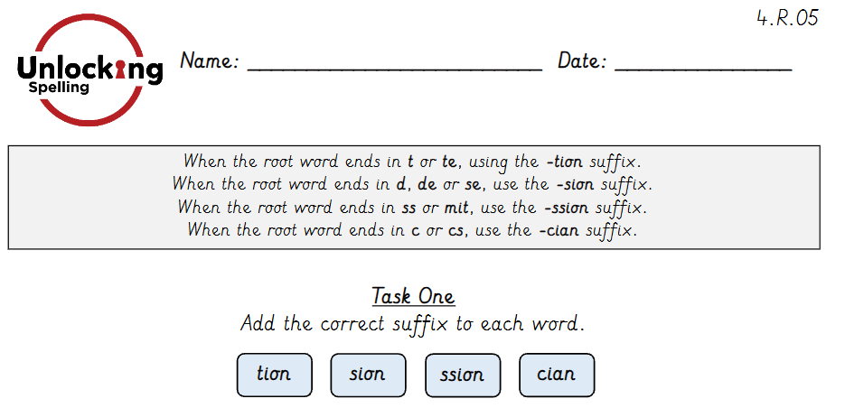
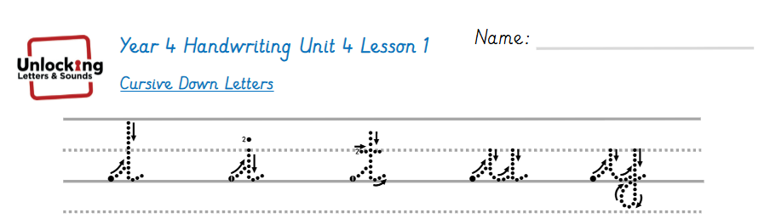

Spelling and Handwriting
We are using a new scheme for our spelling which links to our handwriting programme!

Slide 12

Mathematics
This year we will continue to develop a mastery approach to mathematics, teaching topic areas in blocks to allow depth and fluency.
Pupils are encouraged to use number facts and develop their understanding by exploring numbers in lots of different contexts.
We are working with numbers up to 10,000s. We are also teaching children more formal methods of recording.
How you can help:
- Practice using calculations, counting and sequencing numbers.
- Real- life opportunities for maths through using money, cooking etc.

Slide 13
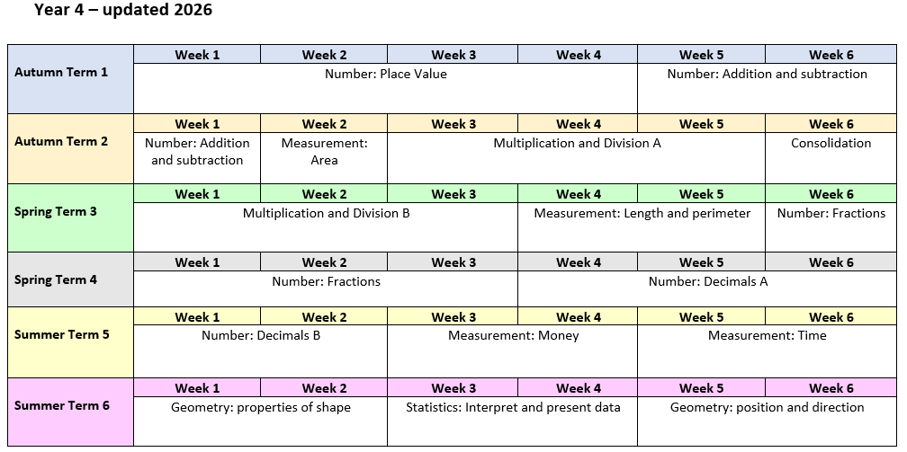
This is our annual overview for Maths
This may change throughout the year to meet the needs of the class.

Slide 14
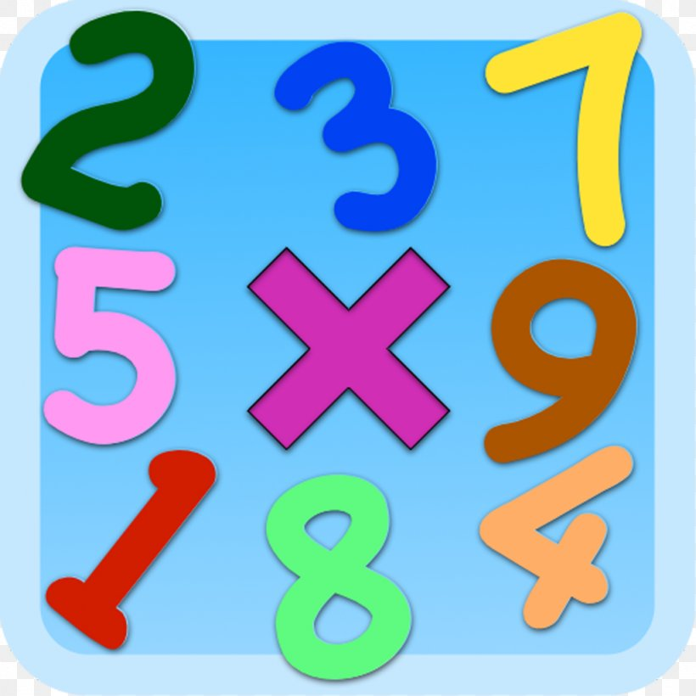

Multiplication Table Check (MTC)
This will take place in May/June of 2027
Little and often – practice is key in school and at home!
Professor Assessor and TT Rock Stars are great tools to practice timed questions.
Typing skills – Dance Mat Typing:
https://www.bbc.co.uk/bitesize/topics/zf2f9j6/articles/z3c6tfr

Slide 15
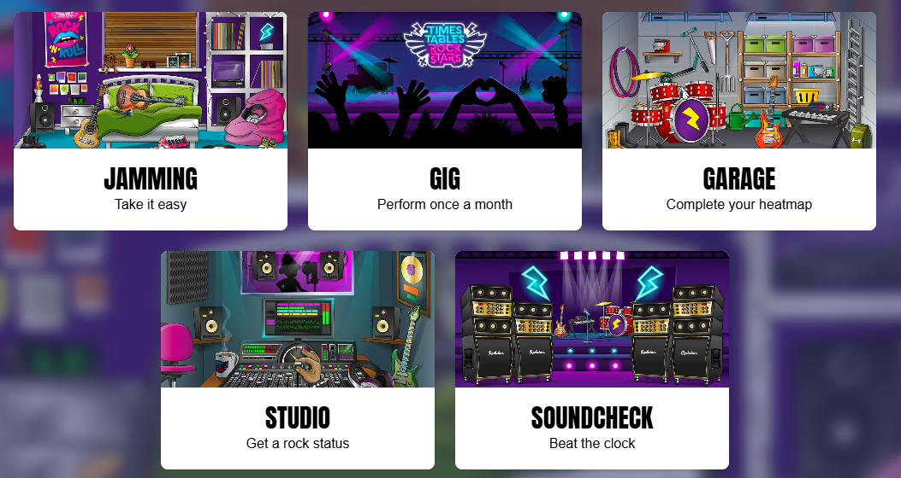
Children choose which tables to practice.
5 mins to answer 100 questions
Practise set tables.
Speed test – how quickly can you do your times tables?
Mock MTC – 25 questions, 6 seconds per question.

Slide 16
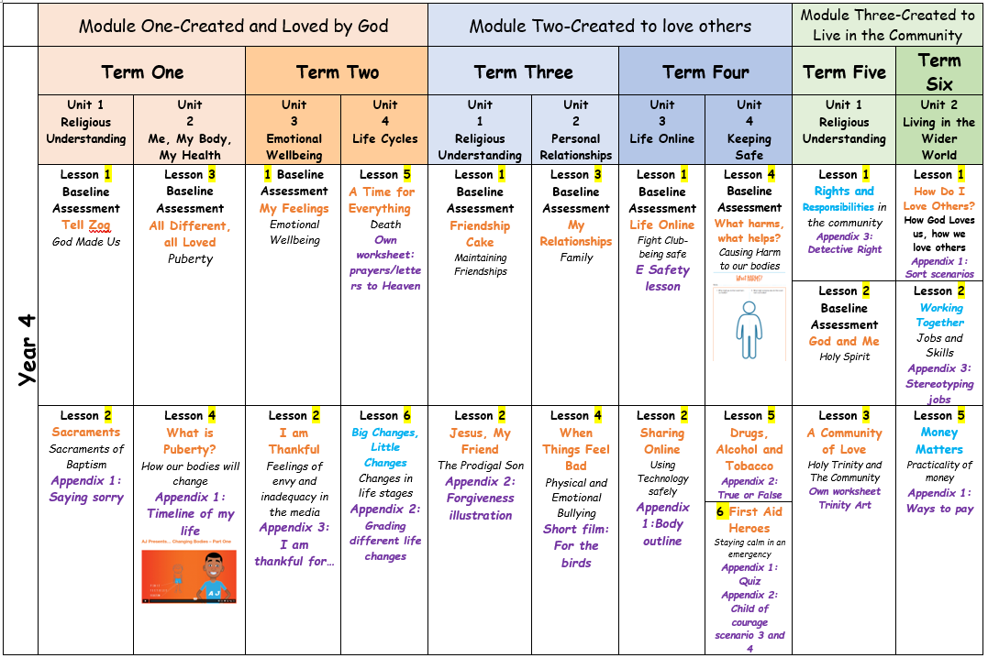
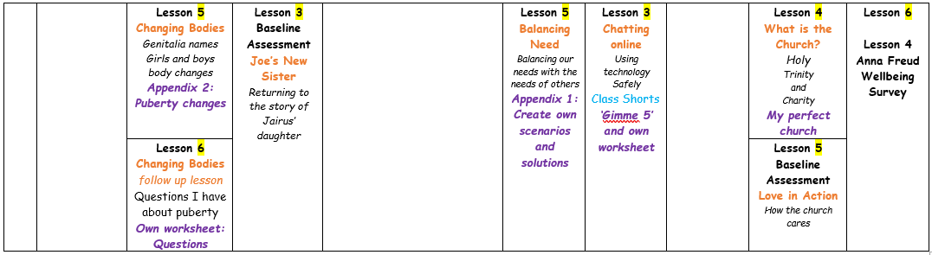
New PSHE/RSE lessons and topic coverage:
We are following Ten Ten – Life to the Full for all of our PSHE/RSE teaching this year.
This will cover many topics which can be seen on this overview.
If you have any questions about what is being taught, a summary of the week’s lesson will be posted on Google Classrooms.
You can ask any questions and if necessary, meet with myself or Mrs Solomon regarding the material.

Slide 17
Home Learning
GOOGLE CLASSROOMS
Home Learning will be given out on a Friday to be returned by the following Thursday. Please spend some time on these activities with your child.
Reading - Reading with an adult at least 3 days per week and independent reading at least 1 day per week. Please sign the record. Discuss the books characters, themes, plot and language style.
Spellings – To be given out on a Friday on the back of our weekly spelling test.
Handwriting – To continue to work on basic letters and joins, to consolidate learning at school, working towards a fluent joined style – perfect to practice with spellings.
Number – There will be weekly times table practice as part of home learning. This will be in a variety of methods such as timed exercises or Professor Assessor.
Enrichment – Each week there will be an optional enrichment activity, this will be linked to our learning and may help prepare your child for upcoming activities (such as double page spread research).

Slide 18
Important Information
PE every Wednesday and Thursday for term 1 – St. Patrick’s PE uniform to be worn
We will be swimming in term 2 – keep an eye on school communication about this (and volunteers will be needed!)
Please name all personal belongings – jumpers, ties, pencil cases, bottles
Water bottles: Pupils are encouraged to drink water in class so please ensure they have their water bottle every day.
Parents Evenings: Tuesday 13th October and Thursday 15th October.
Please keep us updated if someone else is collecting your child.
If you have any questions or would like to arrange a meeting then please contact the office team.

Slide 19

Thank you for coming!
Any Questions?

