Slide 1

Year 5 Curriculum Meeting
Welcome parents and carers to Year 5 with Miss Wilkinson and Mrs Clermont

Slide 2

Our Catholic Ethos & Mission
Live, Love and Learn like Jesus. In Year 5, our Catholic Social Teaching (CST) shapes daily classroom culture, fostering respect for human dignity and the common good.
Pupils take on active leadership as Reception Buddies, putting care for others into meaningful practice through stewarding our school community with empathy, patience and service.

Slide 3
The Year 5 Journey
Developing resilient, independent and curious upper Key Stage 2 learners
Independence Packing daily bags, checking timetables and independently editing written work. Year 5 have the responsibility of their Reception buddies and they set up OPAL daily for playtime.
Growth Mindset
Having an 'I can do it' attitude; seeing errors as crucial stepping stones to mastery. I can’t do it …yet!
The 3 Cs
Culture, comfort and creativity create a calm room where questions thrive.
Enrichment
Kilve Court residential, secondary taster visits and inspiring outdoor learning.

Slide 4

English: Book-Based Reading
Whole-Class Core Texts
Our curriculum centres on high-quality literature including Street Child by Berlie Doherty and Shackleton's Journey by William Grill.
Fluency & Expression: Reading aloud regularly with tone, intonation and awareness of punctuation.
Critical VIPERS Skills: Vocabulary investigation, retrieval, summarising, and justifying inferences using evidence.

Slide 5


Writing, Grammar & Spelling
Composition & Editing
Children plan, draft and refine writing across various genres, using thesauruses to enhance style, vocabulary and precision.
Spelling Strategies
Tested weekly on taught spelling rules included in the UK Year 5/6 statutory lists using root words, prefixes, use pyramid writing and 'Look, Say, Cover, Write, Check' to learn.

Slide 6
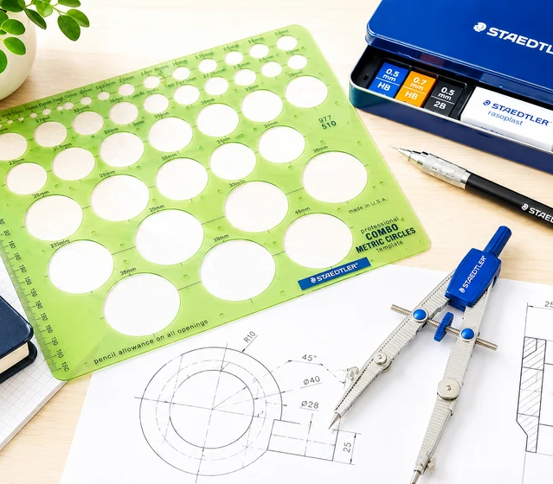
Mathematics Mastery
Fluency, Reasoning & Problem Solving
Year 5 deepens conceptual mathematical understanding aligned with the UK National Curriculum:
Number & Calculation: Numbers up to 1,000,000, formal written methods, fractions, decimals and percentages.
Practical Application: Real-life links with money, converting metric measures, and reading timetables.
Home Practice
Support weekly tasks via Professor Assessor, Topmarks and daily life - measuring, time, money etc .
💡

Slide 7
Weekly Routines & Expectations
PE & Daily Fitness: Wear smart PE kit on Tuesdays. Also, most days, we run the daily kilometre run on the trim trail each day – ‘The Km a Day’!
1
Daily Reading: Read at home every evening with records signed; return books and records for checking. Don't stop reading with and to your child in Year 5!
2
Home Learning Schedule: Uploaded or handed out on Thursday and submitted by following Thursday on Google Classroom or as a paper copy. It’s great prep for secondary school!
3

Slide 8
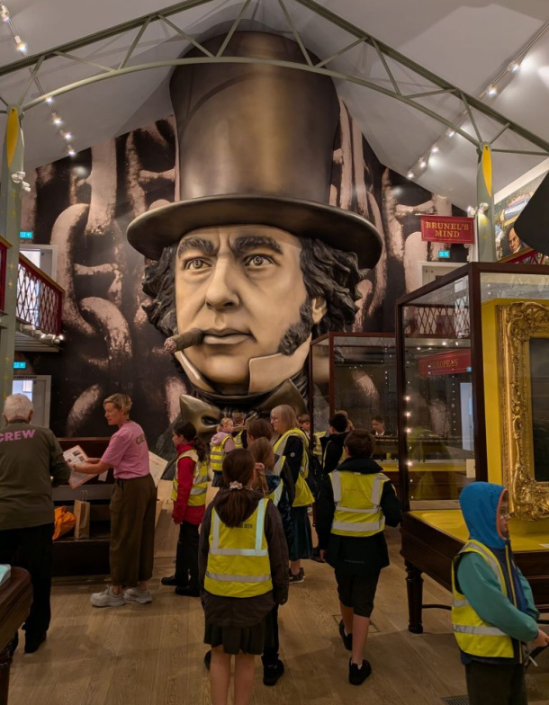
Wellbeing & Flourishing
An Attitude of Gratitude: We encourage pupils to count their blessings, cultivating emotional resilience, self-worth and thankfulness.
Physical Wellbeing: Hydration throughout the day, fruit at breaktime - low-sugar healthy snacks and consistent restful sleep.
Open Communication: Our classroom door is always open for questions, worries or sharing good news!

Slide 9

Home & School Partnership
How can we best collaborate this term to support your child's reading fluency and comprehension as well as maths, while fostering independence at home?

Slide 10
Home & School Partnership
✅
You might have said...
Set aside time to enjoy reading aloud twice weekly - discuss the book and new vocabulary.
Encourage them to pack bags – have list up on the fridge and sign reading records.
Practise mental maths during daily tasks like cooking, shopping, filling the car with petrol (decimals) or reading timetables (time).
Use our open-door policy if any concerns arise.

