Slide 1
Life to the Full Plus
Presentation

Slide 2

What information would you like to gain?

Slide 3
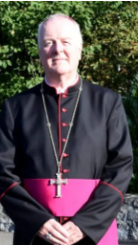
Life to the Full is based on the structure of the Model Primary RSE Curriculum from the Catholic Education Service and we use this as the basis for our sessions and resources.
This itself is cited as a work of good practice by the DfE so it should mean that not only are you fully-compliant with the new curriculum, but you are delivering a programme that puts a Catholic understanding of the human person at the very heart.
Life to the Full is what the Clifton Diocese has said
is suitable for our school

Slide 4

Life to the Full Plus- what is it?
https://www.tentenresources.co.uk/life-to-the-full-plus/

Slide 5
3 Main Themes
• 1. Created and loved by God
• 2. Created to love others
• 3. Created to live in the community
Ten Resources are structured across three core modules for Upper Key Stage 2 (Years 5 and 6), integrating statutory Relationships and Health Education (RHE) with a broader Catholic PSHE curriculum

Slide 6

Theme 1 Created and Loved by God
The Christian imperative to love self, made in the image and likeness of God, shows an understanding of the importance of valuing and understanding oneself as the basis for personal relationships
• Religious understanding of the human person: loving myself.
Me, my body and my health
Emotional wellbeing and attitudes
Life cycles and fertility

Slide 7
Theme 2 Created to Love Others
God is love. We are created out of love and for love. The command to love is the basis of all Christian morality
Religious understanding of human relationships: Loving others
Personal Relationships
Keeping Safe and People Who Can Help Me

Slide 8
Theme 3 Created to Live in the Community
Human beings are relational by nature and live in the wider community. Through our exchange with others, our mutual service and through dialogue, we attempt to proclaim and extend the Kingdom of God for the good of individuals and the good of society
Religious understanding of the importance human communities
Living in the wider world

Slide 9


What are the main differences?

Slide 10
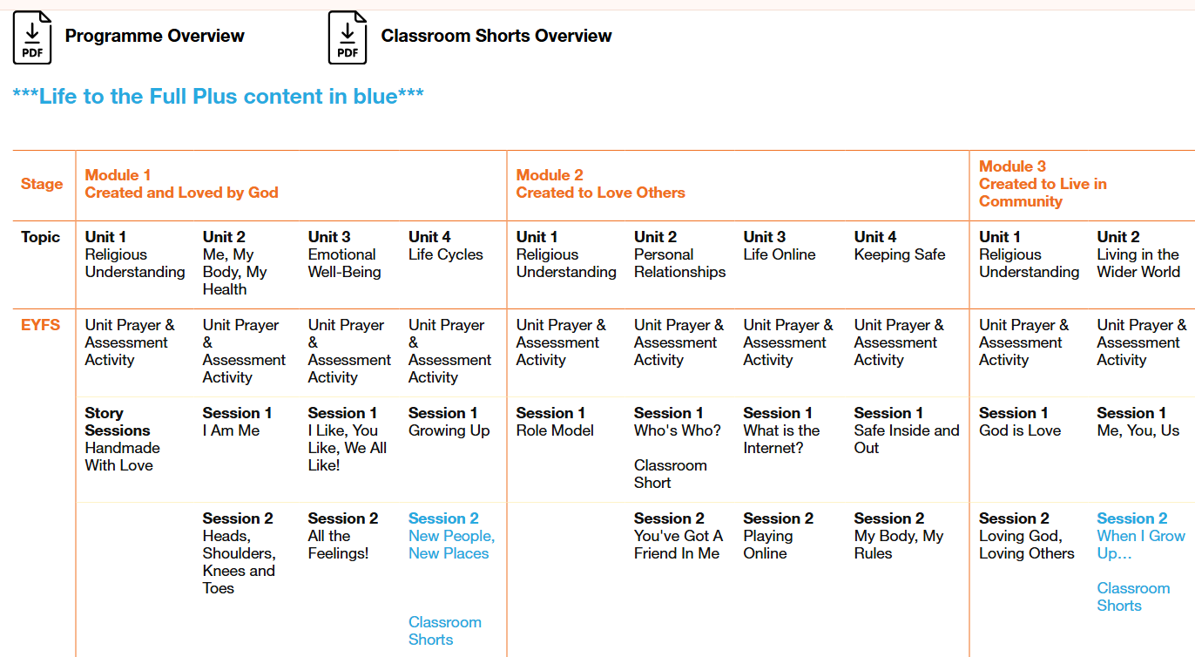
Life to the full Plus new content is always in blue

Slide 11
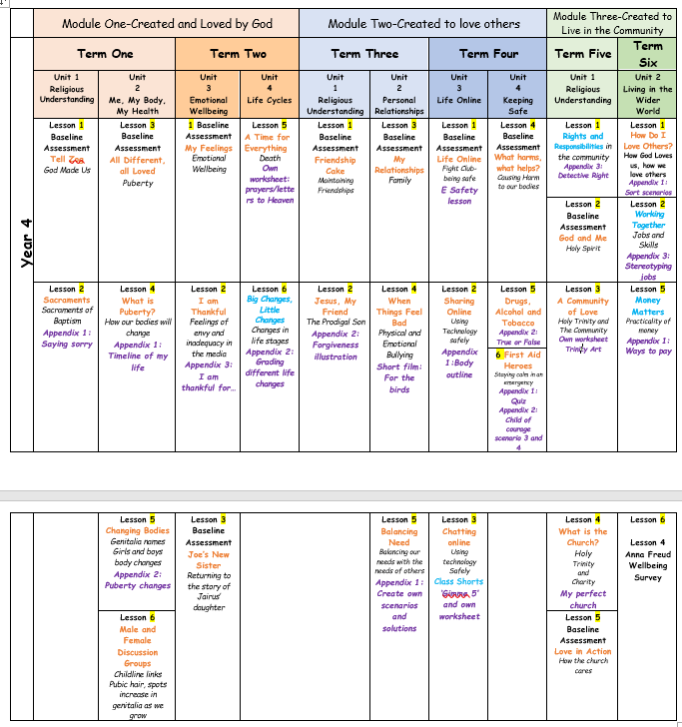
Year 4

Slide 12
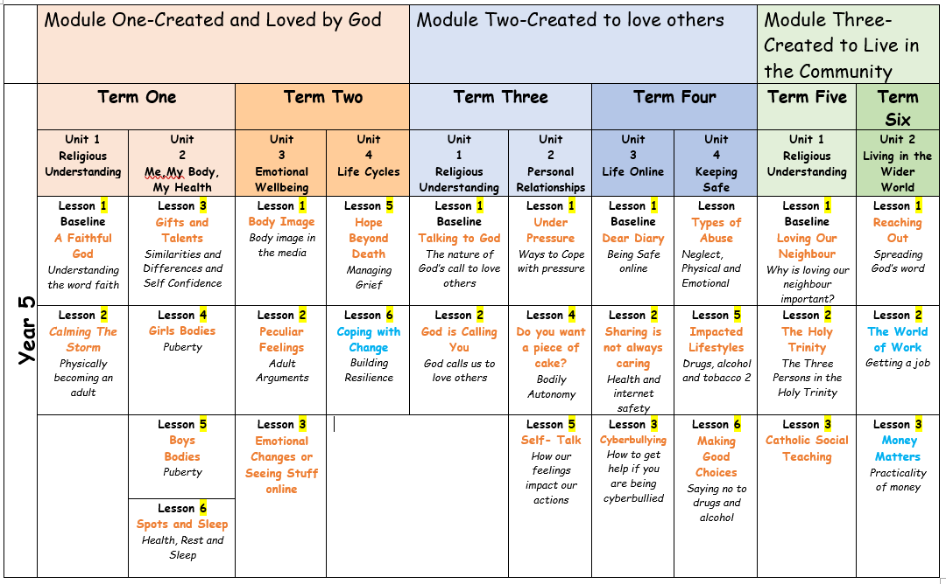

Slide 13
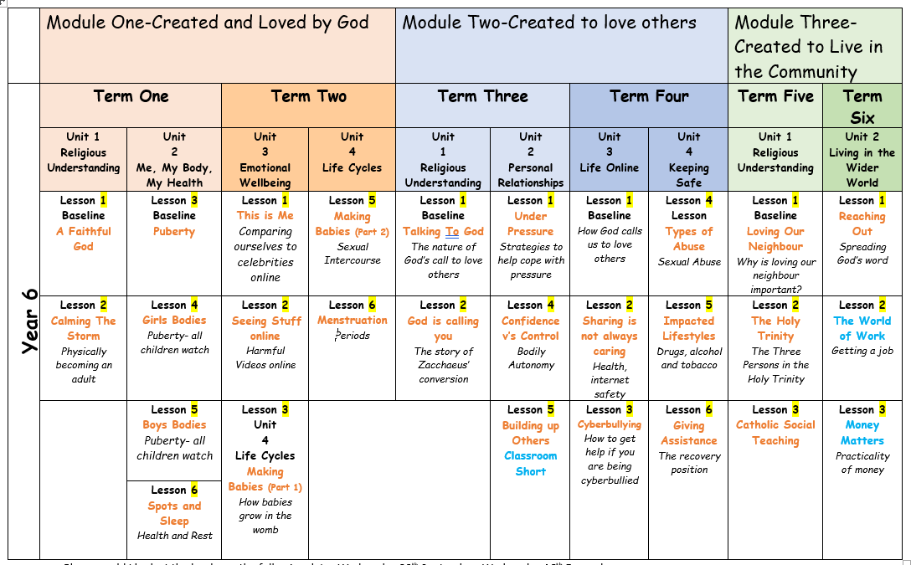

Slide 14
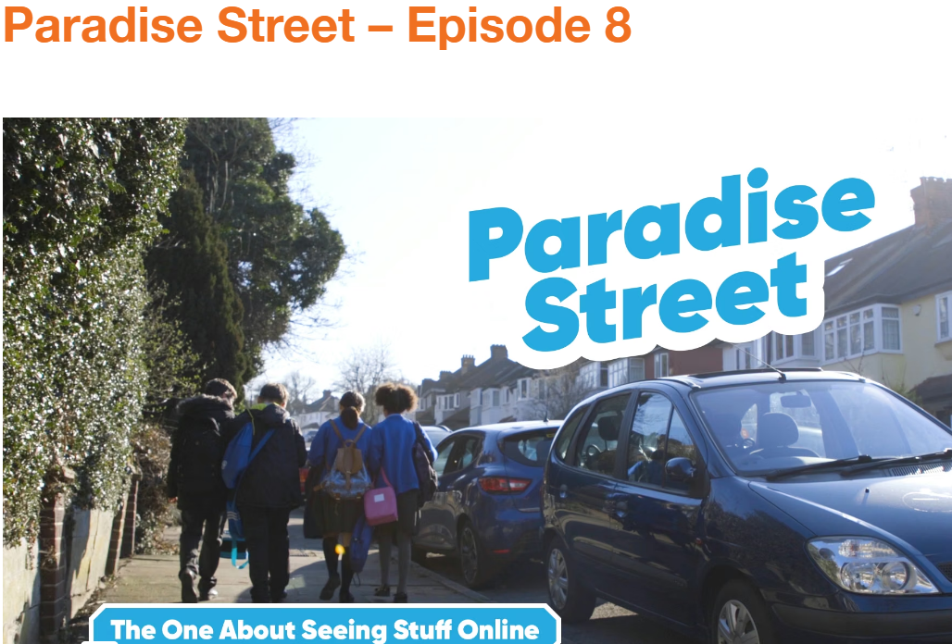
Paradise Street Episode 8
Harmful videos online

Slide 15
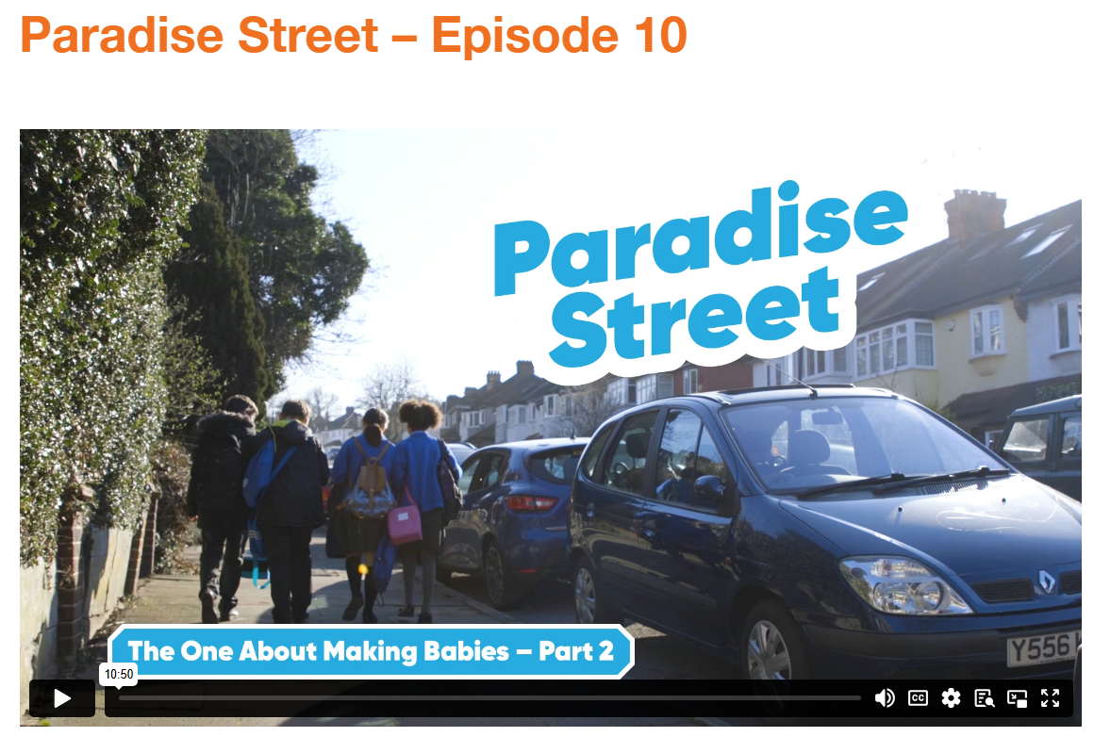
Paradise Street Episode 10
Making Babies Part 2

Slide 16
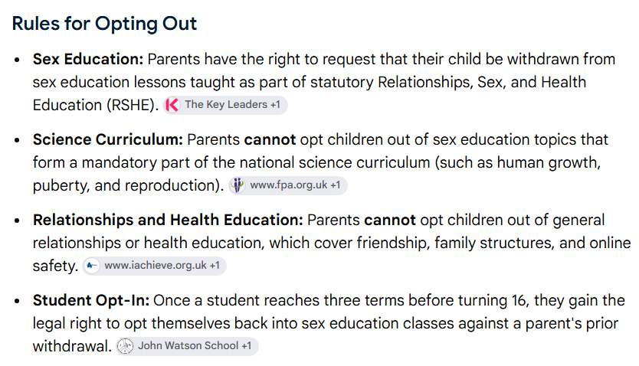
Opting out and alternative work

Slide 17


